Slide 1
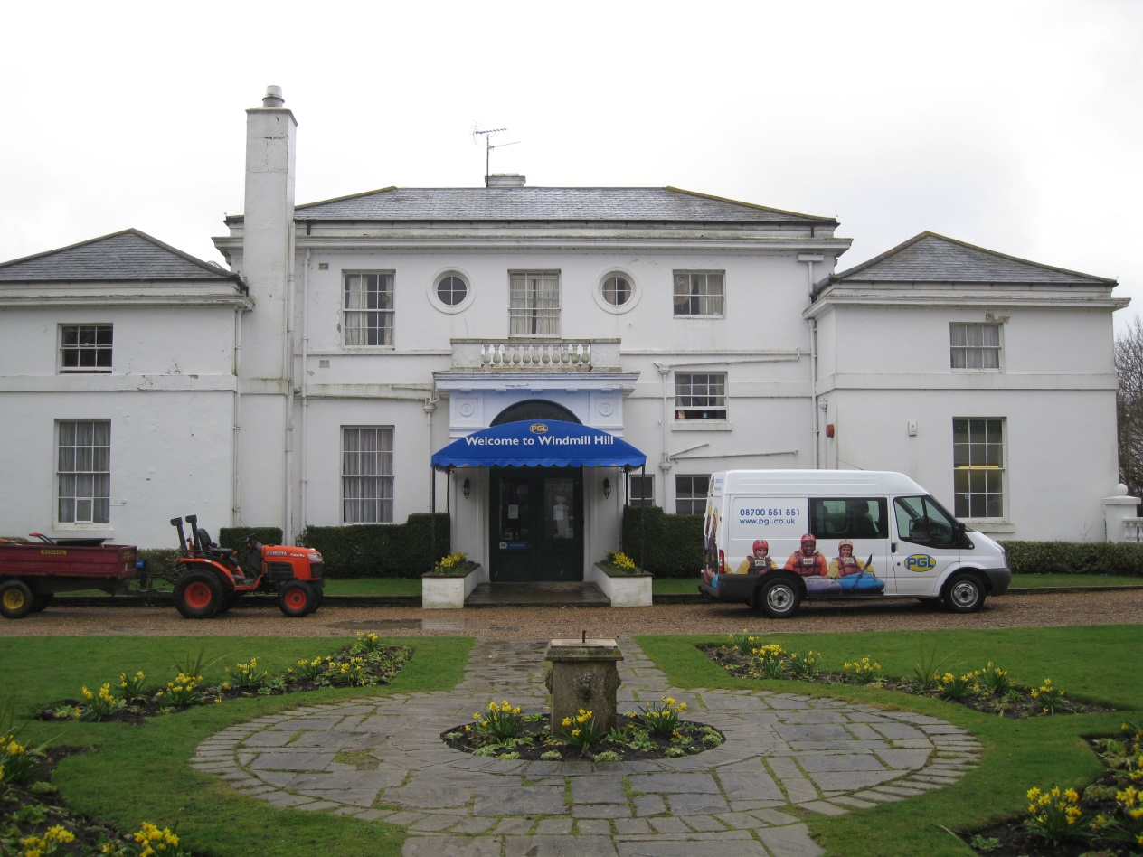
Windmill Hill 29th October – 2nd November 2018

Slide 2
Dates
29th October – 2nd November 2018
Monday - Leaving school at approximately 10.30am.
Friday - We expect to depart at about 1.30pm Friday 2nd November and should return to school by 4.00 pm.
If there are any delays, we will telephone school.

Slide 3
What is PGL?
'Parents Get Lost!’
Takes its name from the man who started it all in the 1950s - Peter Gordon Lawrence.
For children to have fun and grow in confidence through adventure and outdoor activities.
Week trips encourage independence and self-care.
Build relationships between pupils and staff

Slide 4
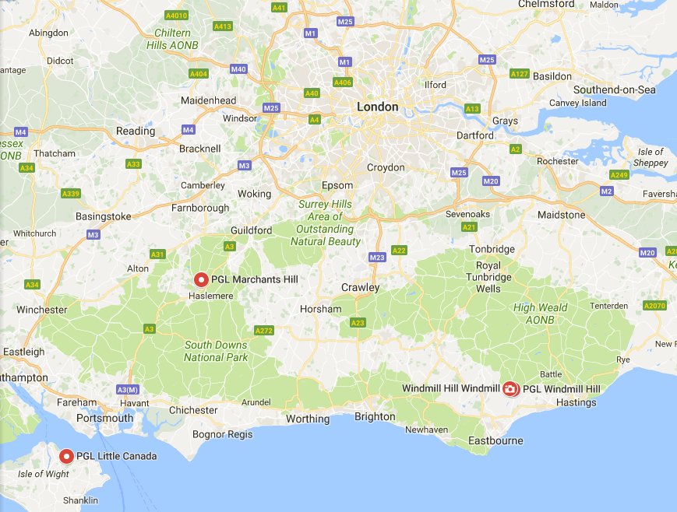
Leave school early Monday morning
Stop at Seven Sisters country park for lunch, a walk and river related activities

Slide 5
A Typical Day
7.00am – Teachers wake the children
7.30am – Breakfast
8.30am – Free time/ showers/ room tidying
9.30am – Morning activities
11.30am – Free time/ room inspections
12.30pm – Lunch
2.00pm – Afternoon activities
5.00pm – Dinner
6.00pm – Free time/ room inspections/ teddy bear competitions
7.15pm – Evening activity
9.00pm – Get ready for bed

Slide 6
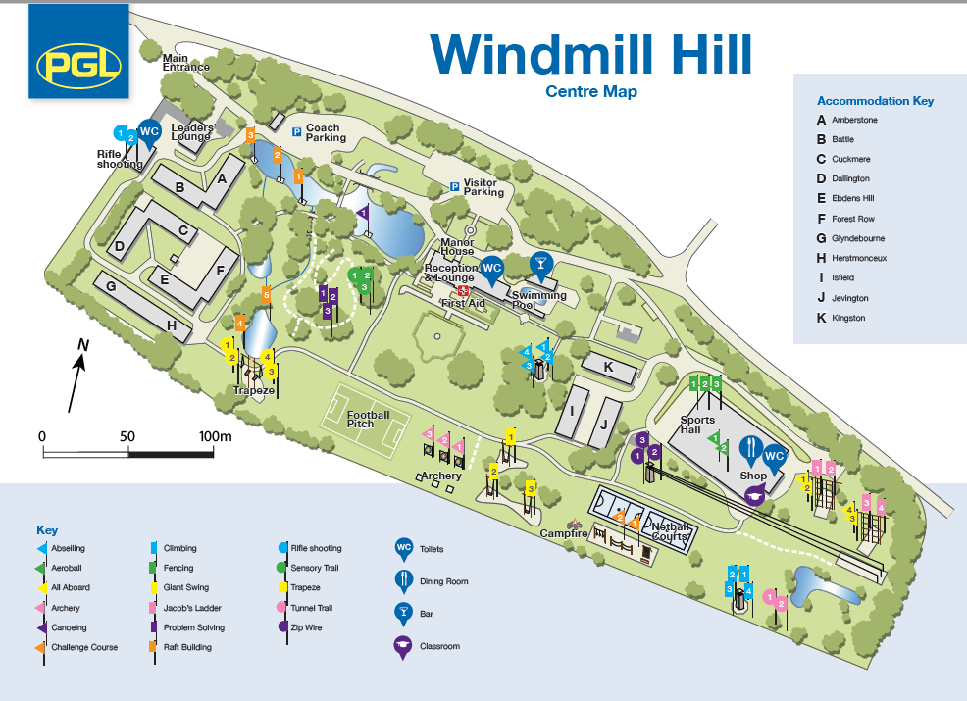
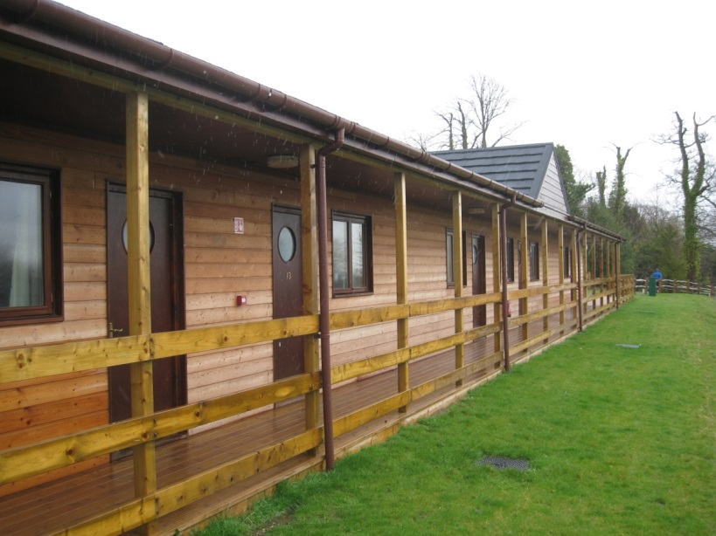
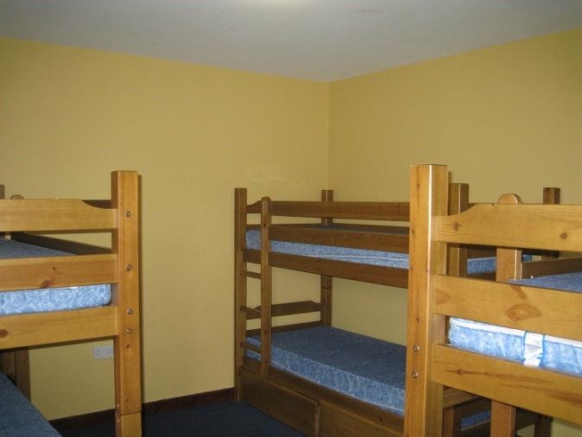
Accommodation
Usually in 2 blocks close by
Rooms for up to 6 children
Toilet, shower and sink in each room
Teachers even spaced

Slide 7
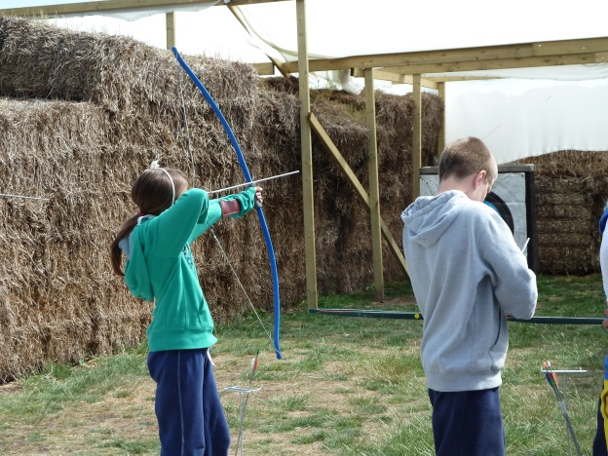
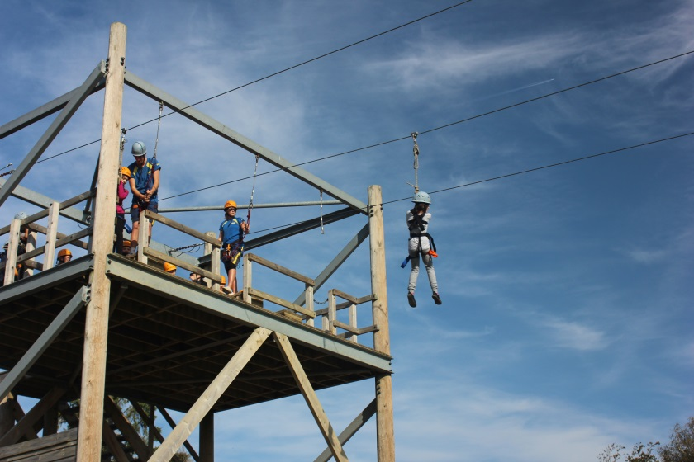
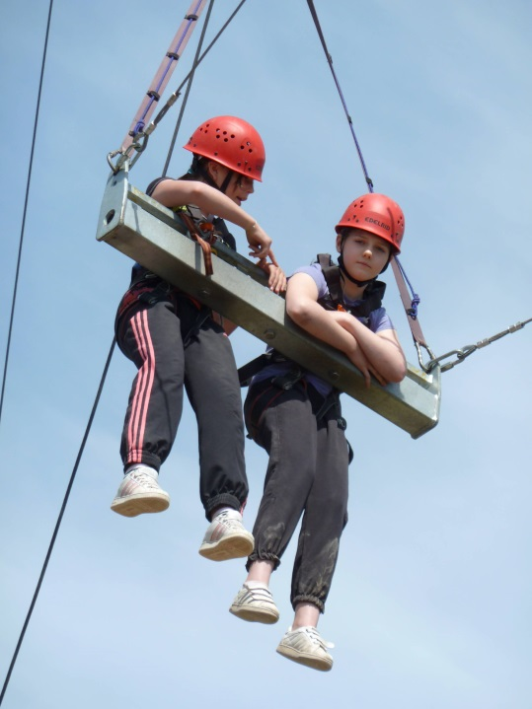
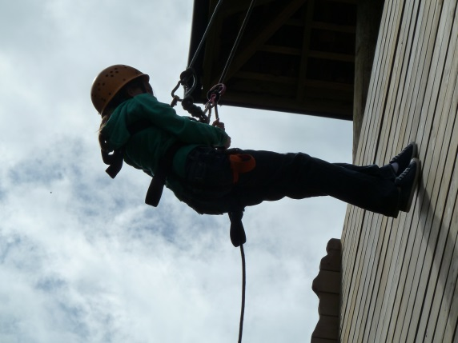
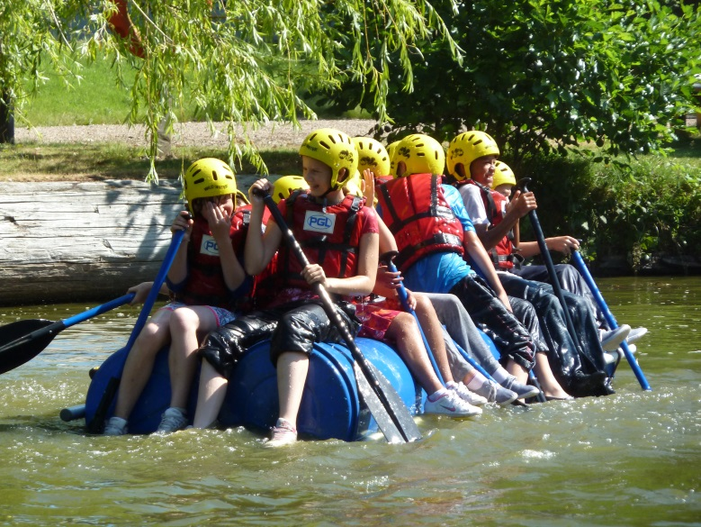
Activities

Slide 8
Activities
Trapeze
Aeroball
Climbing
Abseiling
Zipwire
Jacob’s ladder
Tunnel trail
All aboard
Orienteering
Fencing
Canoeing
Raft Building
Sensory Trail
Problem Solving
Challenge Course
Archery
Giant swing
Campfire
Capture the flag
Disco
Wacky races
Cluedo
Around the world

Slide 9
Activity Groups
The children will be split into around 7 activity groups with a member of school staff in each group.
Groups will all experience the same activities over the course of the week.
Activities are led by PGL staff.
High standards of behaviour will be expected to ensure the safety and enjoyment of all children.

Slide 10
Catering for…
Vegetarian/ vegan
Allergies and intolerances
Diabetics
Fussy eaters

Slide 12
Medical needs
A detailed medical form will go home in September 2018
Medication will go to the teachers on the Monday morning
Medication will be administered mostly by their group leaders at the appropriate times
Please discuss more in-depth needs with the class teacher well in advance to ensure we can make provision for them – risk assessments may need to be written!

Slide 13
A rough outline of what to bring
A waterproof/warm jacket is essential (on coach – not packed)
A water bottle
Packed lunch with drink for the journey there
Bin bags for dirty clothes
Enough clothes for 5 days – cheap, old clothes!
One jazzy outfit for the disco
2 lots of trainers / clothes which can get wet!
A sleeping bag/duvet (under sheets are provided)
A pillow
A cuddly toy!
1 towel
Toiletries (please avoid aerosol deodorants)
£5 money for the shop in a named wallet
Torch
Not permitted – electronics including mobile phones, aerosols
A detailed kit list will go home at the end of year 5
Notes:
#chocolatejoke #cantberesponsible

Slide 14
How do we prepare children for Windmill Hill?
Worships beforehand
Circle time to discuss worries
Look at website
Some ELSA sessions
Sharing previous children’s experiences

Slide 15
Deposit deadline - £60.00 due by Monday 4th December 2017.
Any questions…please come and see us in our classrooms over the next few days ☺
There will be a reminder session with more information at the Year 6 curriculum evening

