Slide 1
Welcome to our Y6 SATs information evening!
Please have a look through some of last year’s tests while you are waiting; try a few questions! Talk to people around you about how you/your children might solve them.

Slide 2
The school
Parents
Why do children sit SATs tests?
Secondary school
County and country data
The child

Slide 3
- Their education throughout the whole of school
- Revising the curriculum
- Re-visiting learning often (Morning Challenge, Early Morning Work)
- SATs style homework tasks
- Practice papers (formal and informal)
- Interventions and booster groups
How do we Prepare children for these exams?

Slide 4
Date | Activity
Monday 14th May 2018 | English Paper 1: grammar, punctuation and spelling
 | English Paper 2: spelling
Tuesday 15th May 2018 | English: Reading
Wednesday 16th May 2018 | Mathematics Paper 1: arithmetic
 | Mathematics Paper 2: reasoning
Thursday 17th May 2018 | Mathematics Paper 3: reasoning
THE
TESTING
ELEMENT
All exams are in the morning and there are none on Friday.
Please avoid booking holiday during this time.

Slide 5
How well did my child do?
The Test
A raw score (number of correct answers)
Scaled score
Once all children’s results are in nationally, their raw score is converted into a scaled score.
What’s reported?
Your child has met the expected standard (scaled score of 100 or more).

Slide 6
80 100 120
Scaled Score
Child A
Raw score 17/50
Standardised score of 93
Did not meet the expected standard
Child C
Raw score 42/50
Standardised score of 114
Met the expected standard
Child B
Raw score 26/50
Standardised score of 100
Met the expected standard
Meeting the expected standard indicates that the child is in a good academic position to access the KS3 curriculum as their KS2 curriculum knowledge and understanding is at a good standard.
Of course, some children will not meet the expected standard so we will endeavour to get them as close to this as possible as we will focus on their progress

Slide 7
Reading
1 hour to complete the test
3 texts, usually a range of fiction and non-fiction
A Set of questions (usually around 12) about each text
Not a memory test – the children can refer to the questions as much as they want!
Focus on understanding language and comprehension

Slide 8
Hearing your child read
Consider the type of questions you are asking your child when they are reading:
“What does that word mean? Can you think of another word which means something similar?”
“How was the character feeling when…? How do you know? What evidence is there in the text?”

Slide 9
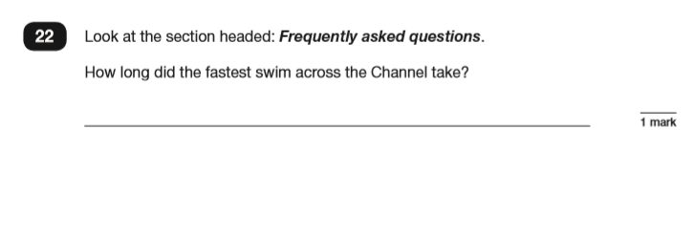
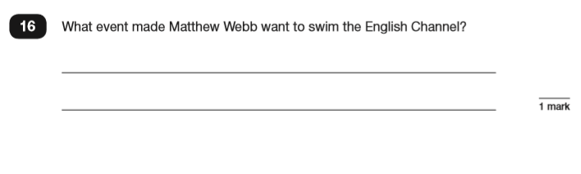
Retrieving Information

Slide 10
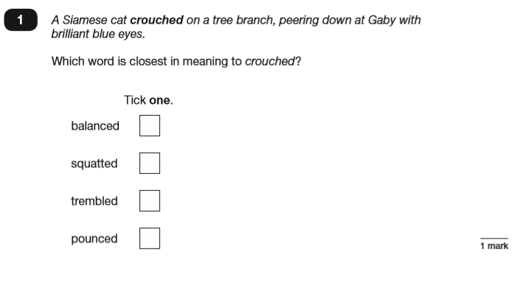
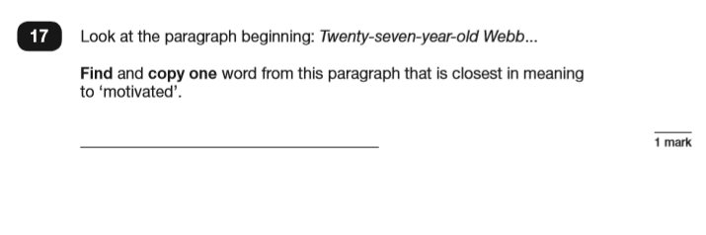
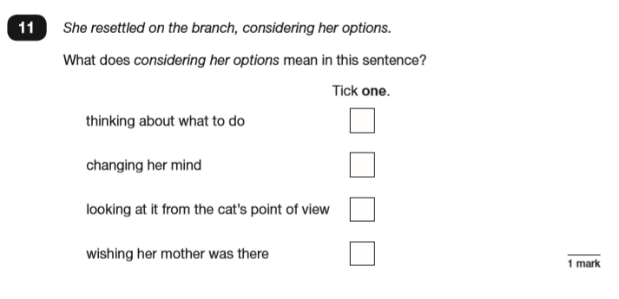
Understanding Language

Slide 11
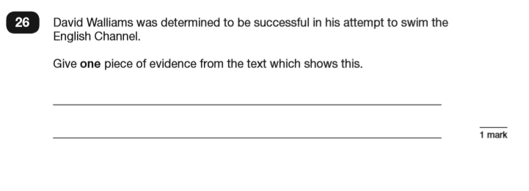
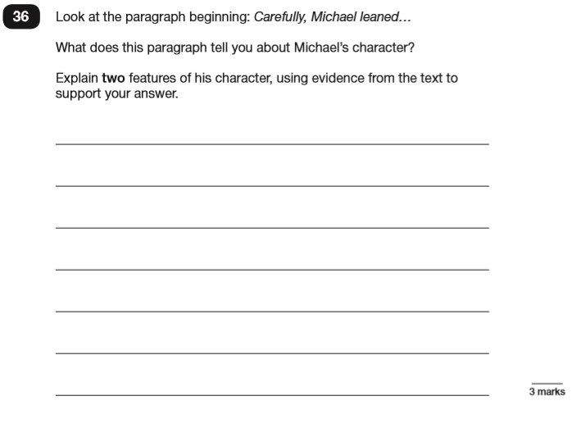
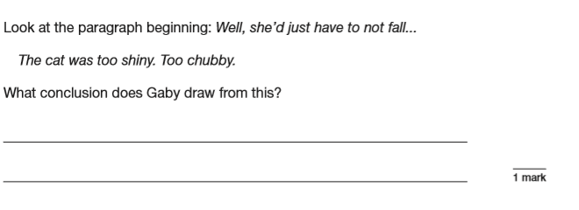
Comprehension

Slide 12
Spelling, Punctuation and Grammar (SPaG)
Comprised of 2 tests
Test 1 (45 minutes) measures their punctuation, spelling and grammar skills:
Terminology, word class, sentence types and structures
Test 2 measures their ability to spell words using a variety of rules

Slide 13
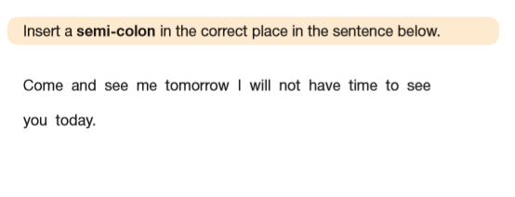
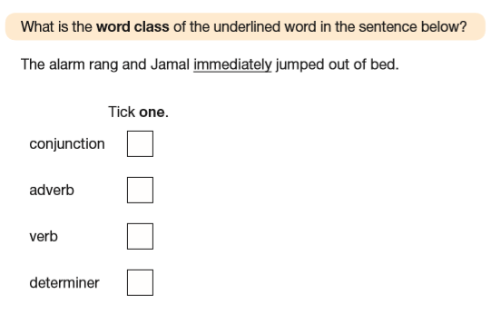
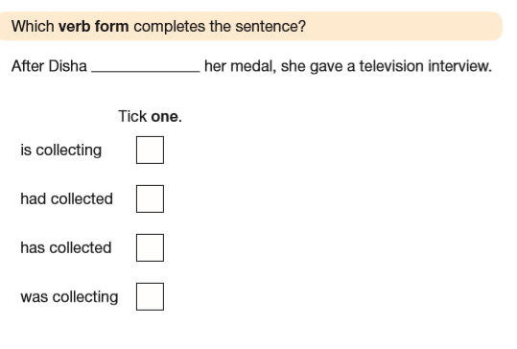
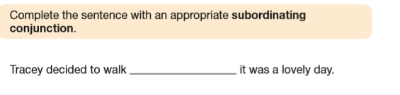

Slide 14
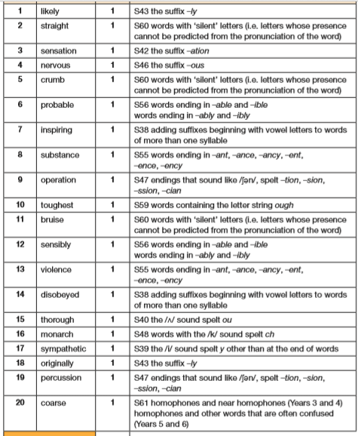

Slide 15
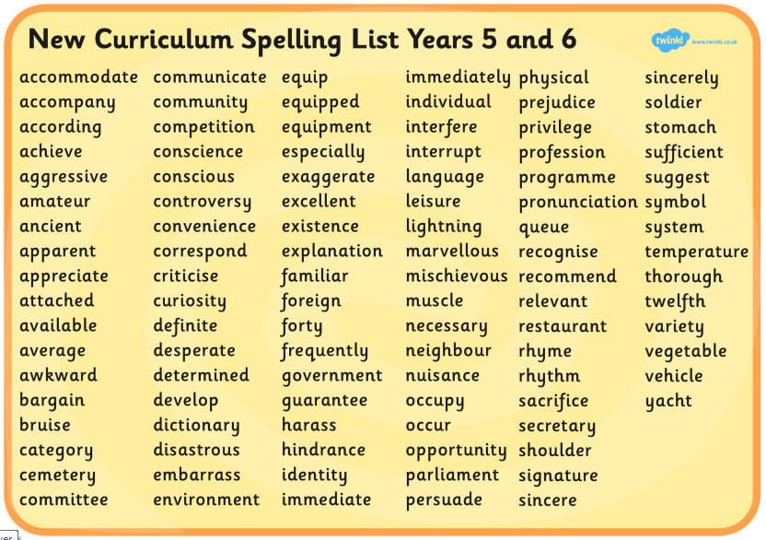

Slide 16
Mathematics
Comprised of 3 tests
Test 1 (30 minutes) Arithmetic
Not in context and a focus on number, fraction and percentages.
Encourage the children to use efficient methods
Test 2 and 3 (each 40 minutes) Reasoning
Questions are in context or require a deeper level of understanding than just procedural mathematics. Number geometry, coordinates, fractions decimals and percentages, angles, algebra are covered

Slide 17
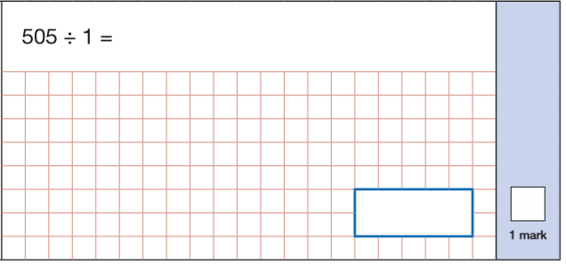
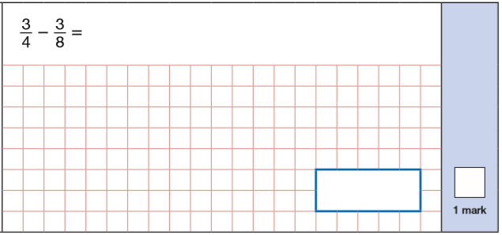
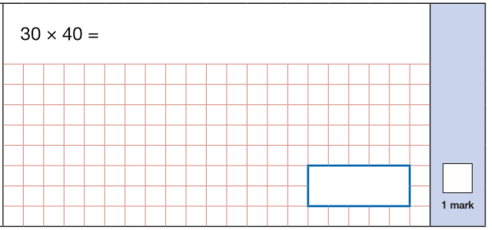
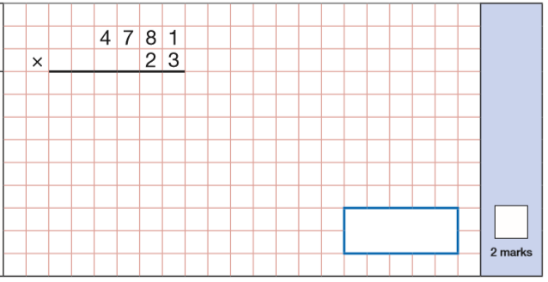

Slide 18
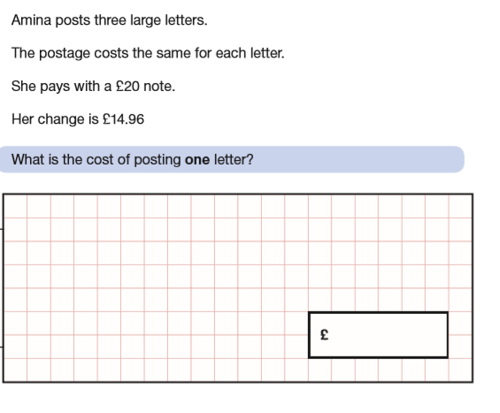
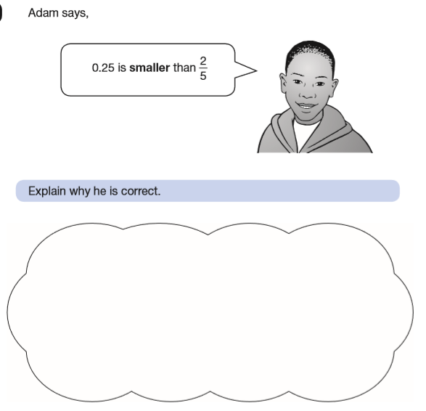

Slide 19
THE
TEACHER ASSESSMENT
ELEMENT
Subject
Reading | The Interim Framework Assessment.
Writing
Maths
As well as a test score, we keep track of their successes. This forms part of their end of term test.
Test in May
Teacher Assessments in June (please avoid holidays still).

Slide 20
How to support your child at home
Hearing them read
Support them with homework
Direct them to useful websites (MyMaths, Rockstars, topmarks)
Bring learning into everyday life
Get them to test you!
Help them to become positive, growth mindset learners

Slide 21
MOCK SATs – Week starting 19th February
All exams
Provision in place
Children experience proper exam conditions
Children know what to expect come May
Keep track of progress to inform parents and to adapt our teaching

Slide 22
Feel free to ask us questions and have a look through some previous SATs papers

