Slide 1

St Mark’s Primary School
Year 1 Curriculum Evening
13th September 2018

Slide 2
The Year 1 Team
  Teachers
Mrs Carter
(Head of Year)
Miss Jamieson
Miss Hall
Other adults who support in Year 1:
Mrs Hygate
Mrs Gatfield
Mrs Parramore
Miss Weller-Evans
Mrs Osborn
Miss Poet

Slide 3
Topics this year
Autumn Hungry, Hungry Animals
Polar Lands
Spring A Toy’s Story
On The Move
Summer A Gardener’s World
Nature Detectives
Notes:
Megan
These are the topics we teach in Year 1.
We try to make links where possible between all the curriculum subjects that we teach within the topic.
Focus of topics?
Hungry and Polar – science links
Toy and on the move – history links
Gardeners and nature – geography links
Art and DT in every term

Slide 4
A typical day
Early morning work and register
Worship
Phonics
English
Snack and playtime
Maths
Book Club
Lunchtime
Topic and challenges (discovery time)
Afternoon playtime
Handwriting
Storytime
Home-time

Slide 5
Writing Expectations
Write sentences using finger spaces and begin to use punctuation (full stops, question marks, exclamation marks).
Spell common exception words, high frequency words and days of the week.
Name letters of the alphabet in order and use these names to show understanding of alternative spellings of the same sound, e.g. ai, ay, a-e.
Use phonics and spelling patterns taught to help spell unknown words.
Use joining words such as and to extend ideas.
Form all letters (lower and upper case) and numbers correctly starting and ending in the correct place.
Sequence sentences to form short narratives, e.g. story retells, information writing, instructions.
Write with increasing independence, composing a sentence orally before writing it.

Slide 6


Reading Expectations
Read a wide range of stories, poems and non-fiction books.
Use their increasing phonics knowledge to help decode unknown words.
Re-read books to build up their fluency and confidence in reading.
Become familiar with traditional tales and fairy stories, retelling them and talking about their characteristics.
Read words with contractions, knowing that the apostrophe means an omitted letter(s).
When reading, make predictions about what they think will happen next.
Segment, blend and read real and unreal words.
Read common exception words and high frequency words with increasing confidence.

Slide 7
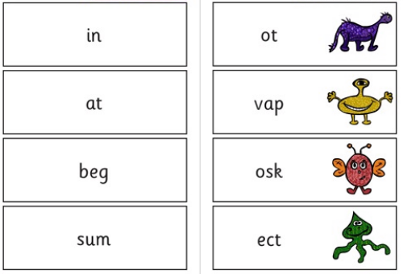
Year 1 Phonics Screening
Takes place in June.
40 words; real and un-real words
Shows their phonics knowledge

Slide 8
Maths Expectations
Count to and across 100, forwards and backwards from any number.
Read and write numbers to 100; writing numbers to 20 in words and numerals.
Count in multiples of 2, 5 and 10.
Tell the time to the hour and half past the hour.
Measure and begin to record length, height, weight, capacity and time.
Find one more and one less than any given number.
Add and subtract one and 2-digit numbers within 20.
Know and use number bonds to all numbers within 20.

Slide 9
At Home Please …
Did you know a child who reads for 1 minute a day
That is 180 minutues in a school year
Learming 8,000 words.
A child who reads for 20 minutes a day
3,600 minutes in a school year
Learns 1,800.000 words
Read with your child regularly.
Practise key words sent home.
Every Minute Counts
Practise writing letters, their name and simple sentences.
Allow your child time to play and explore their world around them.
Play with play doh and use scissors to develop hand control.

Slide 10






Slide 11

It sounds like a lot of hard work…
But we still want your children to have fun!

Slide 12

Thank you for listening; please visit your child’s classroom to look around and see examples of the resources your child will use in Year 1 and to ask any questions you may have.

