Slide 1

St Mark’s Primary School
Year 4 Curriculum Evening
19th September 2018

Slide 2
The Year 4 Team
  Teachers
Mrs Tunnicliffe (4T)
(Head of Year)
Miss Hardy (4EH)
Mrs Happy (4SH)
Other adults who support in Year 4:
Mrs Archibald
Mrs Bennett
Miss Crow
Miss Gaze
Mrs Joshi
Mrs Lethaby
Mrs O’Neill
Notes:
Parent Readers
Ruth

Slide 3
Topics this year
Autumn Walk like an Egyptian
Born and Bread
Spring How to Move a Mountain
It’s Showtime!
Summer Prancing Piranhas
Rotten Romans

Slide 4
A typical day
Early morning activity and register
Morning Challenge
Worship
English
Playtime
Book Club or Grammar, Punctuation & Spelling
Maths
Lunchtime
Reading or Handwriting
Topic
Story time
Home time
Notes:
Sharon

Slide 5
Writing Expectations
Children will have opportunities to write for a range of real purposes.
Children should be able to plan, draft and write their ideas.
Children should structure their writing using paragraphs and other simple organisational devices.
Children will be taught a range of grammar and punctuation concepts including:-
Fronted adverbials
Conjunctions
Pronouns
Prepositions
Children should evaluate and edit their writing to improve consistency.
Children will use a wider range of punctuation including commas, inverted commas and the possessive apostrophe.
Children should proofread their writing for spelling and punctuation errors.

Slide 6
Reading Expectations
Children will maintain positive attitudes to reading by reading a wide range of stories, poems and non-fiction books.
Children will apply their knowledge of root words, prefixes and suffixes to reading aloud.
Children will identify themes and conventions in a wide range of books.
Children can identify the main ideas from across a text and summarise key points.
Children will discuss words and phrases that capture the reader’s interest and imagination.
Children will be able to retrieve and record information from a range of non-fiction sources.
Children will be able to predict what might happen and make inferences based on what they have read.
Children will be able to explain the meaning of words in context.

Slide 7
Maths Expectations
Children will become fluent in their knowledge and will be able to reason mathematically.
Children will count in multiples of 6,7,9,25 and 1,000.
Children will deepen their knowledge of place value in four digit numbers
(1000s, 100s, 10s and 1s).
Pupils should be taught to recall multiplication and division facts up to 12 x 12
Children will be able to round any number to the nearest 10, 100 and 1000.
Children will be able to convert between units of measure, compare and classify shapes, and interpret data.
Children will recognise, show and solve problems involving fractions.
Children will be able to calculate fluently, developing more formal strategies.

Slide 8
Homework in Year 4
English or maths homework
Set on a Friday to return by Wednesday
Spellings will be set on Fridays and tested the following Friday
Reading most days
Topic Homework may be sent home over most holidays

Slide 9
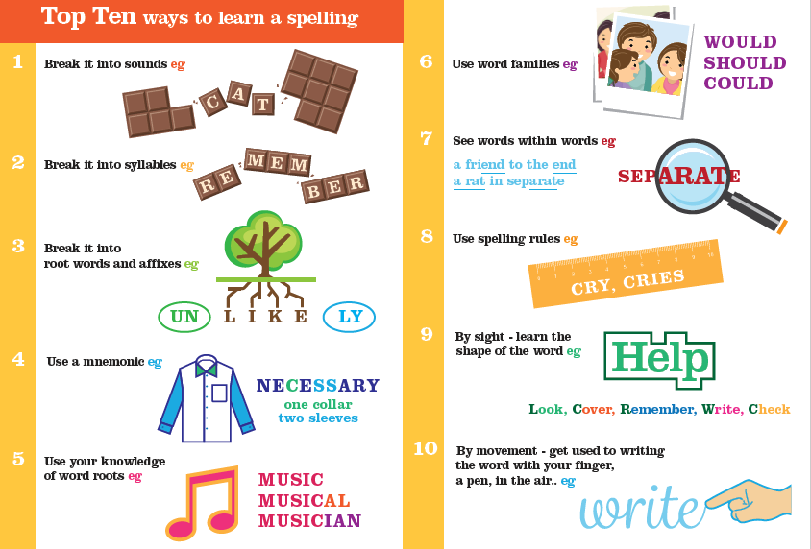
Practical ways to learn spellings

Slide 10
At home please also …
Did you know for a child who reads for 1 minute a day
That is 180 minutes in a school year
Learning 8,000 words.
A child who reads for 20 minutes a day
That is 3,600 minutes in a school year
Learning 1,800,000 words
Read and talk about their book with your child regularly.
Use analogue and digital clocks to teach children to tell the time.
Enjoy family time together playing games, colouring and enjoying the great outdoors!
Use Times Table Rockstars and spelling practice sheets daily
Enjoy practical maths: Cooking, using timetables, money
Encourage independence and organistion.

Slide 11


Slide 12


Slide 13
A few reminders…
Please ensure your child has:-
  A named water bottle
  A full, named PE kit
  Reading book and reading log
  A fruit or vegetable snack

Slide 14

Thank you for listening; please visit your child’s classroom to look around and see examples of the resources your child will use in Year 4 and to ask any questions you may have.

