Slide 1
St Mark’s Primary School
Year R to 1 Transition Meeting
July 2019

Slide 2

The Year 1 Team
  Teachers
Mrs Carter
(Head of Year)
Miss Jamieson
Miss Hall
Other adults who support in Year 1:
Mrs Hygate
Mrs Gatfield
Mrs Parramore
Notes:
Hannah
Blah blah remember us!!

Slide 3

The purpose of this meeting…
How does the move to Year 1 work?
What stays the same?
What is different?
Ideas on how to help your child with the transition.
Reassure you that your children will be ok!

Slide 4




It’s the same but slightly different!
Learning through play
RWI
Maths
English
Reading / Book Club or reading roundabout

Slide 5



Reading
Children will continue to take home a reading book for practise and consolidation.
Independently change their books
Learn high-frequency words/key words
Use phonics to help decode real and nonsense words

Slide 6

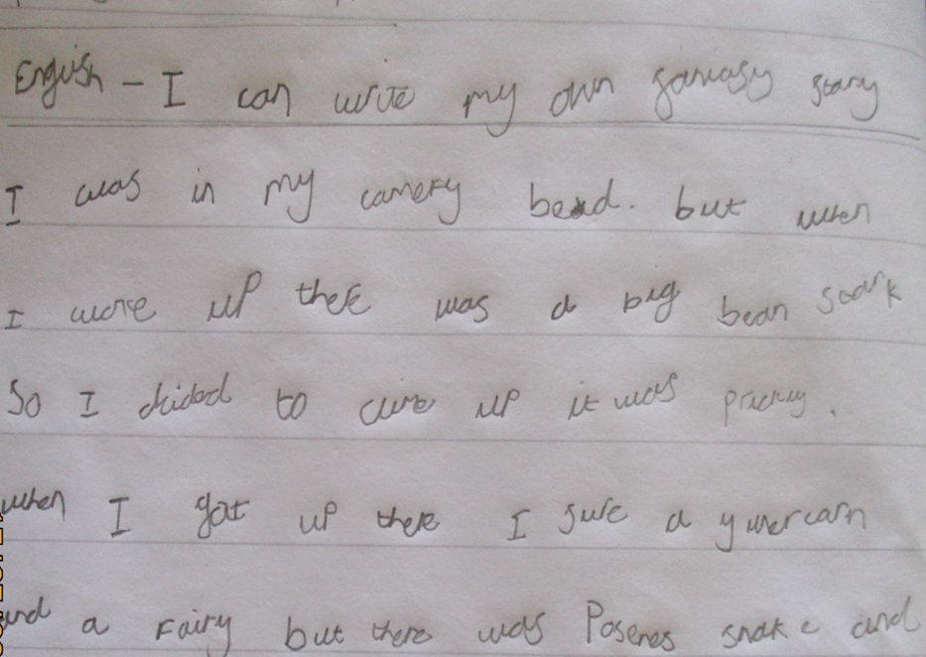
Writing
Hold a pencil correctly
Form letters correctly
Use finger spaces between words
Write full sentences
Use full stops and capital letters
Spelling
Spelling focus taught.
Practice in school.
Key words to learn.
Later in the year, spellings will be sent home.

Slide 7

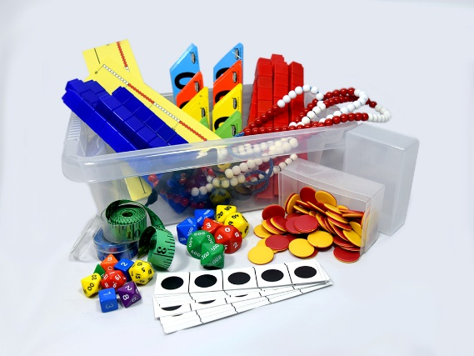
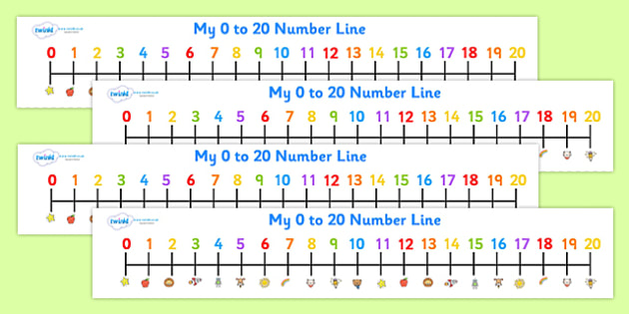
Maths
Maths will be taught in the morning each day.
Autumn term will have a 5-10 minute input.
Adult-led tasks and independent learning challenges.
Learning at tables and around classroom, sometimes outside.

Slide 8


Discovery Time- Autumn 1
Discovery time in the afternoons.
Smaller adult-led groups for topic
Challenges to include English, maths, outside play, construction and art.

Slide 9

Arriving at school
Encourage independence in the morning
Say goodbye at the door like in Year R
Children are encouraged…
  to independently put away book bags, reading books/logs, water bottles and lunch boxes
  Choose their own lunchtime choice
Complete early morning task

Slide 10




Ways you can help over the Summer…
Read lots with your child.
Library Summer Reading Challenge.
Practise phonics – phonicsplay.co.uk
Practise writing
Practise counting and playing with money
Have fun and reassure your child they will be ok!

Slide 11


Any questions?
Please feel free to speak with any of the Year 1 Team about any questions or concerns.
Mrs Carter, Miss Jamieson and
Miss Hall.

