Slide 1
Please sign the register, pick up a pack and get yourself a drink.
Please sit down and keep a space for your child next to you.

Slide 2
HeartSmart@Home – What is the plan?
Timings |  | Session overviews: Get HeartSmart (28th Feb) Don’t forget to let love in (6th March) Too much selfie isn’t healthy (13th March) Don’t rub it in, rub it out (20th March) Fake is a mistake (24th April) No way through, isn’t true (1st May)
8.30 | A hot drink and an informal chat
8.45 | Introduce the principle for the session. Mrs Poole & Mrs Spiers lead this presentation.
9.00 | Your child/ren join the session and complete some activities with you in relation to that day’s focus.
9.45 | Your children go back to class and we have a discussion about the session. We set homework to be completed before the next session.
10.00 | Finish
Notes:
Bex

Slide 3
Get
HEARTSMART
Notes:
Bex - HeartSmart is about being smart with our heart. The life of our heart affects the whole of our life. So with the children, we’ve been looking at how we can get the best out of our life by thinking about our heart. The Bible talks about the heart almost 300 times so it’s pretty important! We’ve been using Boris the Robot to help us on our journey.
There’s a HeartSmart high five that help us know how to make good decisions. If you imagine a cake with five slices, each one of the high five is a slice, but the cake is HeartSmart. We’re starting our HeartSmart journey by thinking about the cake, which is of course, the heart.

Slide 4
Notes:
Debbie - We want the children to know that we all have a body, a mind and a heart. The heart is the epicentre of who we are, the driving force of why we do what we do. We want the children to understand that there are times to listen to our heart and times to lead our heart. So how can we know when to listen to our heart and when to lead our heart? How can we know how to be HeartSmart? The power on button helps us to do this. It means –
I - love yourself. The inside of you. Consider your feelings
O - love others. The outside of you. Consider others. (Loving others doesn’t mean doing whatever the other person wants us to but it might mean
finding a way to be kind to them.) Every time we use the power on button, it gives our heart a work out and helps it to become strong.

Slide 5
Notes:
Debbie - Through our Get HeartSmart unit we also explore the consequences of choices. The choices we make will always affect us and can affect others around us too. We want children to be thinking is this choice good for me? Is it good for others? When children do this, they learn to make powerful choices and this is being HeartSmart. Often choices that are good for others (like choosing to help) are good for us to as they strengthen our hearts and make us feel good.

Slide 6
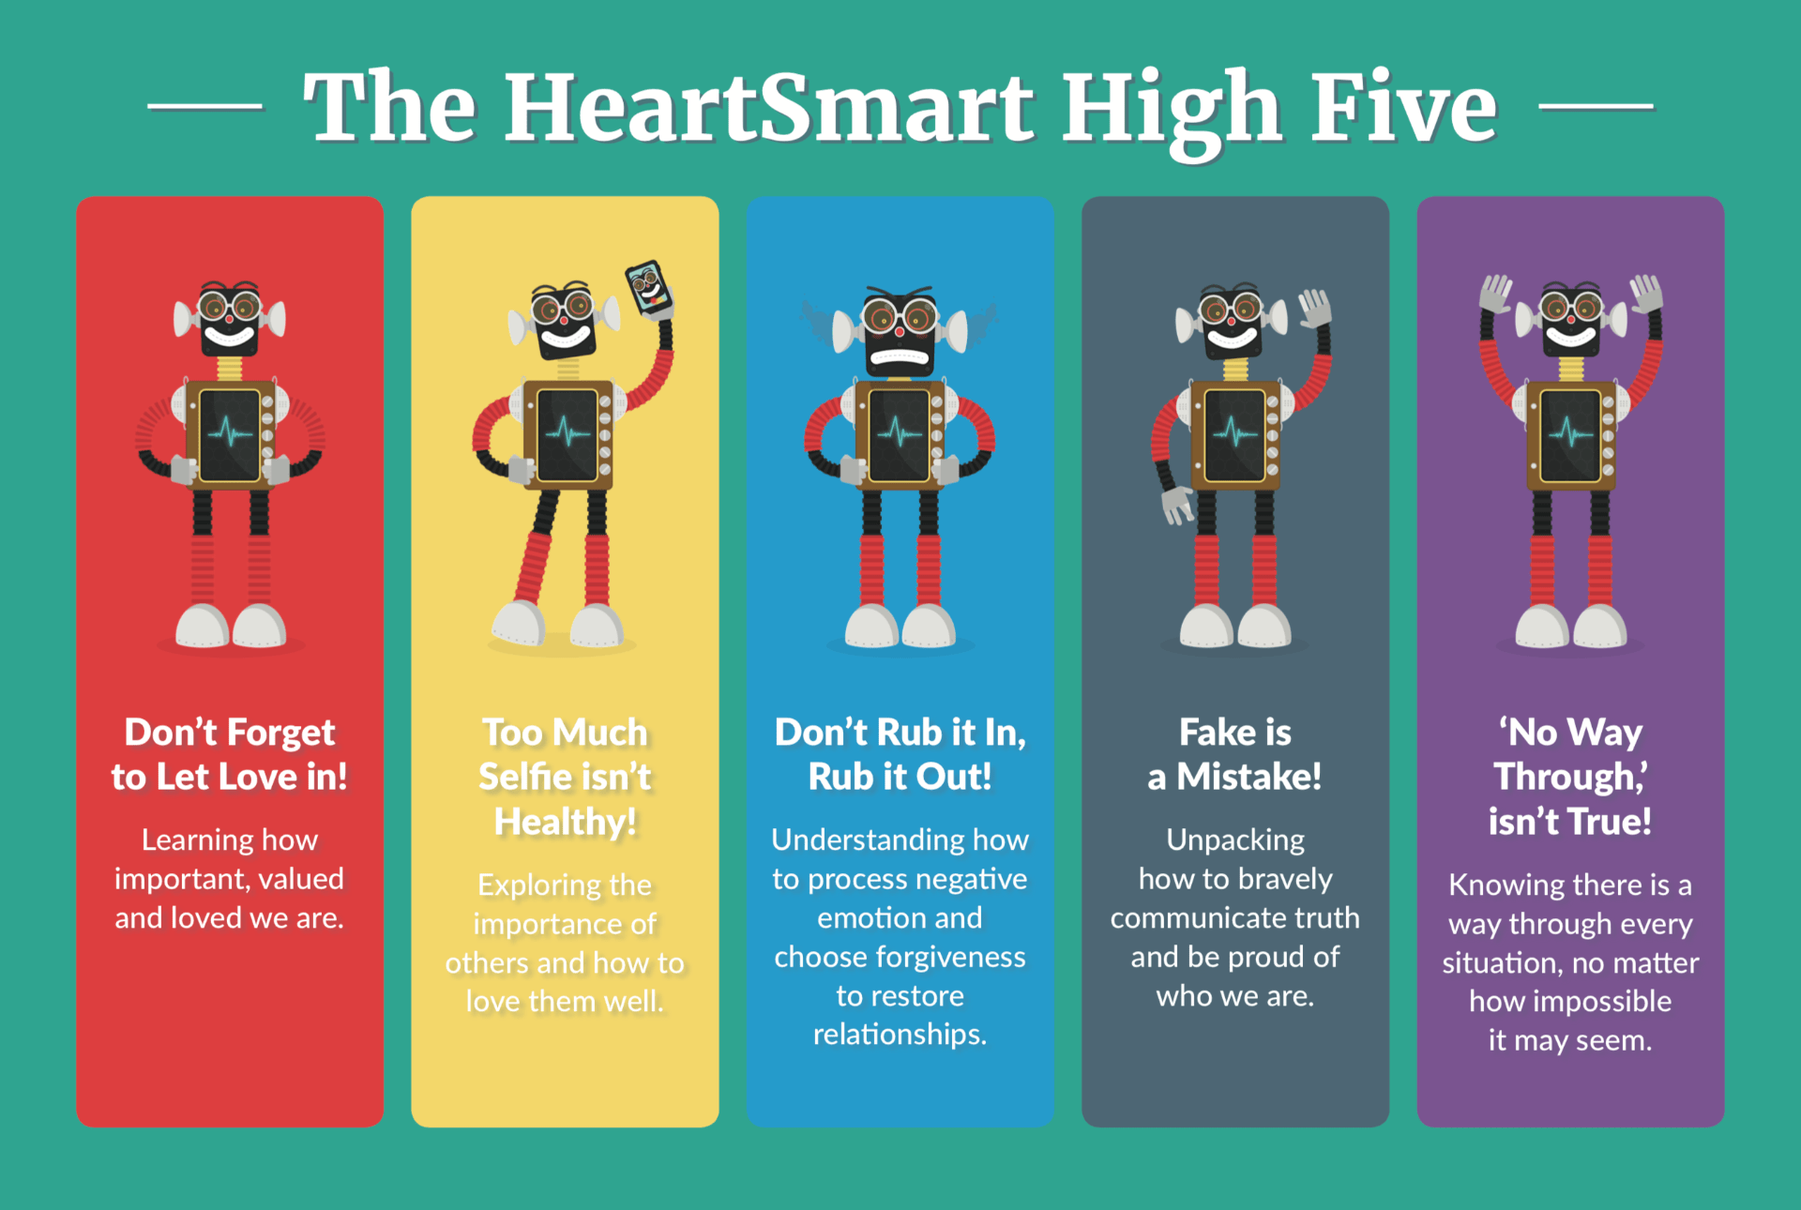
Notes:
Bex - Introduce and explain the first principle.

Slide 7
Notes:
Bex - Introduce and explain the second principle.

Slide 8
Notes:
Bex - Introduce and explain the third principle.

Slide 9
Notes:
Debbie - ntIroduce and explain the fourth principle.

Slide 10
Notes:
Debbie - Introduce and explain the fifth principle.

Slide 11
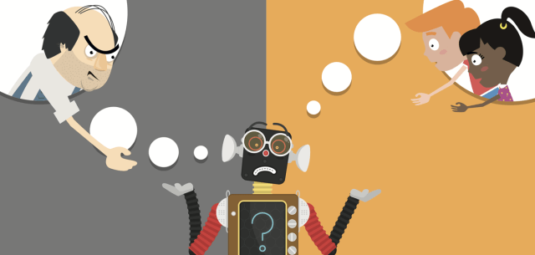
Notes:
Debbie - When the children come in we will read Boris’ story. Talk about how this page is really key for the children that we have in our school. Sometimes they hear different voices in their heads – the voice of the scrap man saying that they’re rubbish and the voices of you and us, who say that we care for them and love them, that we believe in them and they’re brilliant. It’s really hard for children to ignore the voice of the scrapman at times – its hard for adults too! HeartSmart is all about using the five principles to help us be HeartSmart and drain out the voice of the scrapman.

Slide 12
Welcome children!
Notes:
Bex -

Slide 13
Let’s hear all about HeartSmart, straight from the creator himself…
https://youtu.be/WI9XpRqJXwQ
Notes:
Bex

Slide 14
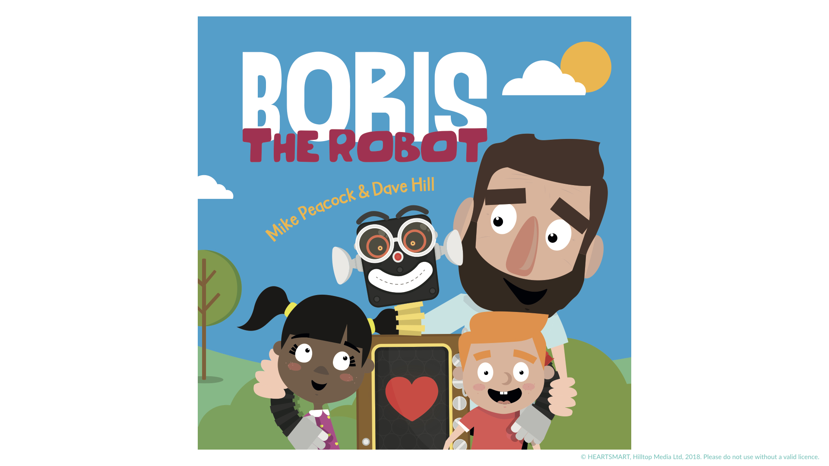
Notes:
Debbie - Ask children and parents to read the book together
NB – Order enough books – one per family

Slide 15
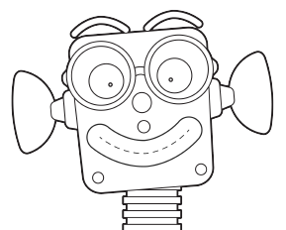
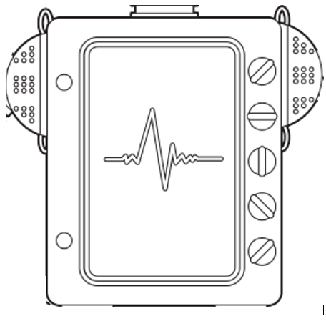
Make your own Boris using the card shapes and split pins.
Notes:
Debbie - Decorate Boris using he pens. Can you show where Boris’ heart is?

Slide 16
Thank you so much for joining us children – you may go back to class
Notes:
Bex

Slide 17
Things to consider…
The voice of the Scrapman – how much does this impact upon your child?
Are there particular principles that your child/ren finds easier or trickier to master?
How do any difficulties with these principles present themselves at home?
How could you use the HeartSmart language at home?
Notes:
Bex
Need grid for self reflection

Slide 18
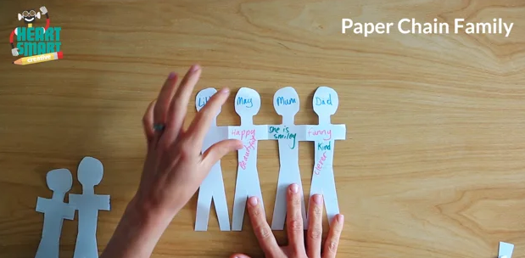
Homework Task
https://www.heartsmart.school/hsCreative-getheartsmart
Notes:
Debbie - In homework packs:
Paper
Pencil
Scissors
Website link
Colouring pens/pencils?

