Slide 1
Art
Monday 23rd March

Slide 2
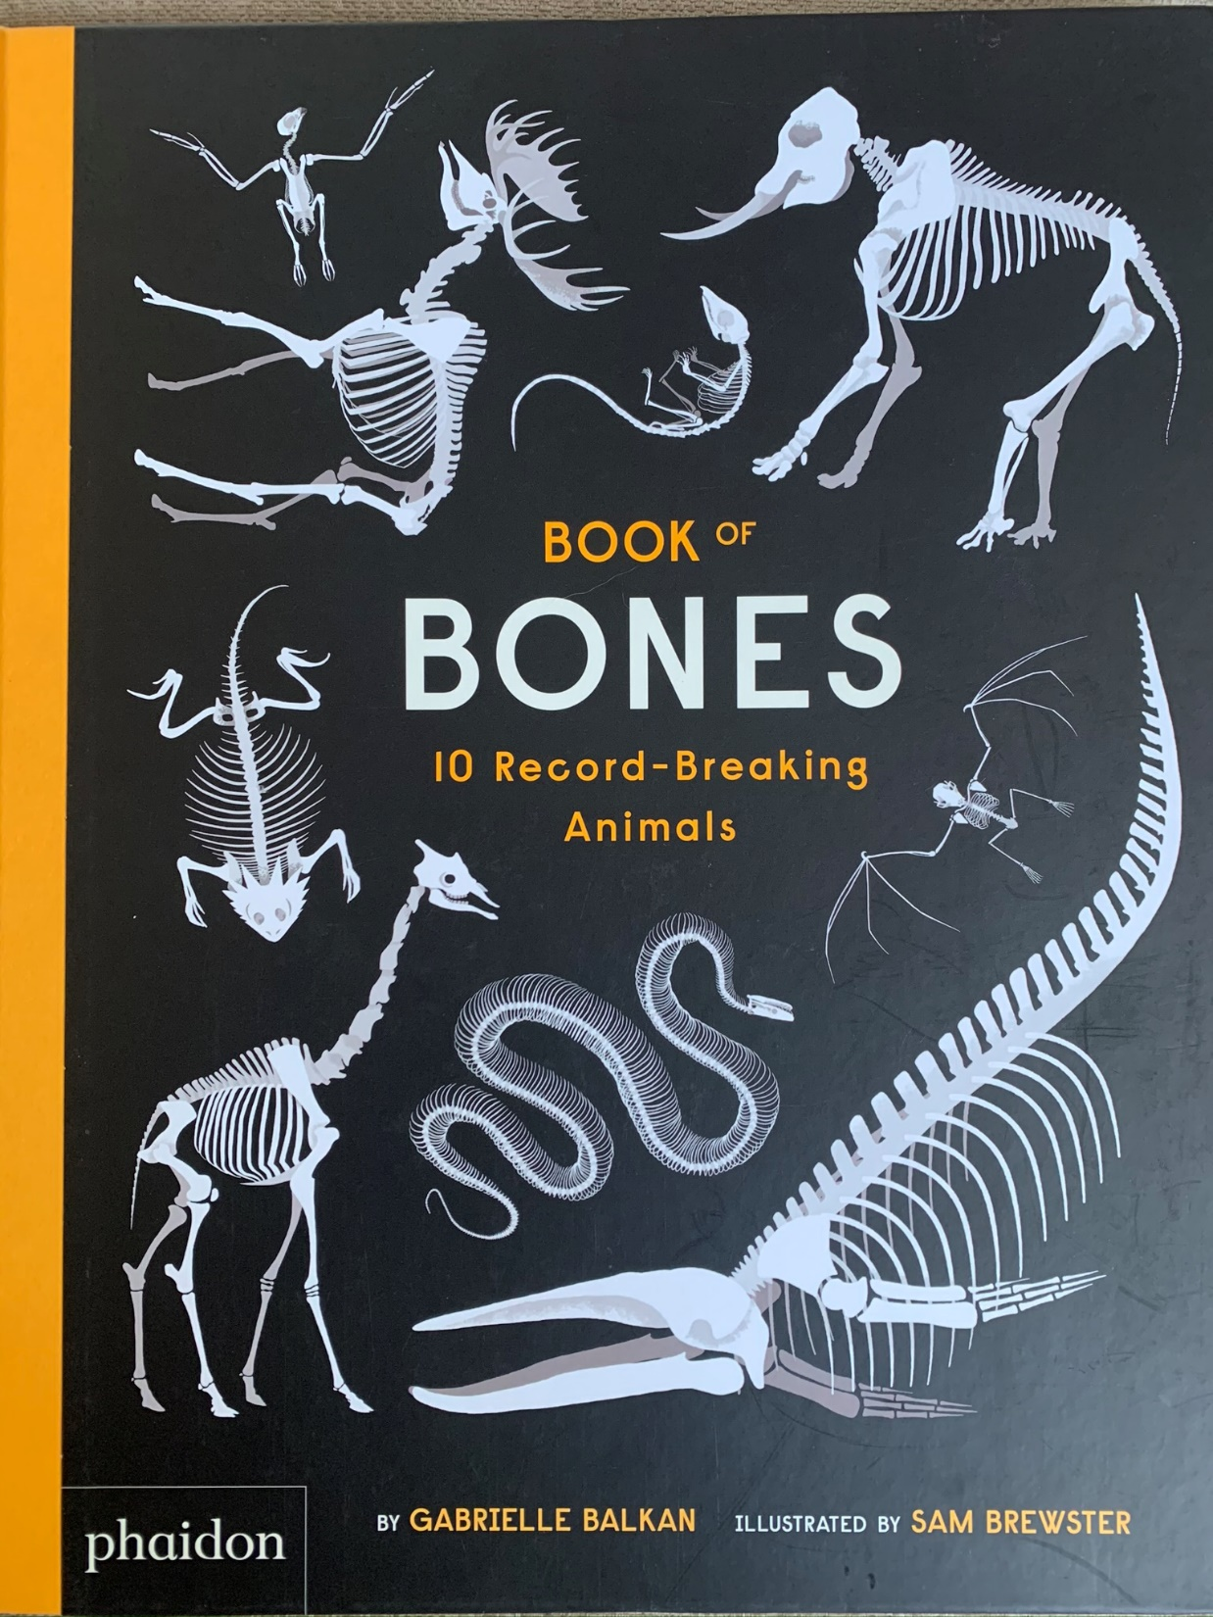
We are going to continue to think about the
missing page from the book of bones.

Slide 3
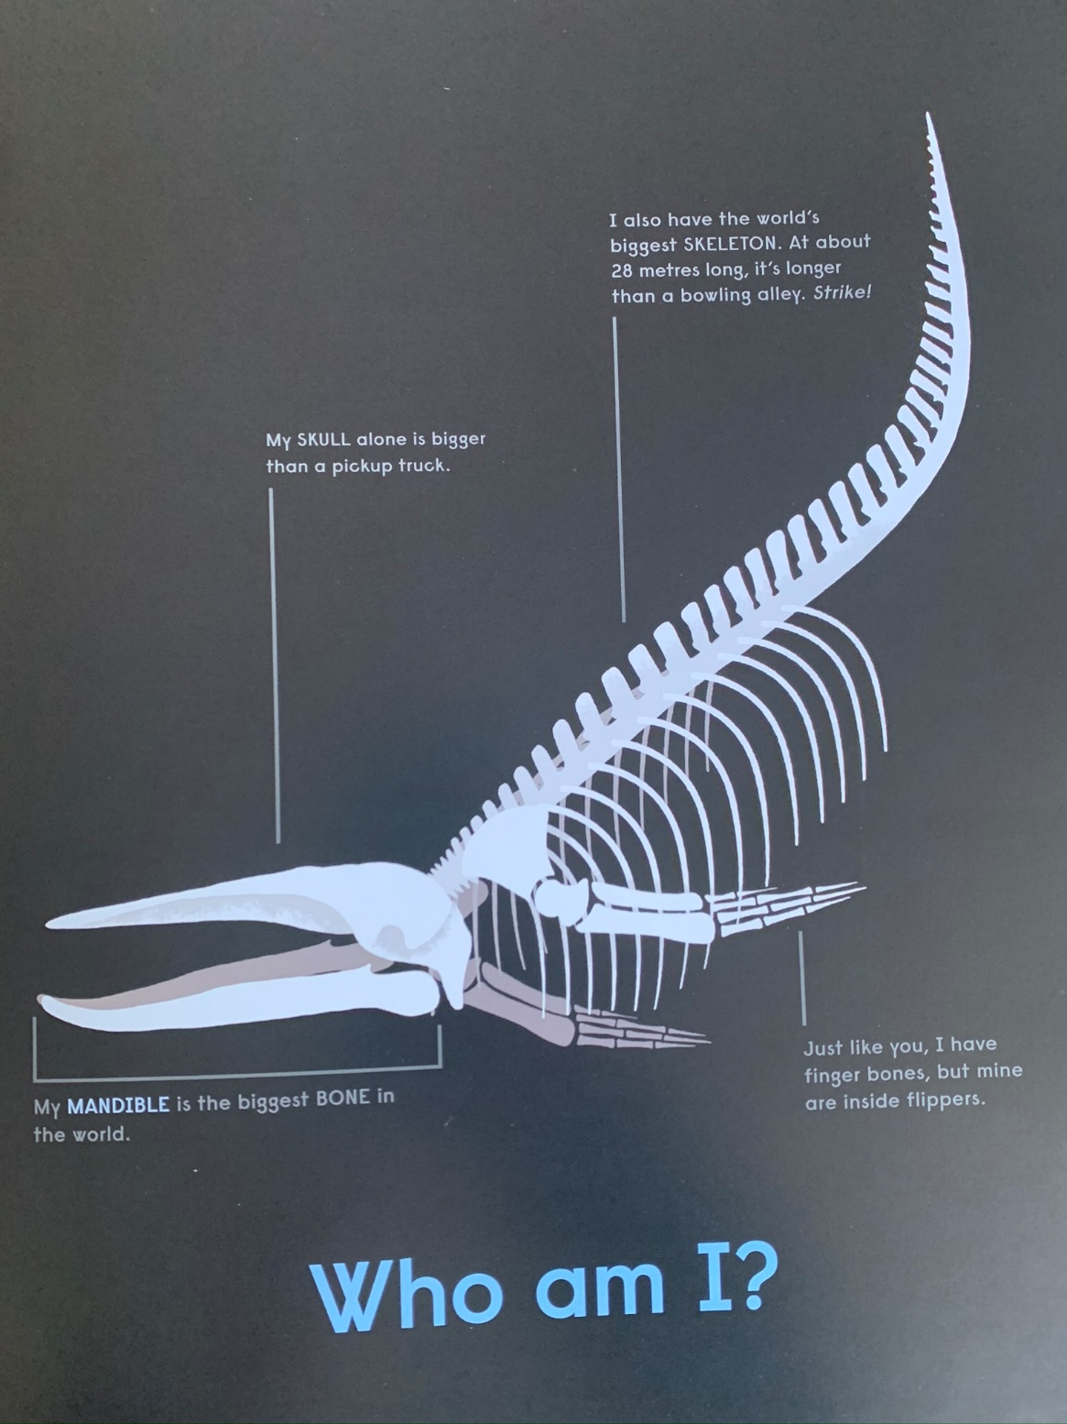
In school we remade this page for the human.

Slide 4
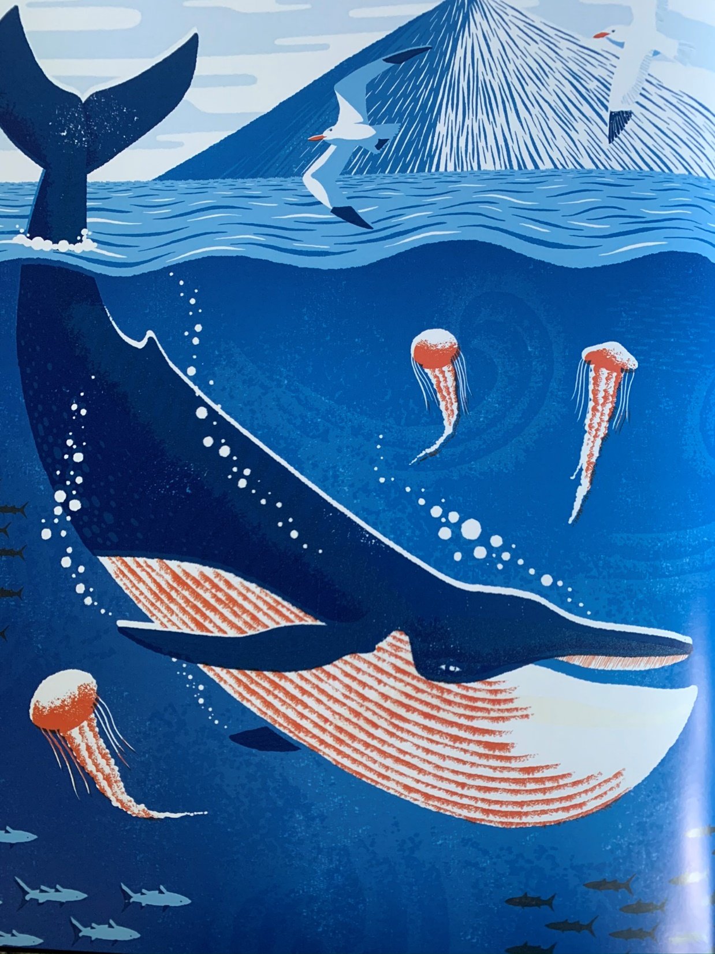
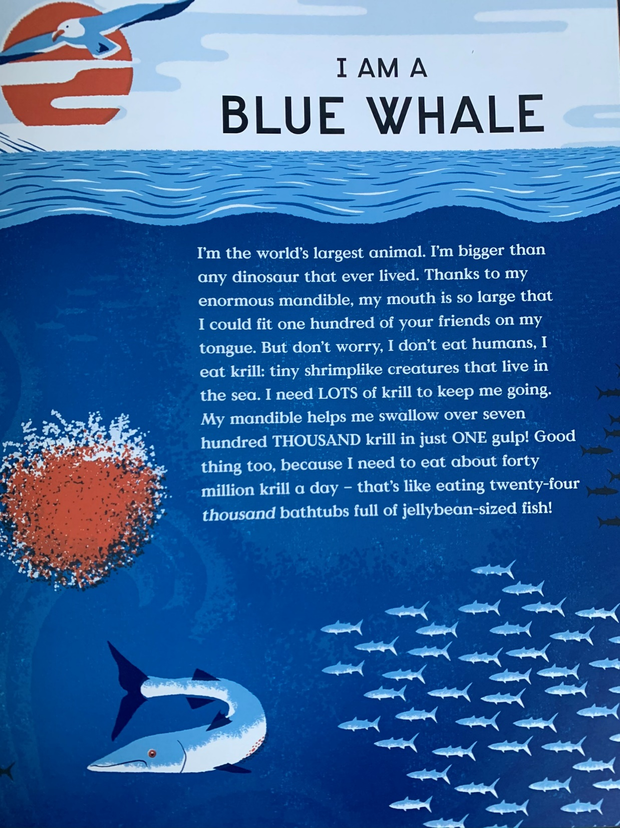
And we loved these pages as we could feel the bones in the book.
It’s a shame we can’t see them from this picture!

Slide 5
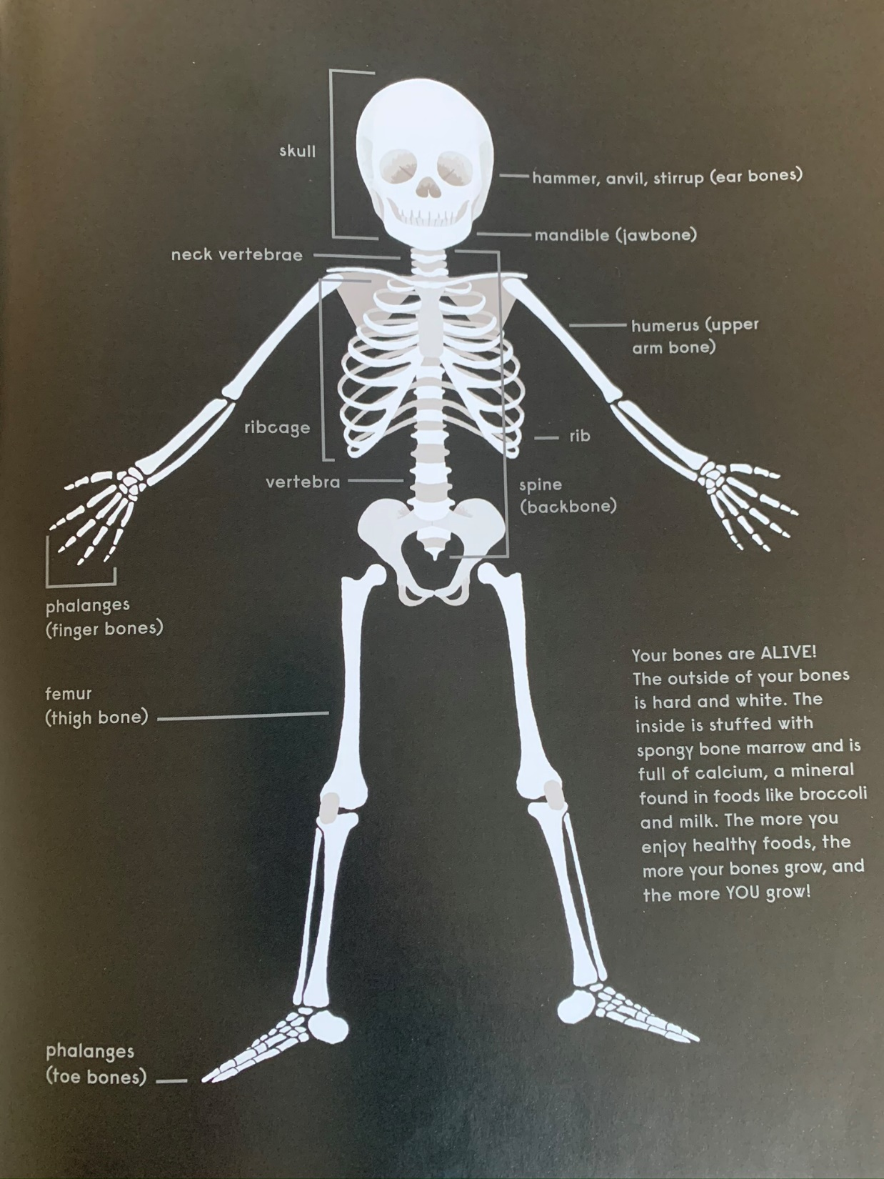
So the author made the skeleton page but not the page
that follows.

Slide 6
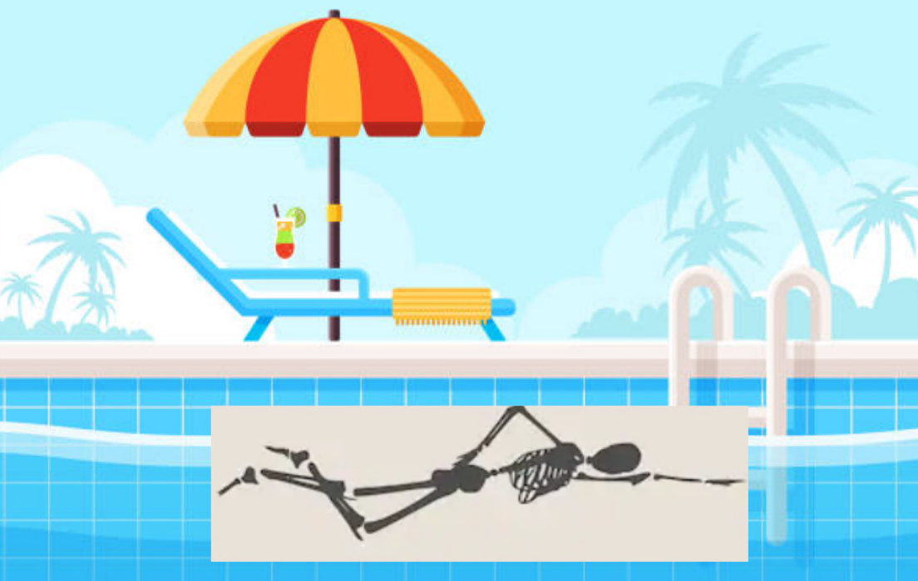
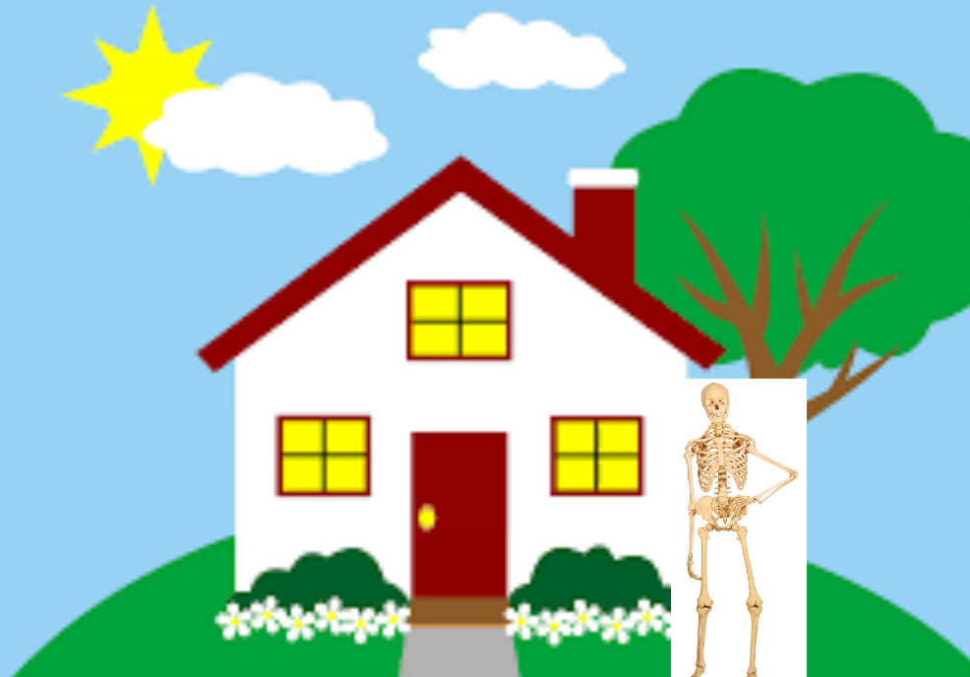
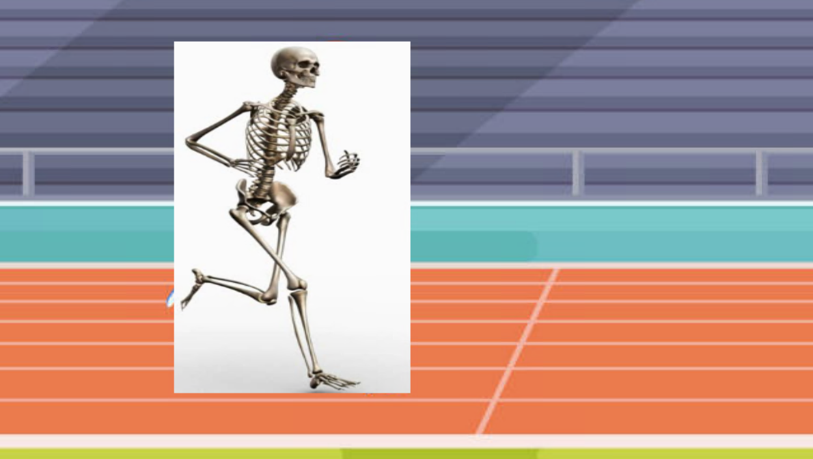
Do you remember planning your backgrounds in your art books at school?
Remember your drawing? If you can’t don’t worry you can do a new one!

Slide 7
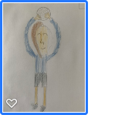
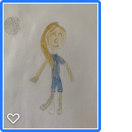
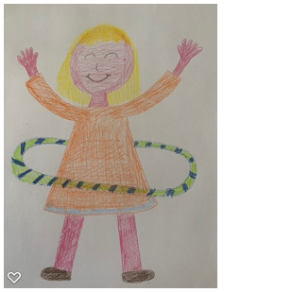
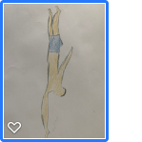
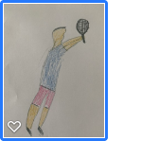
First, draw yourself doing your chosen activity. Colour with pencils – Not pens (You’ll see why soon!)
Don’t draw it too small – fill your piece of paper.
Pause on this page whilst you draw your picture.

Slide 8
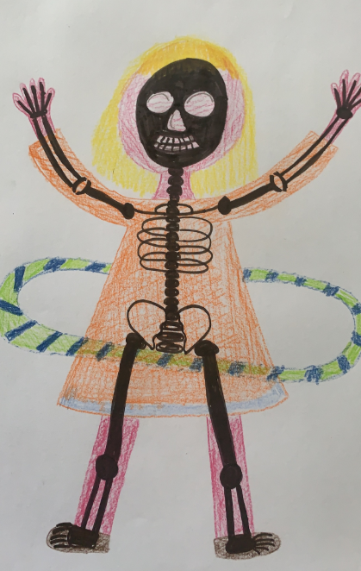
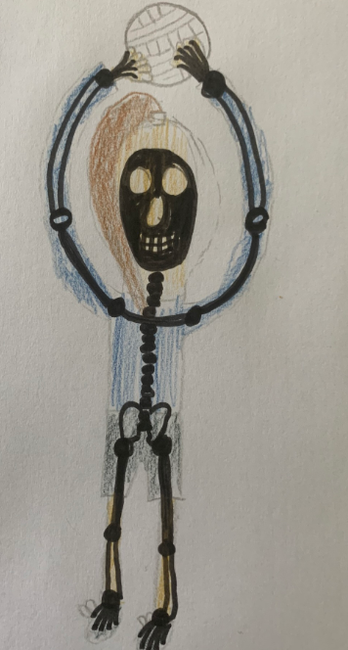
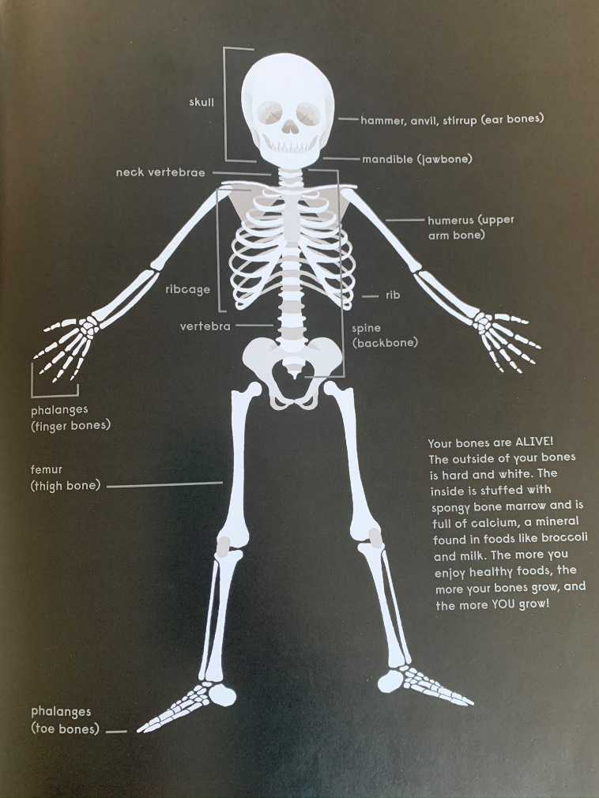
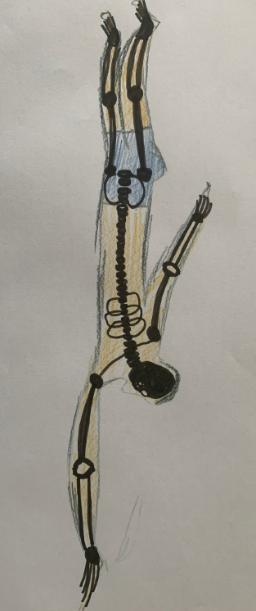
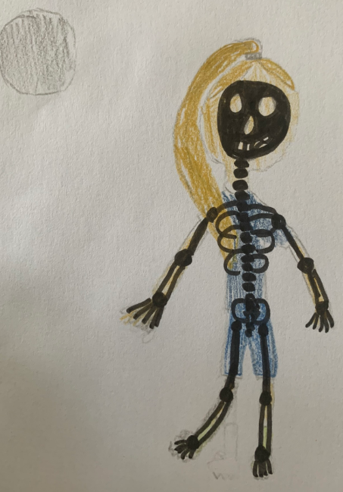
Next use a black pen to complete the bones on your body…..
Use this picture to help!

Slide 9
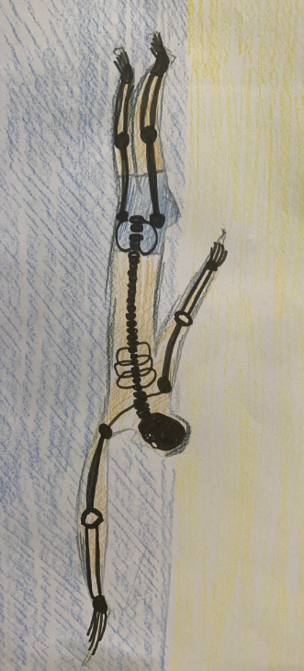
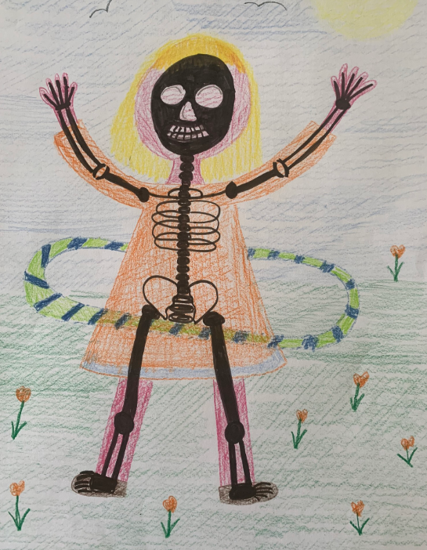
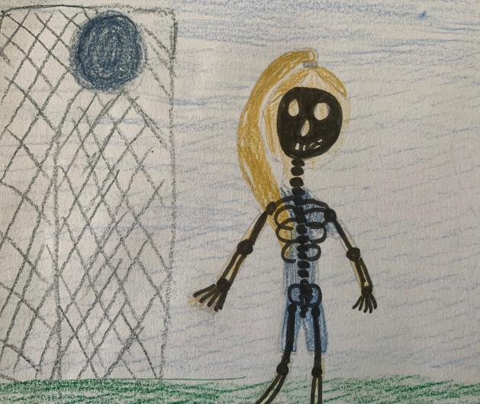
Finally, add a background …..
We can’t wait to see your pictures. Send us an email to show us if you can………..
year3@stmarksce.org.uk

