Slide 1
Calculations
Microsoft Excel is very clever at adding up calculations for us ☺
Click on the second sheet named ‘Calculating the sum.’
Can you get the computer to do all of the hard work for you?
CHALLENGE 3: Highlight the numbers in the row and press the
AutoSum button found in the top panel.
Can you add up each row of numbers without having to do any of the hard work yourself? ☺

Slide 2
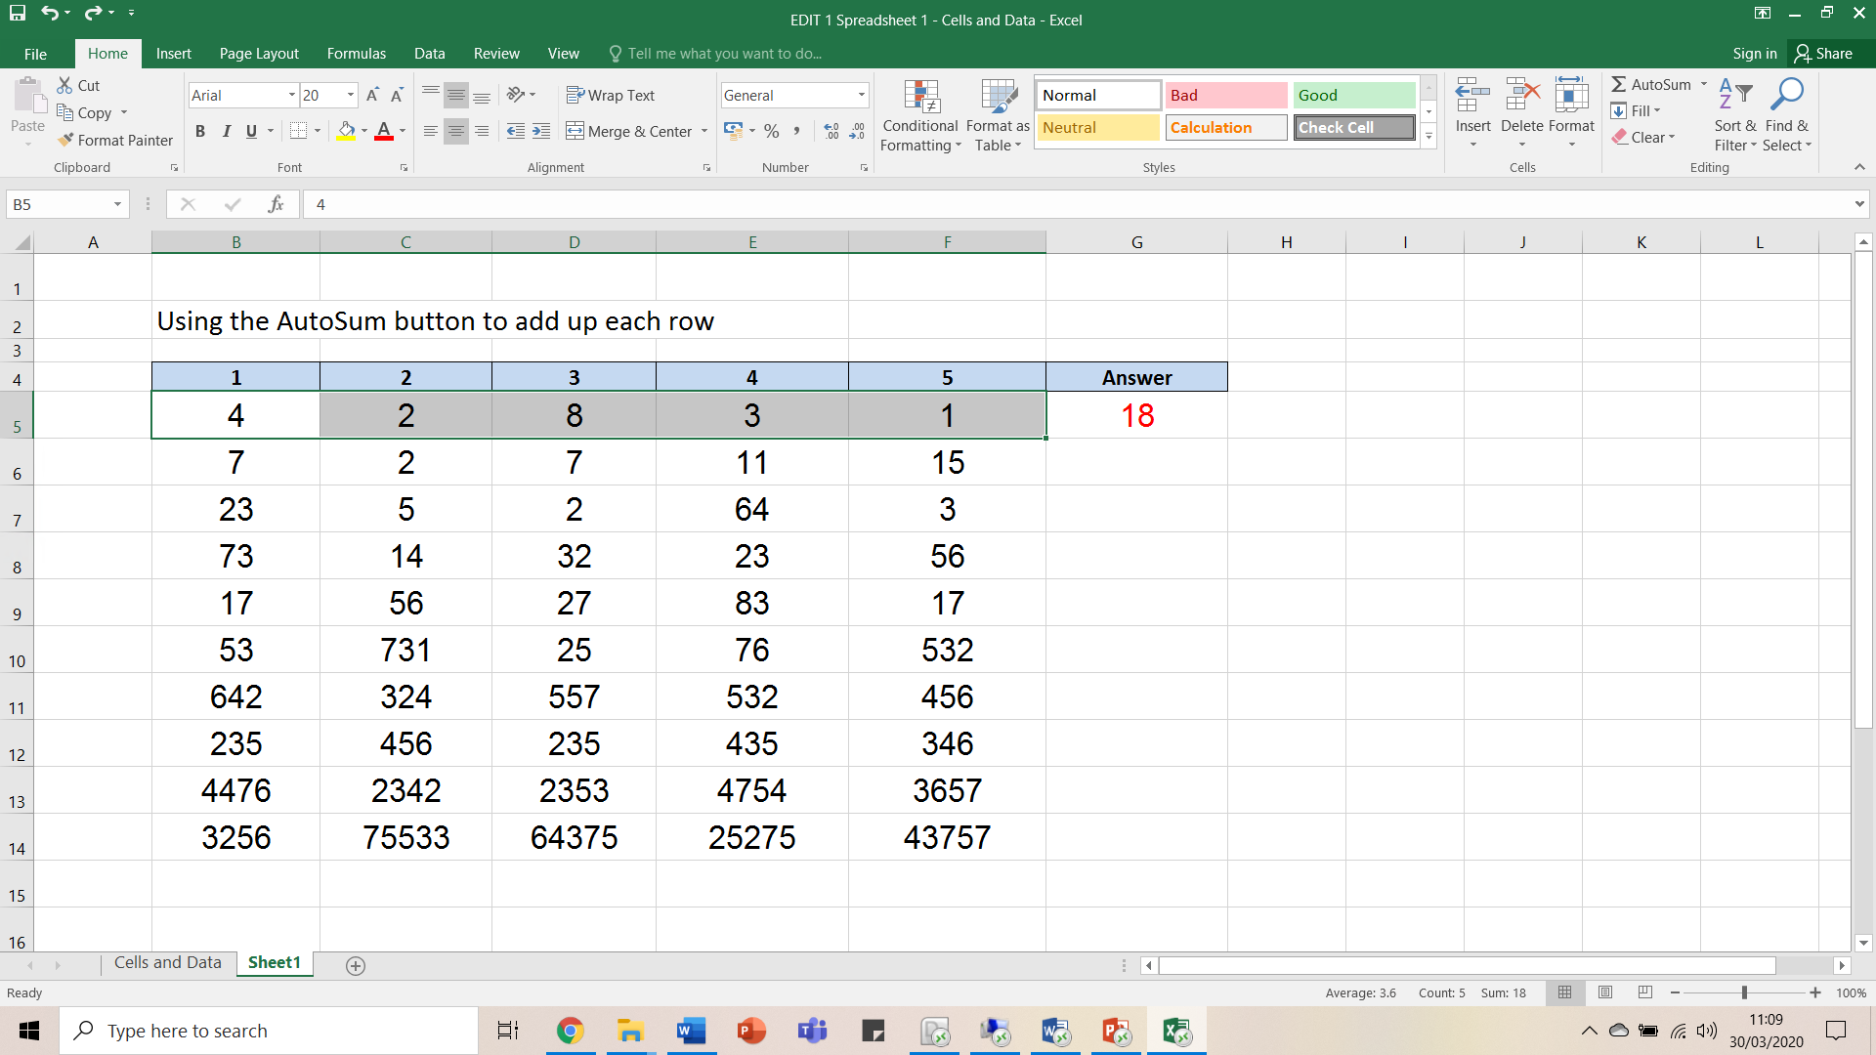
Calculations
1. Highlight each number in the row
2. Push the AutoSum button and you should see the total appear here

Slide 3
Challenges Completed ☺
How did you find that?
If you are becoming a bit of an Excel expert, feel free to create your own data table to reinforce the skills we have practised today.
Maybe over the next week you could record how many minutes you have spent doing your learning tasks, or how many star jumps you could manage before stopping. Push the AutoSum button at the end of the week and you will find out the total!
Great stuff ☺

