Slide 1
English: Monday, 30th March, 2020
Before we can begin today’s writing you need to read the first pages of a book all about the Easter story. We will stop at the point of the Last Supper and continue tomorrow.
The story is told from the point of view of a lady who witnessed Jesus entering Jerusalem on Palm Sunday when she was just a young girl. She tells people at a picnic many years afterwards what she saw.

Slide 3
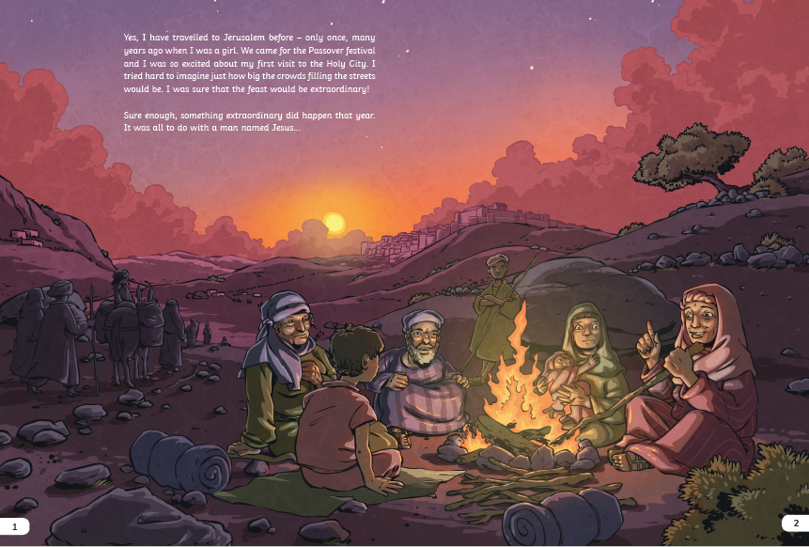
Yes, I have travelled to Jerusalem before – only once, many years ago when I was a girl. We came for the Passover festival and I was so excited about my first visit to the Holy City. I tried hard to imagine just how big the crowds filling the streets would be. I was sure that the feast would be extraordinary!
Sure enough, something extraordinary did happen that year. It was all to do with a man named Jesus …

Slide 4
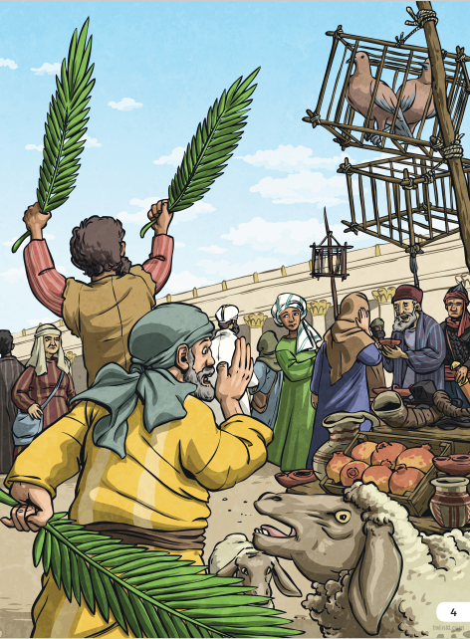
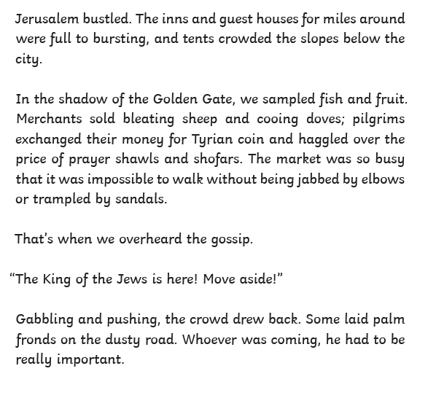

Slide 5
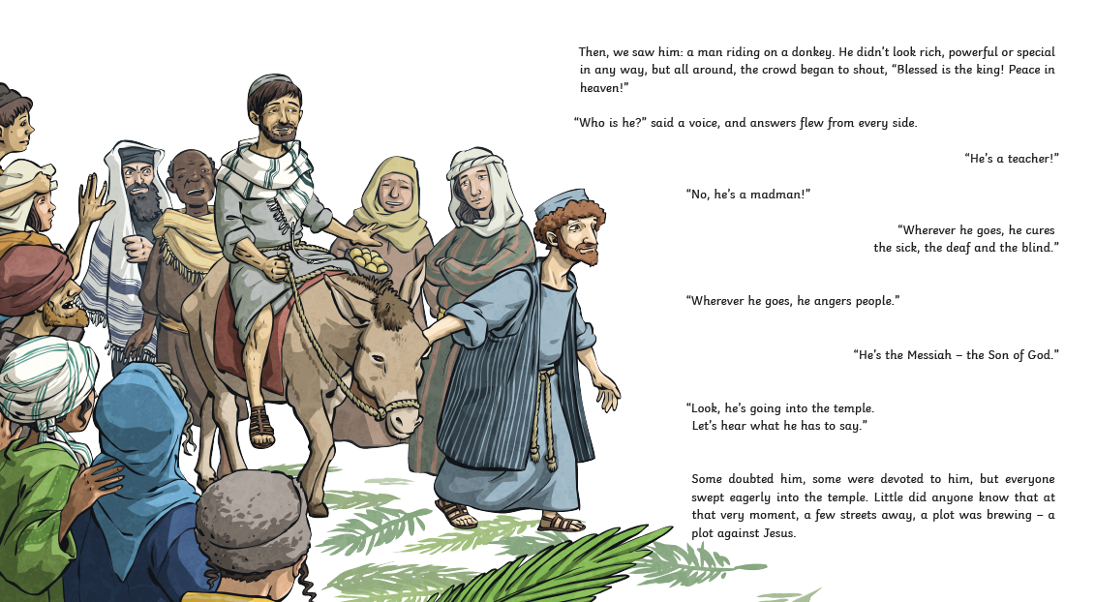

Slide 6
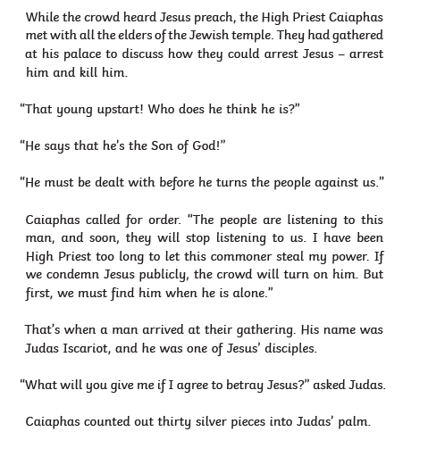
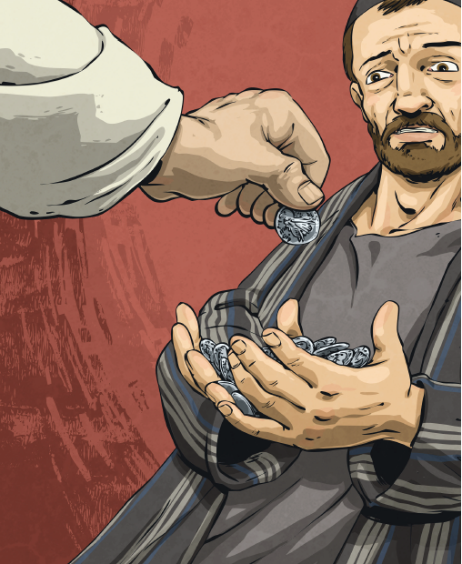

Slide 7
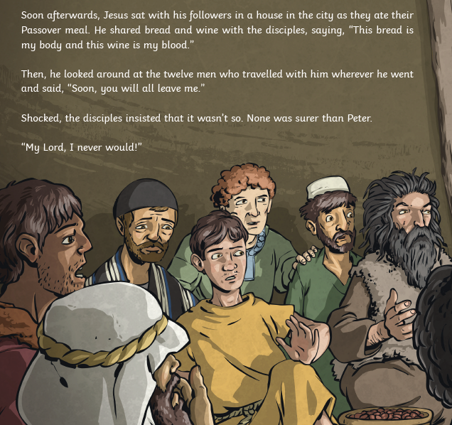

Slide 8
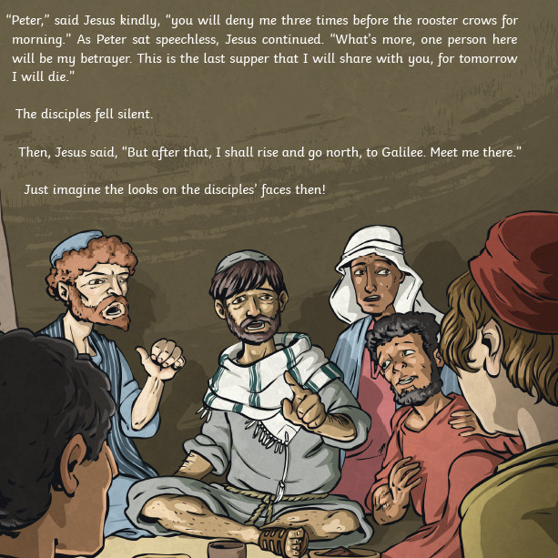

Slide 9
Now we are ready to retell the beginning of the Easter story in our own words.

Slide 10
I can retell the Easter story in detail.
To retell the story we will begin at the entry in Jerusalem.
Think about feelings – of the disciples, of Jesus, of the various onlookers.
Include important vocabulary – palm fronds, Golden gate, jubilation, King of the Jews, welcomed, crowds, jostling, cheering.

Slide 11
Begin your new paragraph with: While Jesus was preaching at the temple,
Some important vocabulary to add into this section:
Judas Iscariot, one of Jesus’ disciples, High Priest Caiaphus, the elders of Jewish temple, gathered at his palace, thirty silver coins,
Include ideas about why Caiaphus wanted to arrest Jesus (feeling threatened and angry that a commoner – poor man- might be more powerful than him)
How might Judas be feeling?

Slide 12
The next paragraph(s) will cover the Passover meal Jesus had with his disciples before the Roman soldiers arrived to arrest him.
Important vocabulary to include:
Passover, last supper, bread, body of Christ, wine, blood of Christ
Use direct speech for –”One of you will betray me,” and “Peter, you will deny me three times before the cockerel crows.”

Slide 13
Tomorrow, we will continue the story where Jesus goes into the Garden of Gethsemane to pray.
As you write think deeply about the retelling of the Easter story and the characters you write about. Include feelings and weave these into your story.
Remember the importance of varied sentence openers and do remember to paragraph your work.

