Slide 1
English - Monday

Slide 2
Unfortunately the last few minutes of the video of Chapter 18 were missing, and so please read the last 3 and a bit pages of Chapter 18.

Slide 4
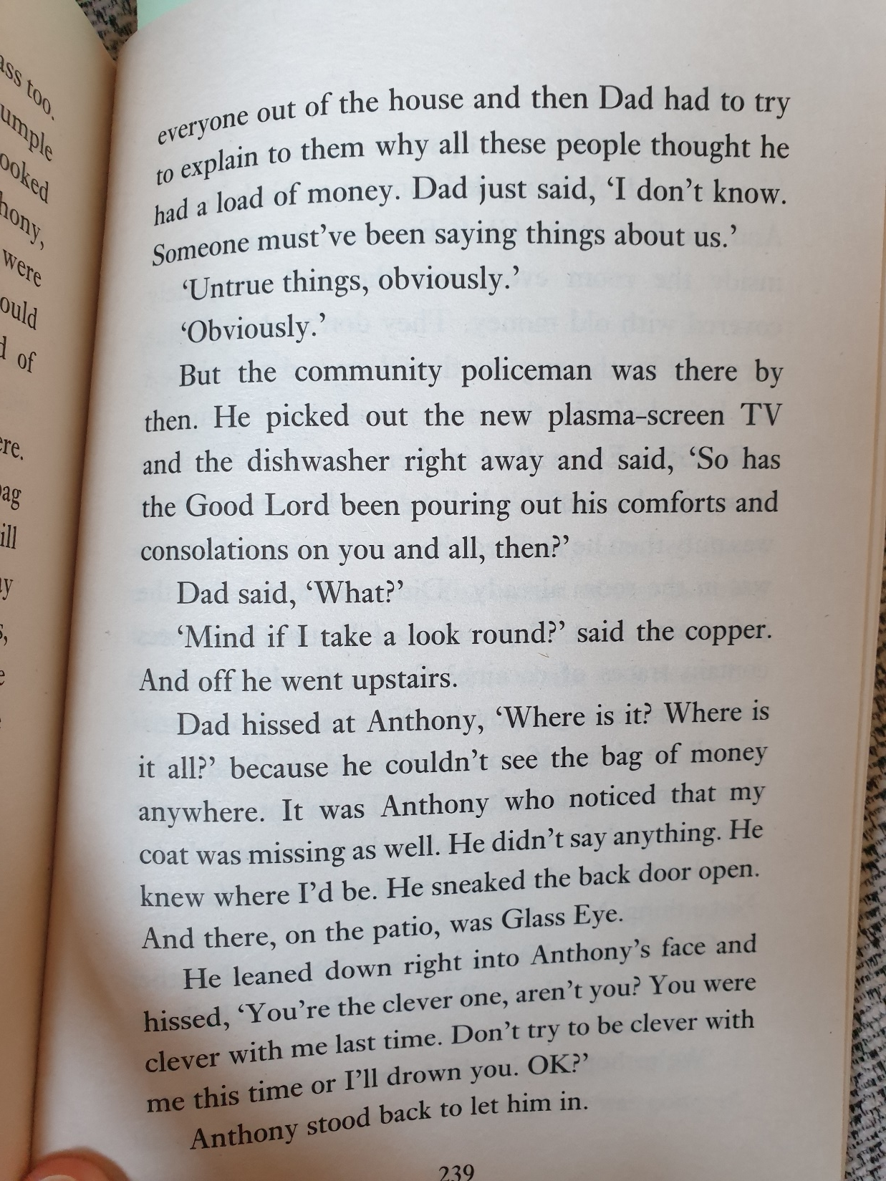

Slide 5
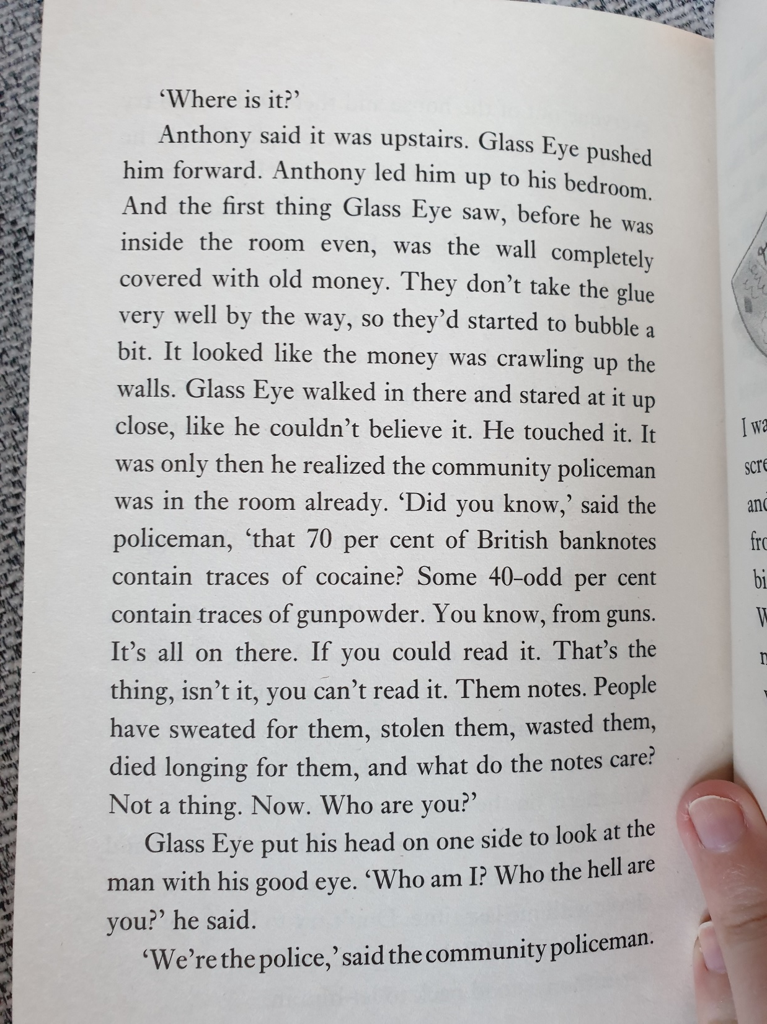

Slide 6
Listen to the video of Mrs Poole reading Chapter 19.
Find the video in the video resources page of the website post.

Slide 7
Now that we have read chapter 19, we only have 1 chapter left.
In the final chapter it tells us what the family did with the rest of the money and how they felt about the events.

Slide 8
I can make predictions for the ending of a book
Your job today, is to write Chapter 20 of the story, based upon what you think will happen.
Spend 20 minutes writing your own version of chapter 20, making sure you include what they will do with the remaining money and how they feel.
Remember that it is in past tense and first person
(you are pretending to be Damian)

