Slide 1
Monday

Slide 2
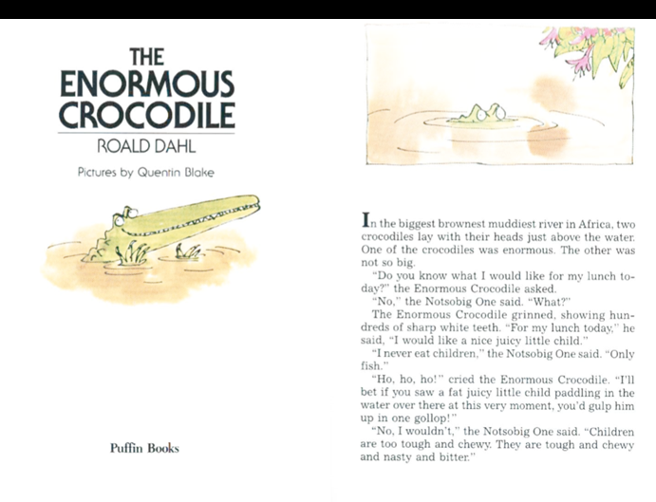
From the story so far, what kind of character do you think the crocodile is?

Slide 3
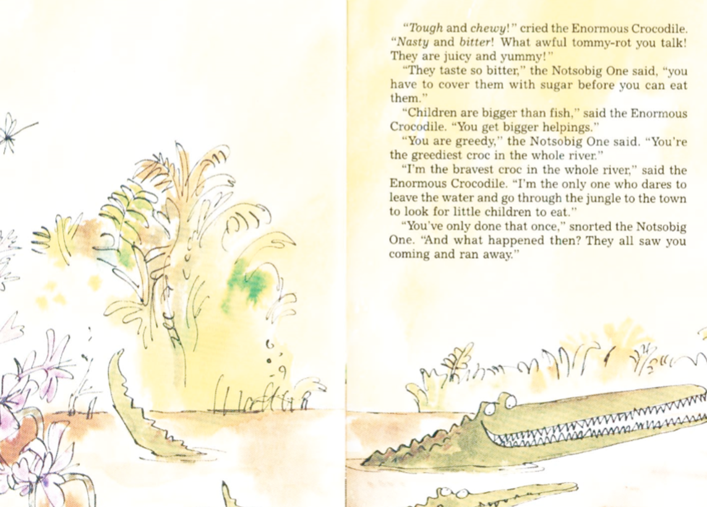
Would you warn your friends about the enormous crocodile?

Slide 4
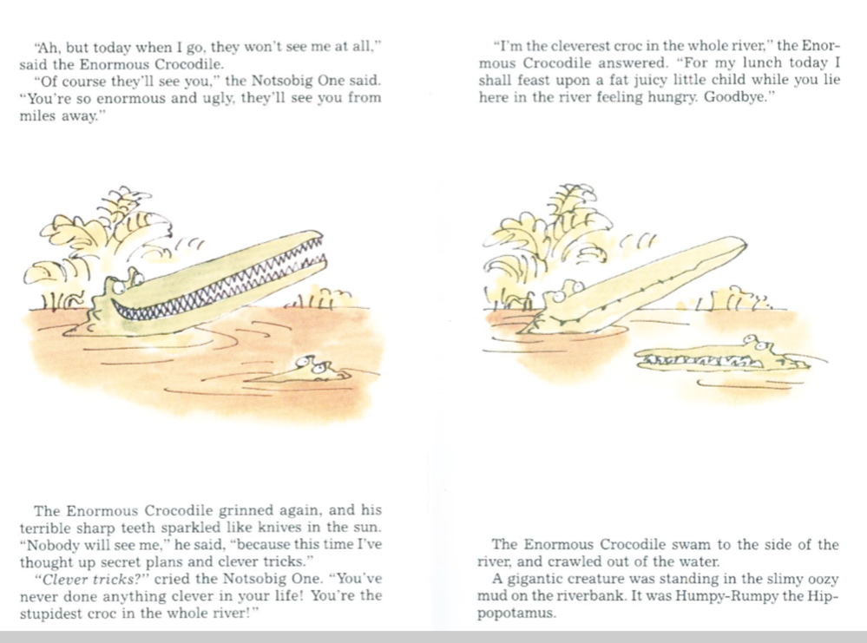

Slide 5
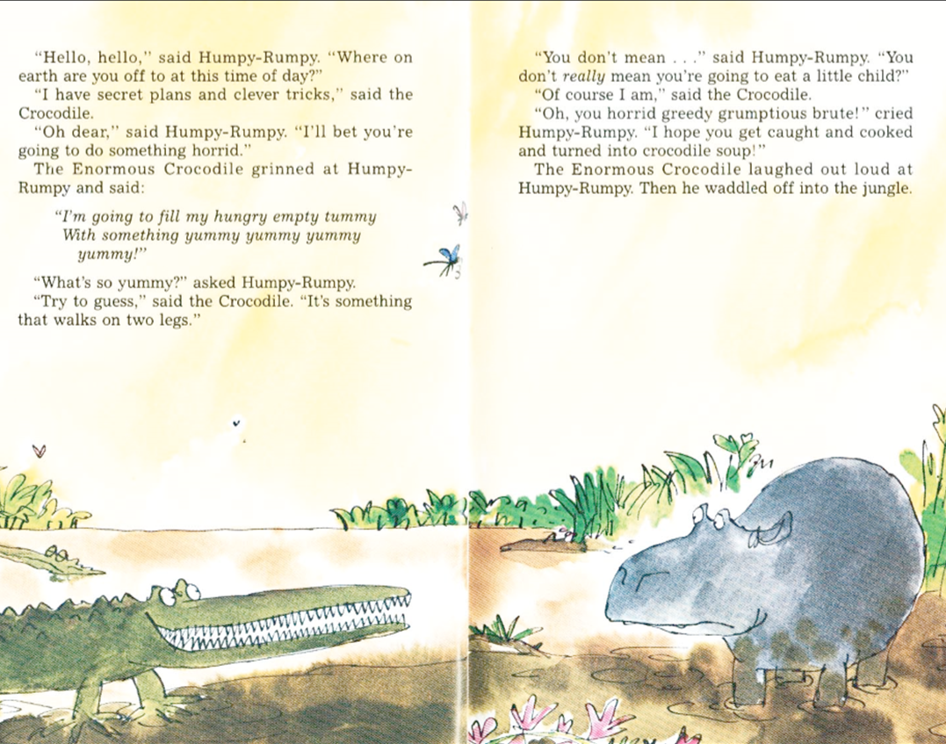
Do you think Humpy-Rumpy likes the Enormous Crocodile. Why?

Slide 6
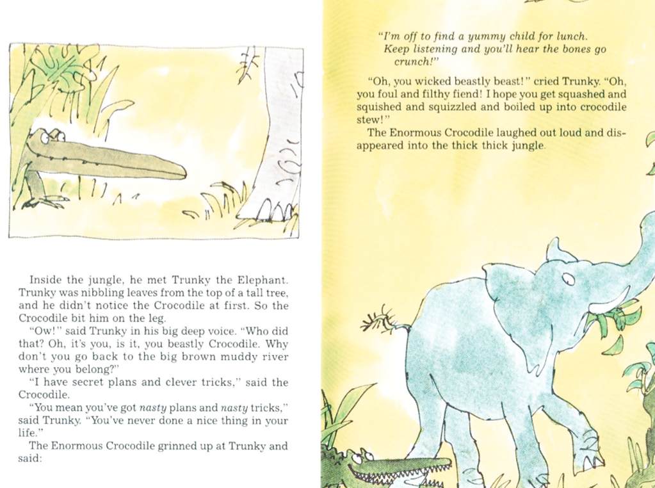
How do you think Trunky the Elephant is feeling?

Slide 8
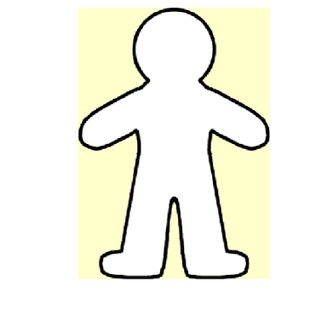
Write a character description
Outside: Write words to describe appearance
Inside: Write words to describe his
Personality or behaviour
Write some sentences to describe the Enormous Crocodile’s appearance.
The Enormous Crocodile’s skin is………..
He has …………..
If you look at him closely you will see….
Write some sentences to describe the Enormous Crocodile’s
personality and behaviour.
He is …
If you met him…..
When you see him…..
I would/wouldn’t like to be friends with him because……

