Slide 2
https://www.youtube.com/watch?v=9RhX3lRJQMg

Slide 3
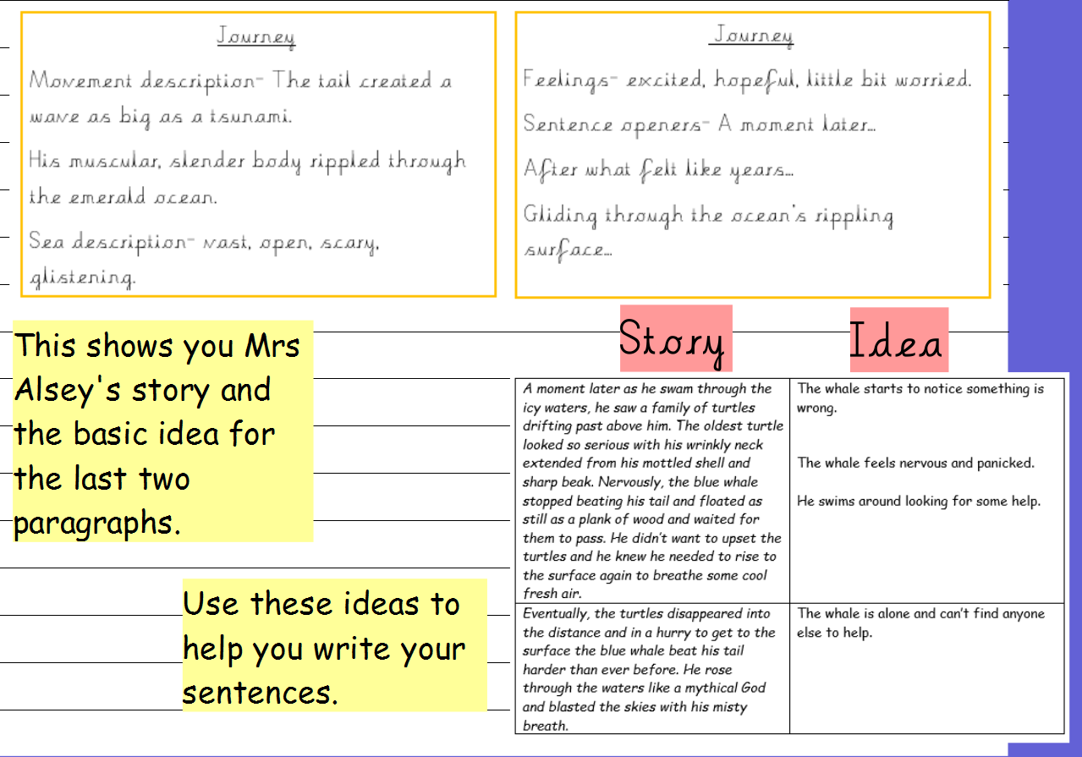

Slide 4
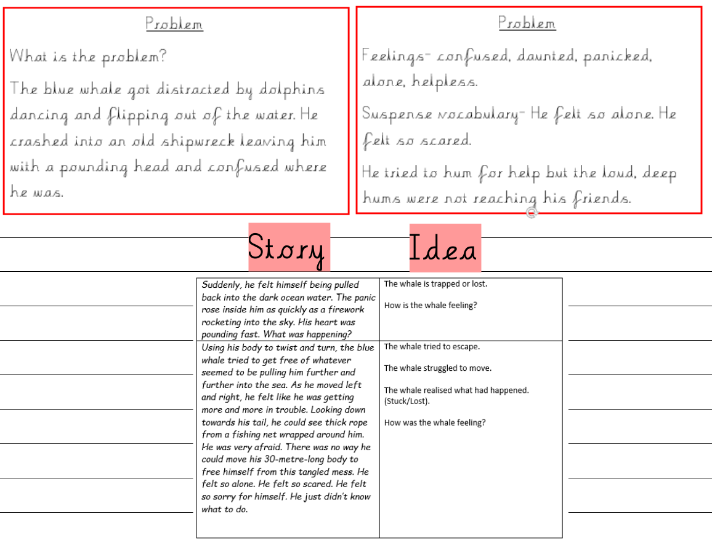

Slide 5
