Slide 1
English and RE: Tuesday, 31st March, 2020
I can continue to retell the story of Easter in the narrative style thinking carefully about events and emotions.

Slide 2
Today, we will cover the part of the story which sees Jesus being arrested in the Garden of Gethsemane up to the point where the crowd chant for Jesus to be crucified.
You will be asked to weave emotions into the narrative. Remember what that means. Instead of writing:
Jesus felt betrayed.
Link it to an action:
Betrayed, Jesus was forced to leave the Garden of Gethsemane.

Slide 3
The next five pages are reproduced from Twinkl’s ebook, ‘The Easter Story,’ which we started reading yesterday.

Slide 7
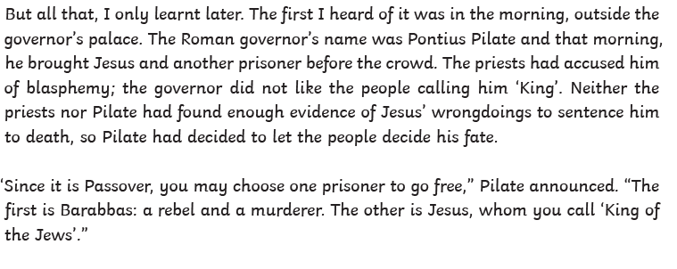

Slide 8
Now you have read that part of the story from the book, we are ready to write.
This is the part where Jesus has left the table of their Passover meal and has gone into the Garden of Gethsemane to pray.
Vocabulary you will need:
Olive trees, almond blossom, troubled, feverishly prayed, disciples, darkness of night broken, burning torches, golden light flooded the garden.

Slide 9
In your next paragraph, you need to tell the reader of the soldiers and priests who entered to arrest Jesus.
Vocabulary you will need:
Soldiers, priests, Judas, signal, seized Jesus, marched him out, disciples fled.
Think how you can weave feelings into this stage.

Slide 10
Your next paragraph, takes us to the Palace of Caiaphus where Jesus was taken and Peter followed.
Vocabulary you will need:
Palace of Caiaphas, Peter, desperate, courtyard, trembled, elders, servant, denied knowing Jesus, shame, rooster crowed.

Slide 11
Your next paragraph, begins with, ‘The following morning, …’
Vocabulary you will need:
Roman governor – Pontius Pilate, governor’s palace, prisoner, Jesus, accused, blasphemy, ‘King of the Jews’, people were to decided his fate, Passover, go free, Barabbas, rebel, murderer.
Remember, to weave in some feelings too of Pontius, Jesus and Barabbas.

Slide 12
Well done! You should now have at least four clearly written paragraphs with important parts of the story and the feelings of characters woven through the action. Remember direct speech will need a new paragraph so you may well have several more paragraphs by the end of today’s write. My example has six paragraphs to cover these four sections of the story.

