Slide 1
Thursday 19th March 2020

Slide 2
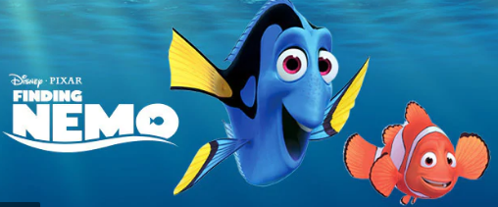
This week we started planning our own whale adventure story.
Which of these whale adventure stories have to seen?

Slide 3
Today, we would like you to write the introduction for your whale adventure story. You had incredible and exciting ideas when we planned in class on Monday. Mrs Alsey also wrote her own whale adventure story to inspire us. Spend five minutes enjoying it again to help get your own thoughts bubbling.

Slide 4
You can use the whale facts we have learnt from this story book in your own adventure story.

Slide 5
So, what is the purpose of the introduction in a story?

Slide 6
What is the purpose of the introduction in a story?
To set the scene.
Introduce us to the characters.
Describe what the main character looks like.
Describe what personality the main character is.

Slide 7
How will you capture the interest of the reader so they want to find out what happens next in your whale adventure story? You could include some of the different ways of using exciting descriptive language that we explored last week.

Slide 9
How did Mrs Alsey use this lovely vocabulary in her story introduction?
Let’s have a look…

Slide 10
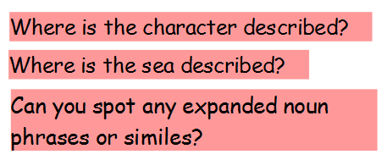

Slide 11
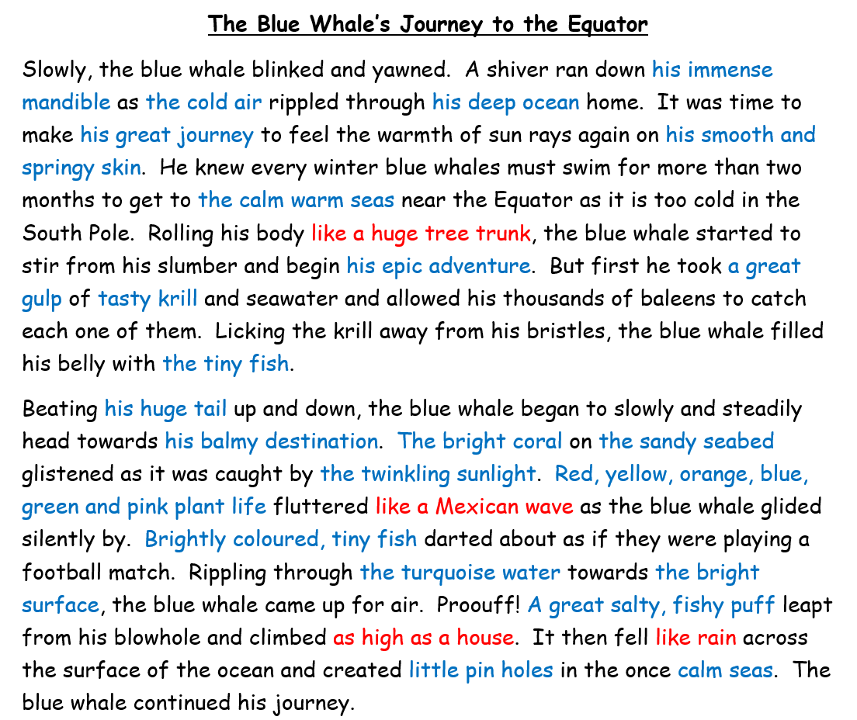
simile (a way of describing something by comparing it to something else using ‘like’ or ‘as’) expanded noun phrase (a phrase with a noun and at least one adjective)

Slide 12
Now it’s time to get writing. Remember, use a ruler if you can to underline your date and title and work just a carefully as you do in class. REMEMBER You are only writing the introduction today.

Slide 13
