Slide 1
Music for the beginning of Worship

Slide 6
Have a read or listen to the story of the Selfish Crocodile.

Slide 7
How did the mouse show kindness?
Did he have to do that?
Do you think the mouse was brave?
Did the crocodile show kindness at all in the story?
How do you think the crocodile feels at the end of the story?

Slide 9
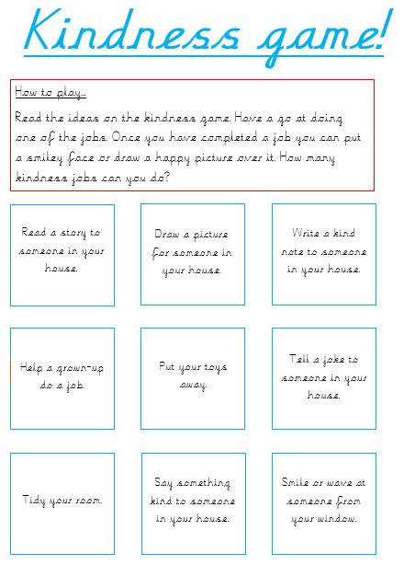
Have a go at playing the kindness game with someone in your house.
A bigger version is linked on the website.

Slide 12
Peace be with you
And also with you
Music for the end of Worship

