Slide 1
Maths
I can find the difference between measurements on two different scales

Slide 2
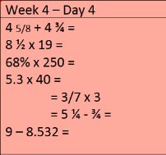
Success in Seven

Slide 3
Success in Seven answers
1) 75/8 or 9 3/8
2) 161 ½
3) 170
4) 212
5) 9/7 or 1 2/7
6) 18/4 or 4 2/4 or 4 1/2
7) 0.468

Slide 4
