Slide 1
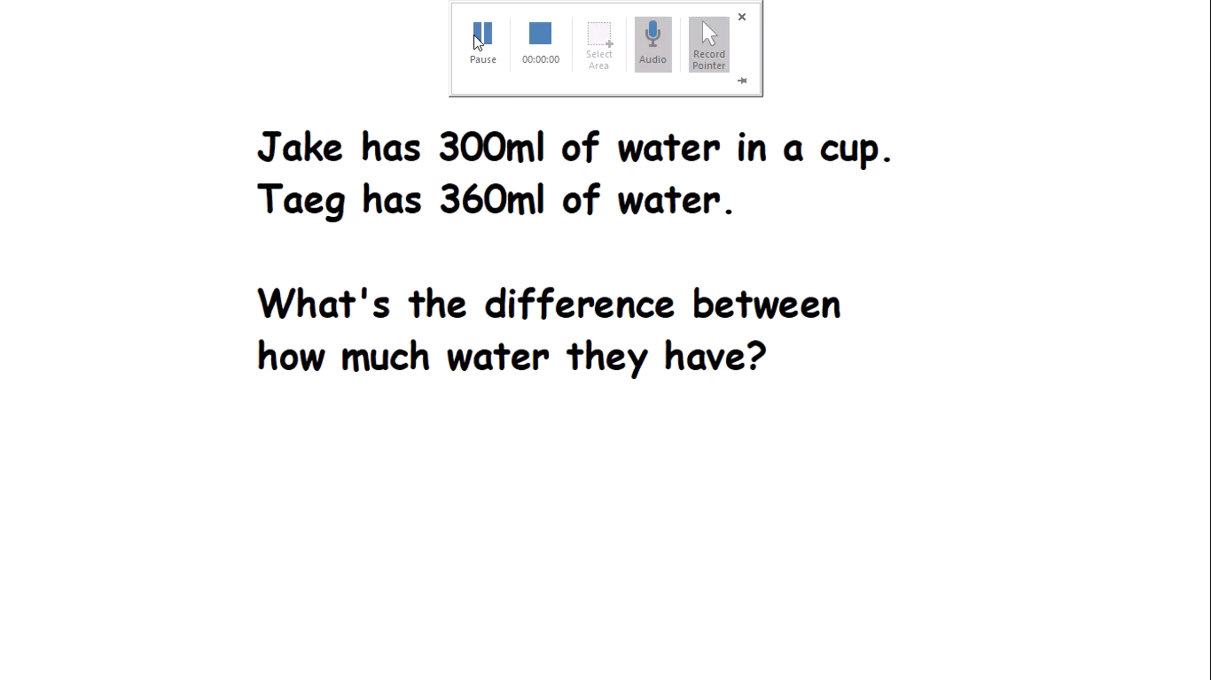
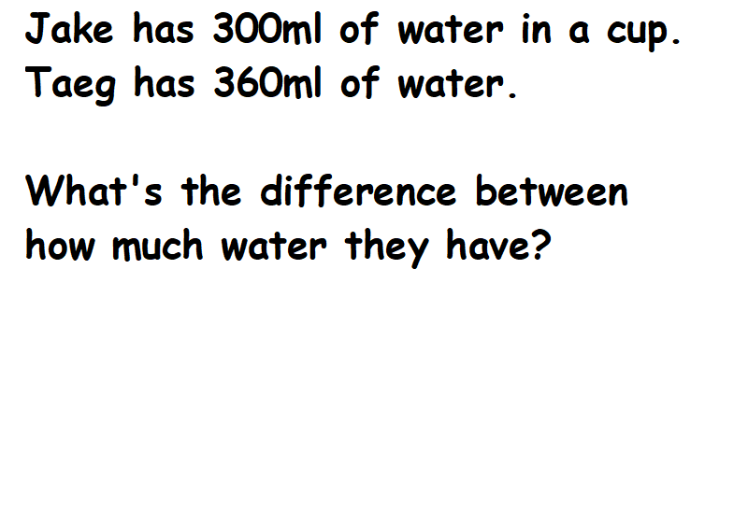

Slide 2
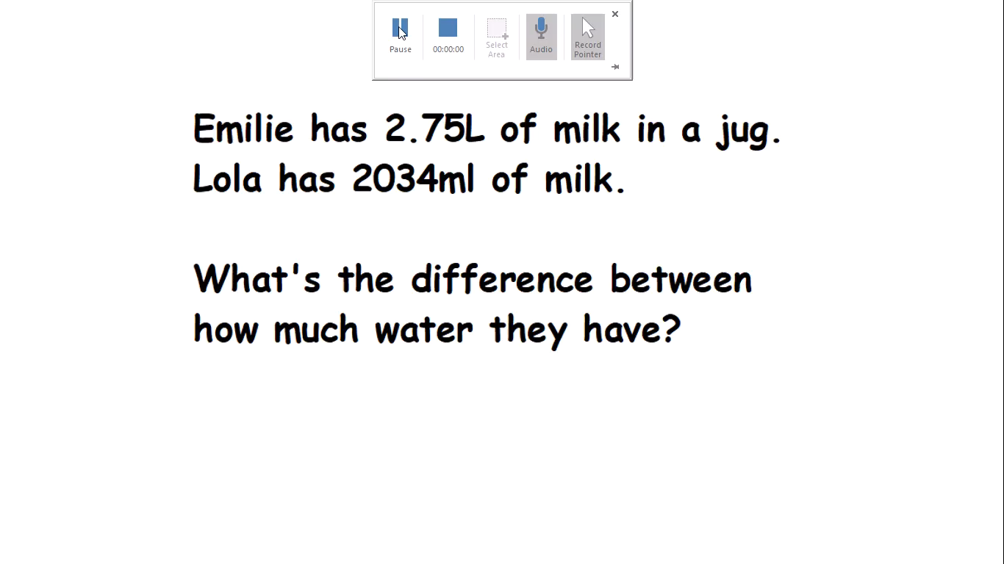
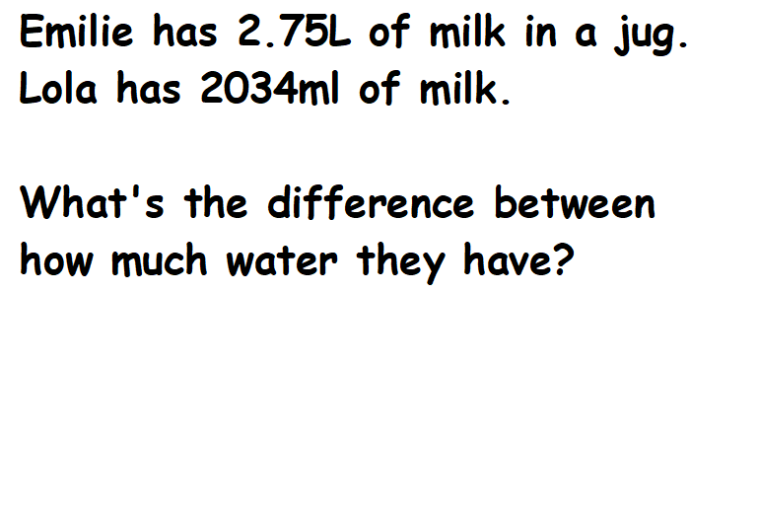

Slide 3
20.03.20
I can find the difference between measurements on two different scales
See worksheets uploaded on the website.
Choose the ‘less tricky’ one if you are feeling unsure or the ‘main’ sheet if you feel confident and want a challenge.

