Slide 1
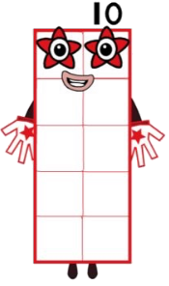
Hello, I hope you enjoyed playing my Numberblocks game yesterday!
Let’s start today with a game of
‘10 or not 10!’

Slide 2
Don’t forget to say whether there are ‘more’ or ‘fewer’.
If you want, you can tell your grown up how many more or fewer there are!

Slide 3
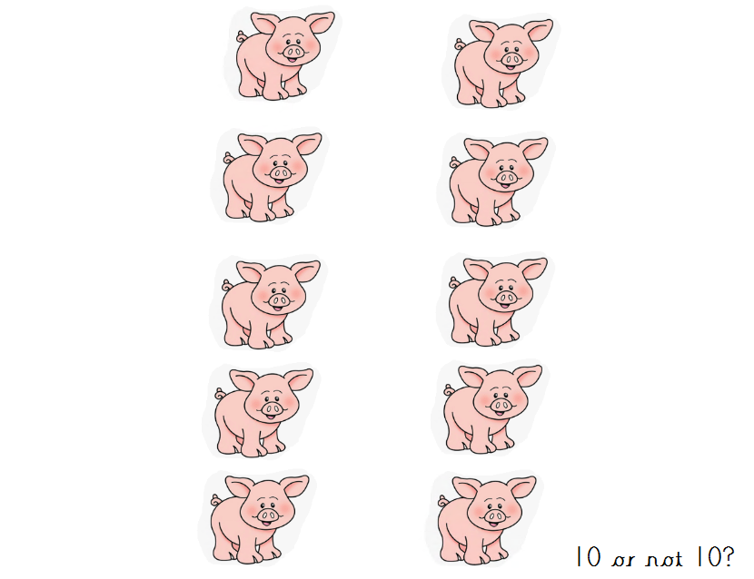

Slide 4
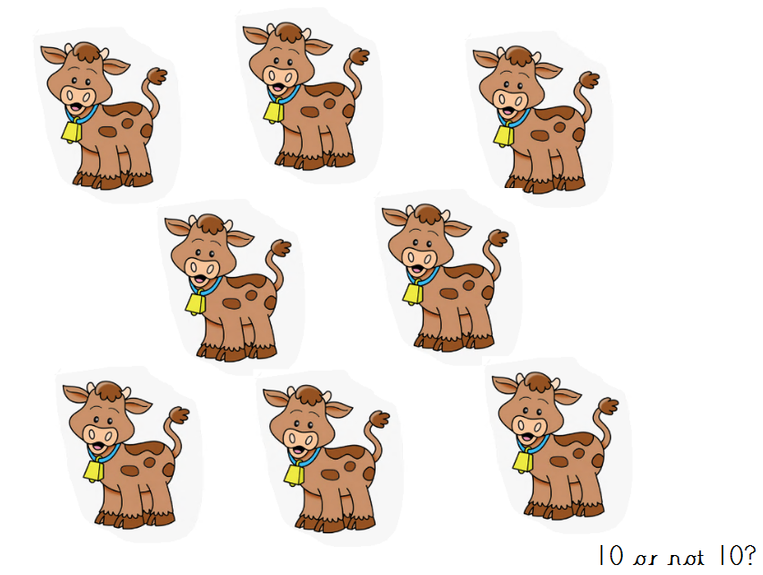

Slide 5
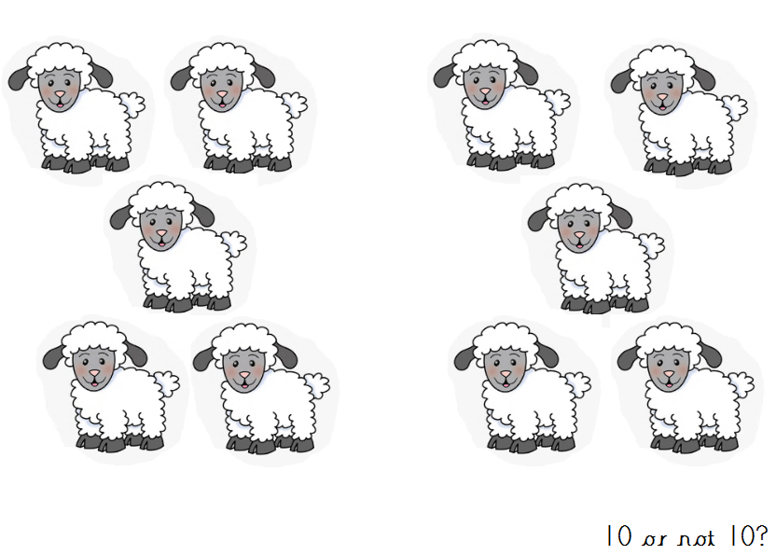

Slide 6
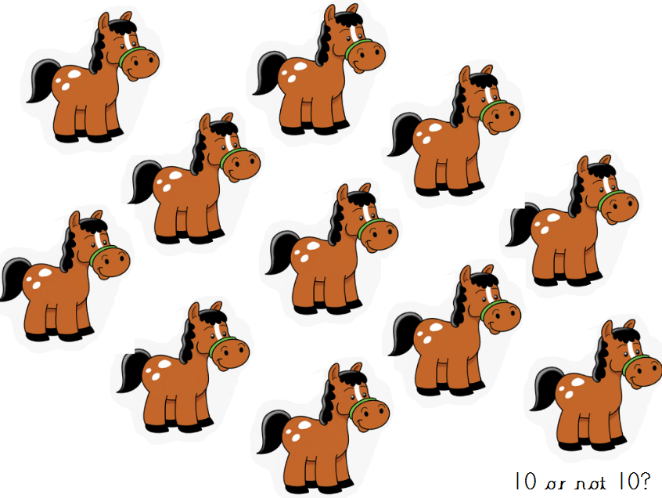

Slide 7
Wow, you did so well!
I think now you are ready to look at my number in lots of different ways.
Can you tell your grown up where you can see 10?
Don’t forget to use your careful counting!

Slide 8
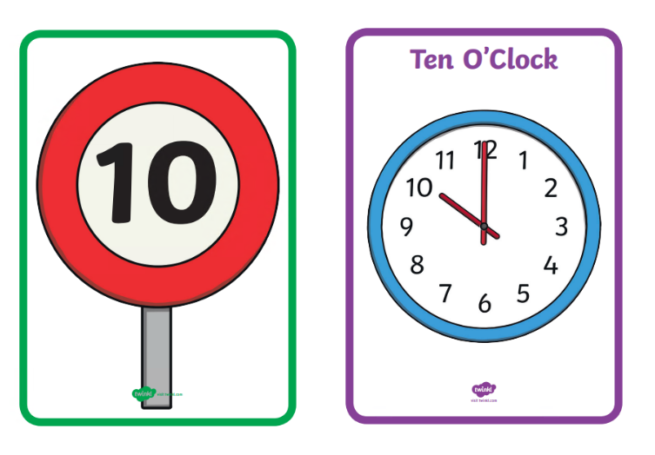

Slide 9
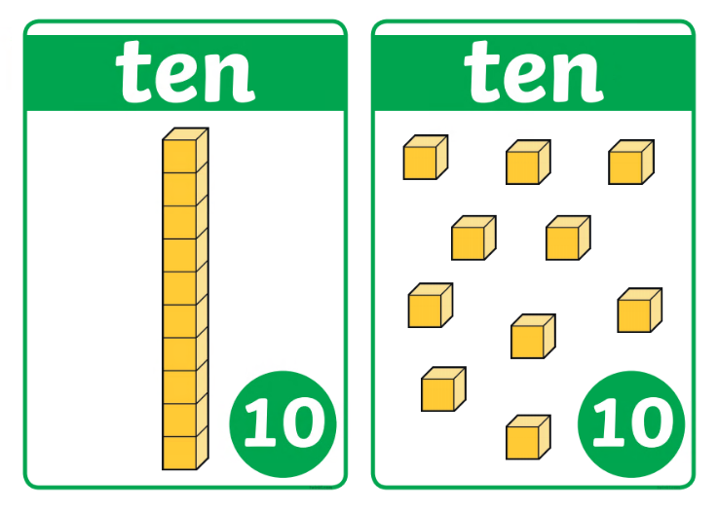
“ I’m 1 ten and 10 ones!”

Slide 10
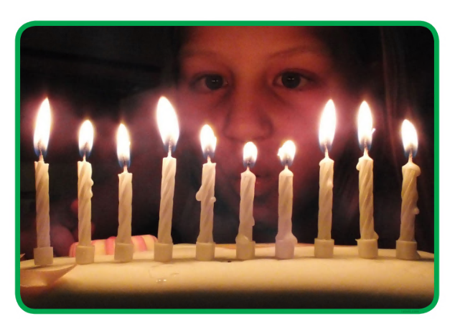

Slide 11
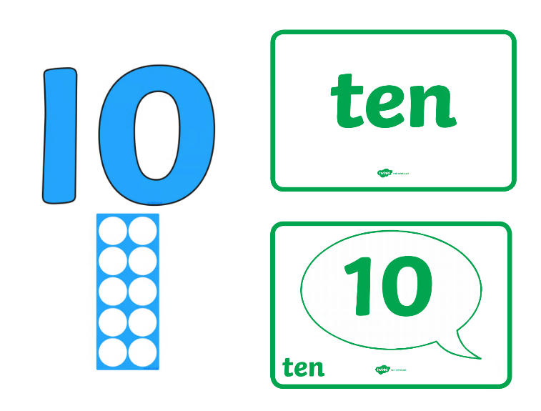

Slide 12
Fab work, give yourself a marshmallow clap! ☺
All the other Numberblocks only have 1 number on top. This means they are a 1 digit number.
Well, I am an extra special Numberblock because I am the first Numberblock to have 2 numbers on top - I have 2 digits and I am a 2 digit number!
My ‘1’ shows I have 1 ten and my ‘0’ shows I have nothing more.

Slide 13
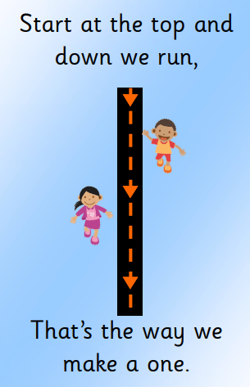
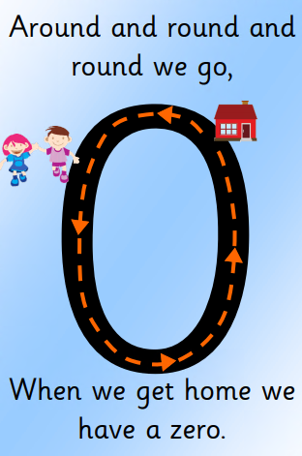
Because I am a 2 digit number we need to write 2 of the numbers we have already learned together.
Can you practice writing my 2 digit number using the rhymes we have learned?

Slide 14
Now write my number in the corner of you page.
Just like you have done with all our other numbers, can you represent the number 10 in as many different ways as you can?
Then click on the next page to see my ideas.

Slide 15
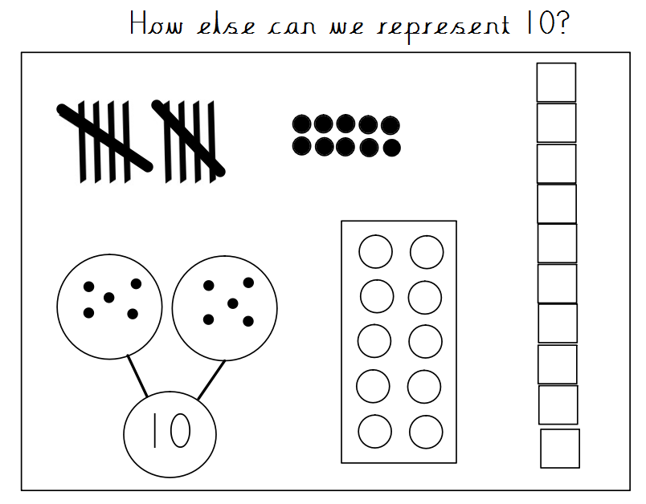
You can also show this in lots of different adding and taking away number facts!

Slide 16
I had fun learning with you today, have a lovely weekend.
I’ll see you next week for some more number 10 fun! ☺

