Slide 1
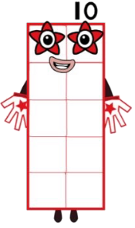
Hello Year R,
Well done for all your hard work yesterday! I loved seeing what you had been up to on tapestry!

Slide 2
Yesterday you used tens frames to make 10.
Today can you subitise and tell me how many are in each of my tens frames?
(Subitising – quickly being able to state how many items there are without having to count them.)

Slide 3
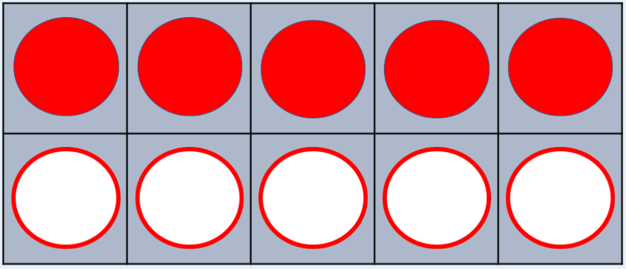

Slide 4
10

Slide 5
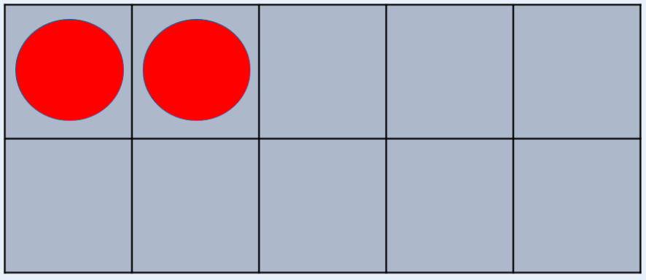

Slide 6
2

Slide 7
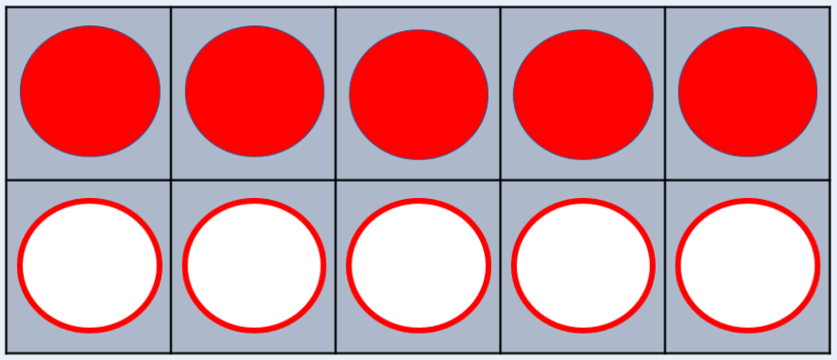
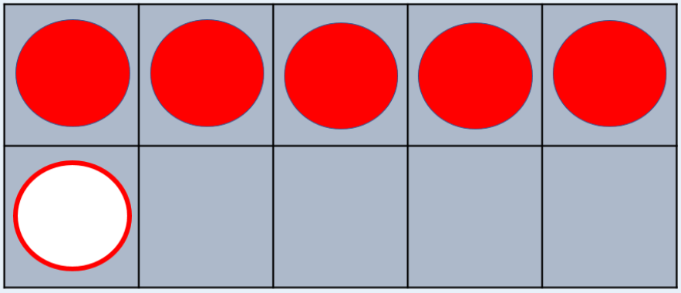

Slide 8
6

Slide 10
10

Slide 11
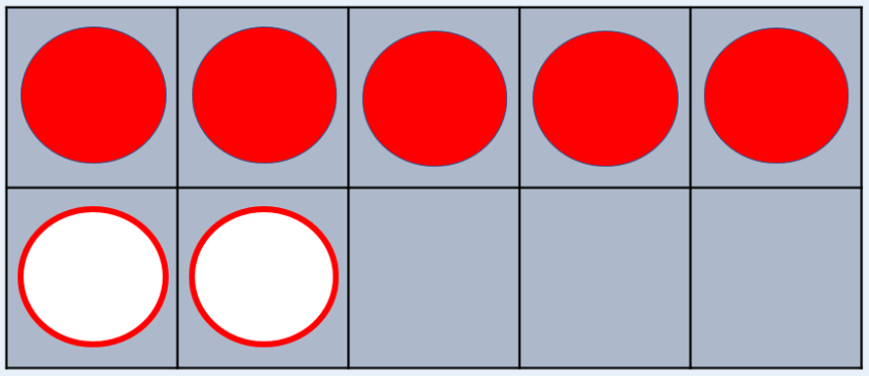

Slide 12
7

Slide 13
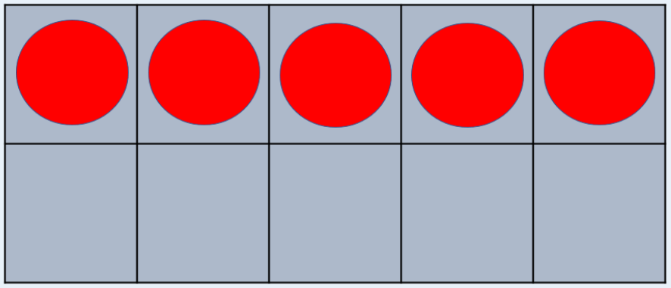

Slide 14
5

Slide 16
10

Slide 17
Super subitising skills!
Give yourself a bubble clap! ☺
On my episode you saw me showing how many ones there were in each number.
I am 1 ten and I have 10 ones.
Can you tell me how many ones are in each of my friends?

Slide 18
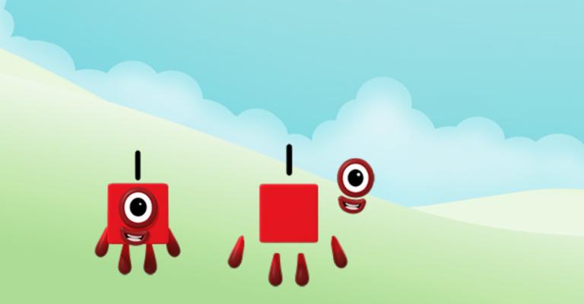

Slide 19
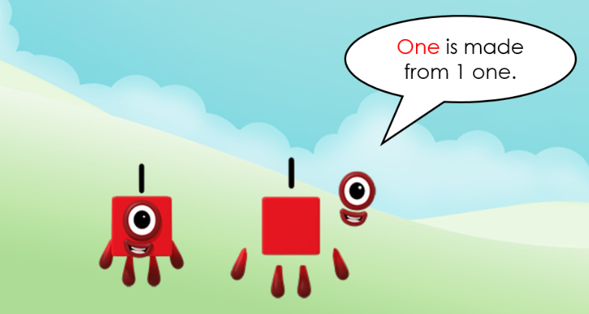

Slide 20
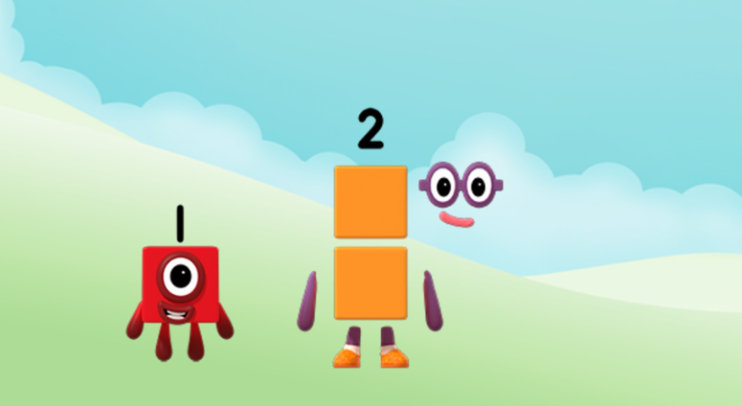

Slide 22
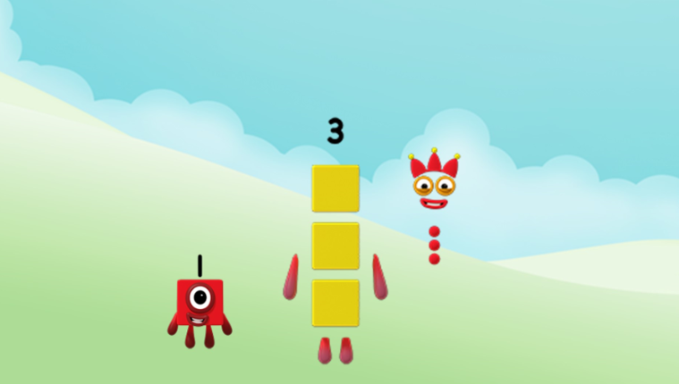

Slide 23
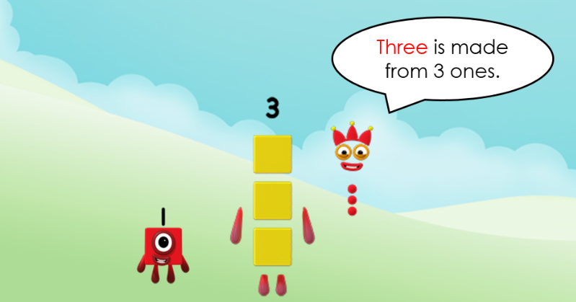

Slide 24
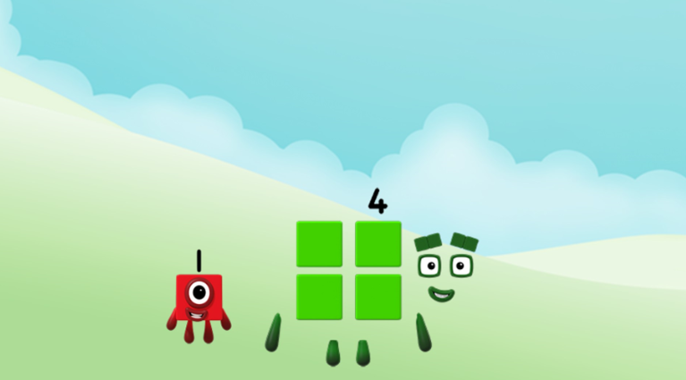

Slide 25
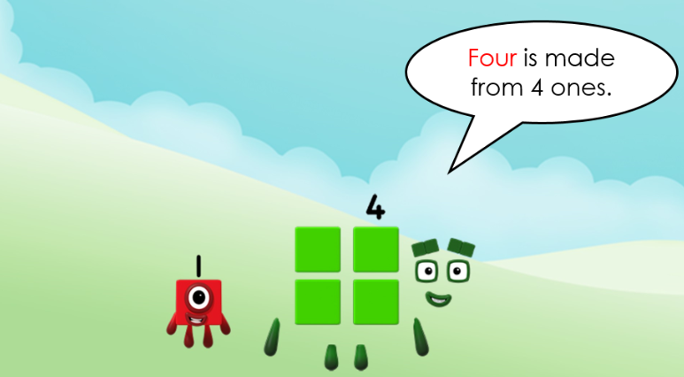

Slide 26
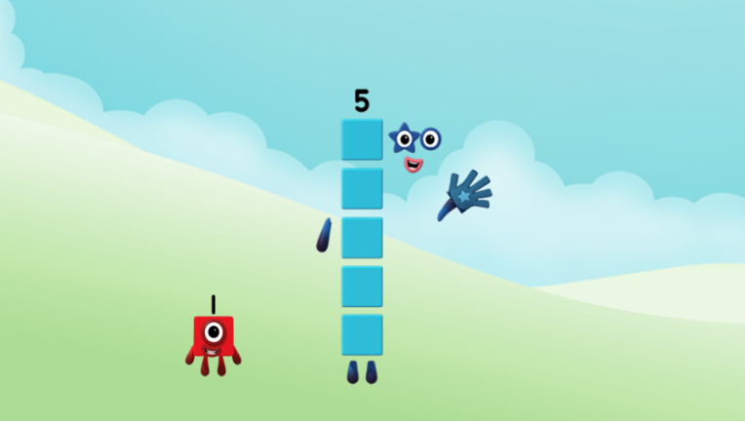

Slide 27
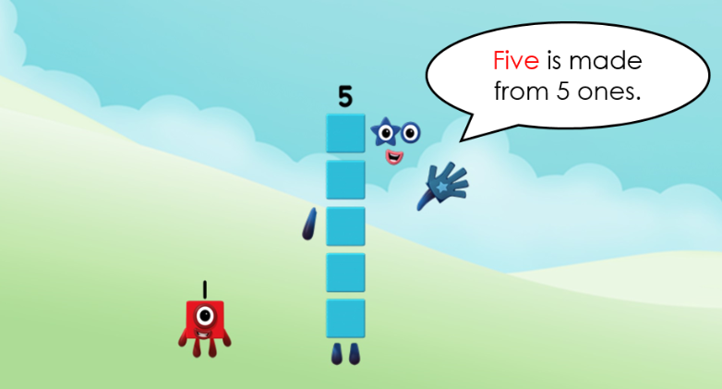

Slide 28
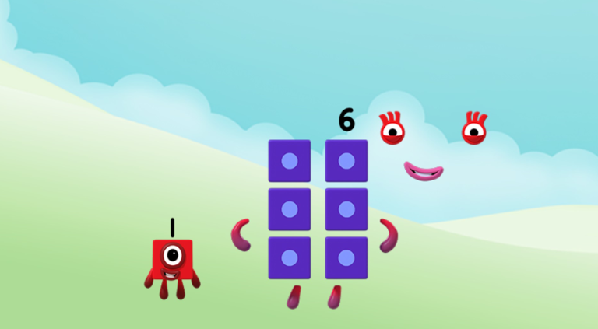

Slide 29
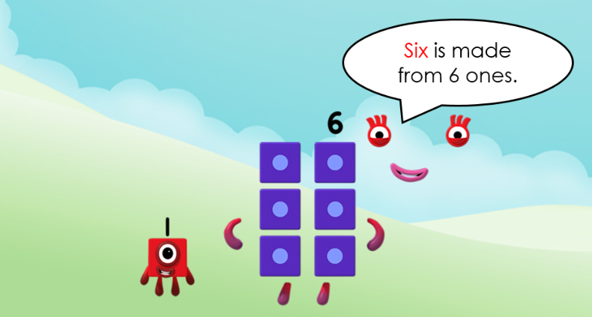

Slide 30
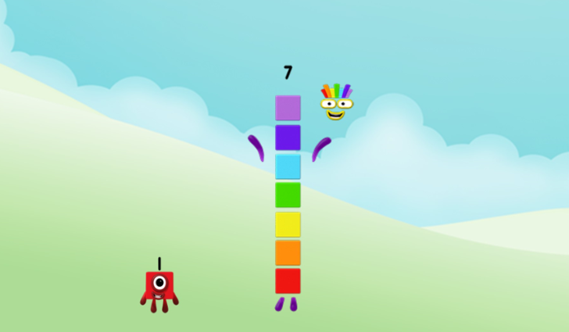

Slide 31
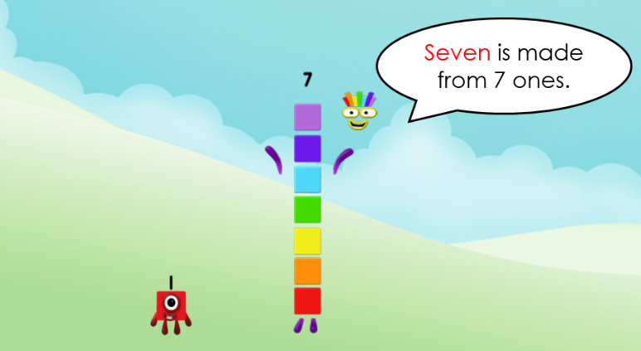

Slide 32
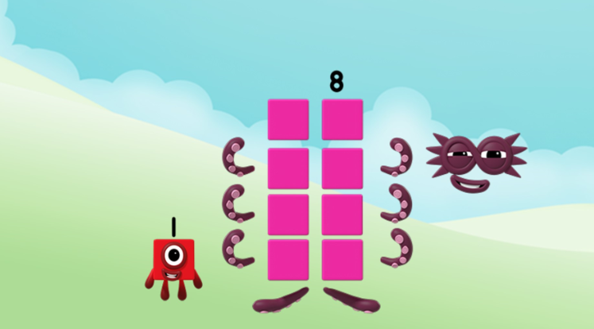

Slide 33
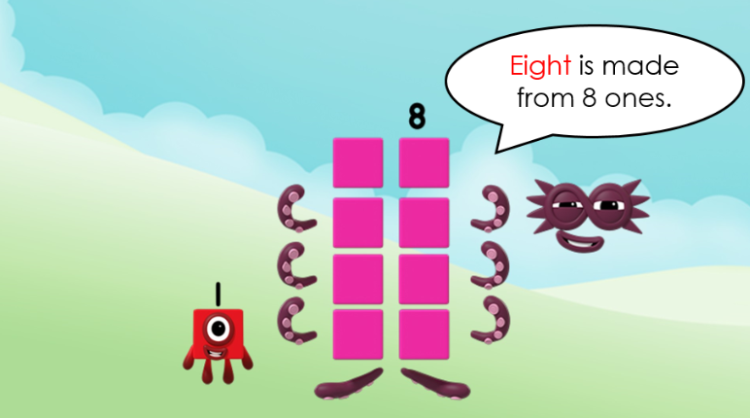

Slide 34
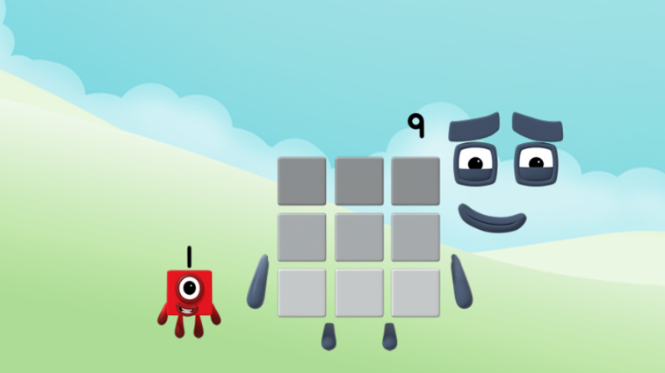

Slide 35
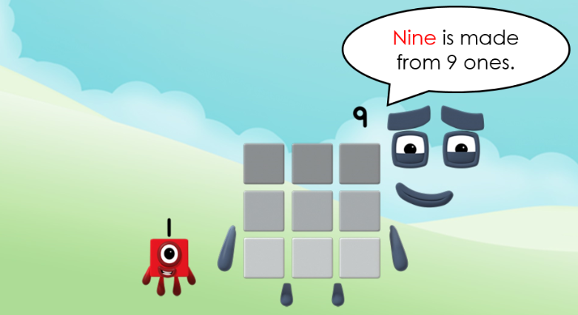

Slide 36
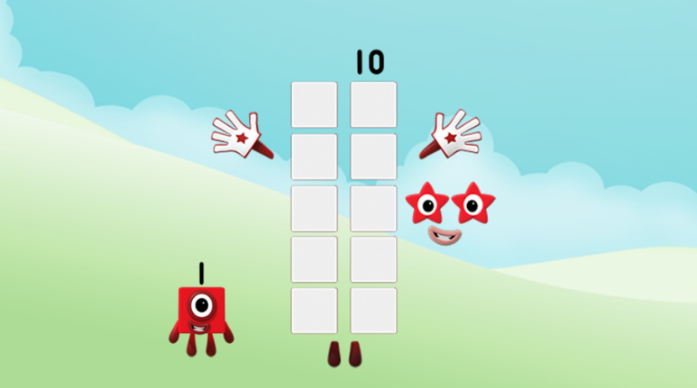

Slide 37
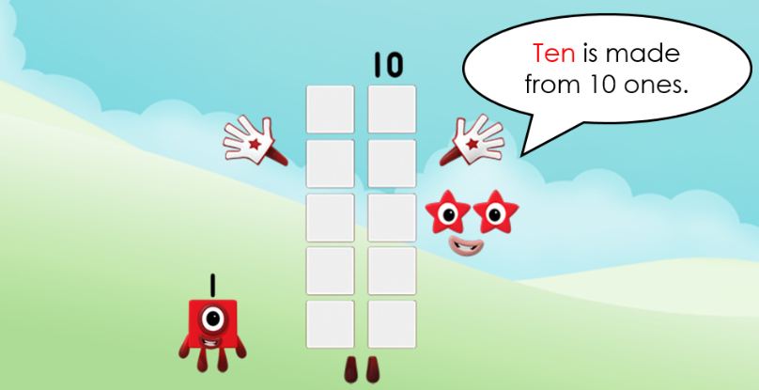

Slide 38
Wow, you have worked so hard today!
Time for a little reward I think!
Click on the link on the next page to come and meet us all on a fun game.
Don’t forget to say how many ones are in each number you meet.
Have fun! ☺

Slide 39
https://www.bbc.co.uk/cbeebies/games/numberblocks-make-and-play

