Slide 1
Maths
I can find the difference between measurements on two different scales

Slide 2
Success in Seven

Slide 3
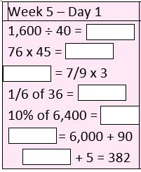
Success in Seven answers

Slide 4
Converting between grams, kilograms and tonnes
g kg
kg tonnes

Slide 5
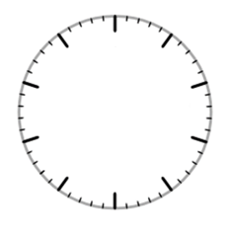
Reading scales

Slide 6
23.03.20 I can find the difference between measurements on two different scales See worksheets uploaded on the website. Choose the ‘less tricky’ one if you are feeling unsure or the ‘main’ sheet if you feel confident and want a challenge. Use the answer sheet to check your answers when you have finished. No peeking!

