Slide 1
Maths
I can solve two step problems involving converting

Slide 2
Success in Seven

Slide 3
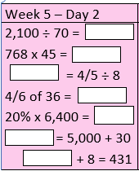
Success in Seven answers
30
34,560
4/40 or 1/10
24
1280
5,030
423

Slide 4
Key conversion facts for today:
ml → L
1000ml = 1L
2460ml = 2.46L
L → ml
1L = 1000ml
5.301L = 5301ml
¼ L means ¼ of 1000ml = 250ml
½ L means ½ of 1000ml = 500ml
¾ L means ¾ of 1000ml = 750ml
So…
1¼ L = 1,250ml
1½ L = 1,500ml
1¾ L = 1,750ml

Slide 5
24.03.20 I can solve two step problems involving converting See worksheets uploaded on the website – complete part 1. Use the answer sheet to check your answers when you have finished. No peeking! Move onto the next slide to think about part 2.

Slide 6
Part 2: Use this example of the first one to help you solve the rest
Amber wants to fill a jug with orange squash.
Her jug holds 1 litre.
Her cup holds 500ml.
How many cups of squash does she need to fill the empty jug?
Step 1 – convert 1litre into 1000ml
Step 2 – 1000ml ÷ 500ml → How many 500ml go into 1000ml? 2

