Slide 1
Maths Warm Up Questions

Slide 3
Using bar charts and pictograms.
We can show information in bar charts as well as on pictograms.
On a pictogram, it is really important to look at the key to see what each individual picture represents.
This is the same with a bar chart. The numbers on the side are called the scale. The scale can go up in different size jumps depending on how many things are being counted.
Remember to look at the scale so you look at the information on the bar chart correctly.

Slide 5
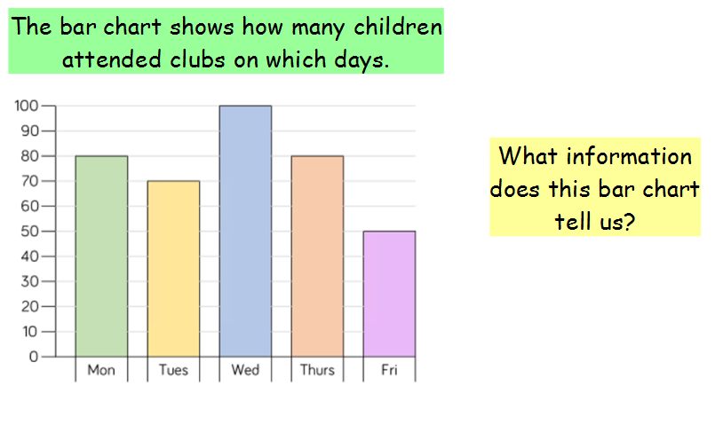
Why aren’t Saturday and Sunday on the chart?
Look carefully at the scale.

Slide 6
How many children went on each of these days?
Look carefully at the scale.

Slide 7
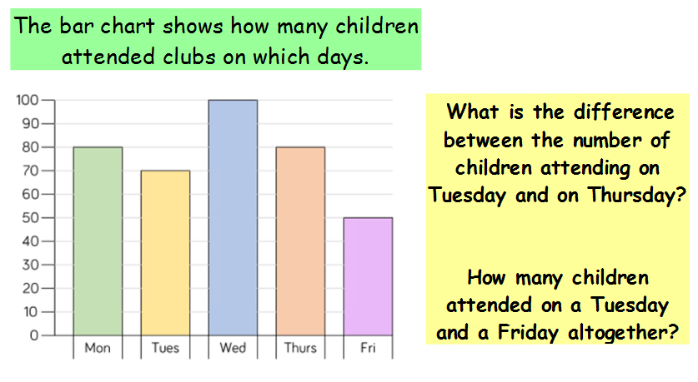
Look carefully at the scale.

Slide 8
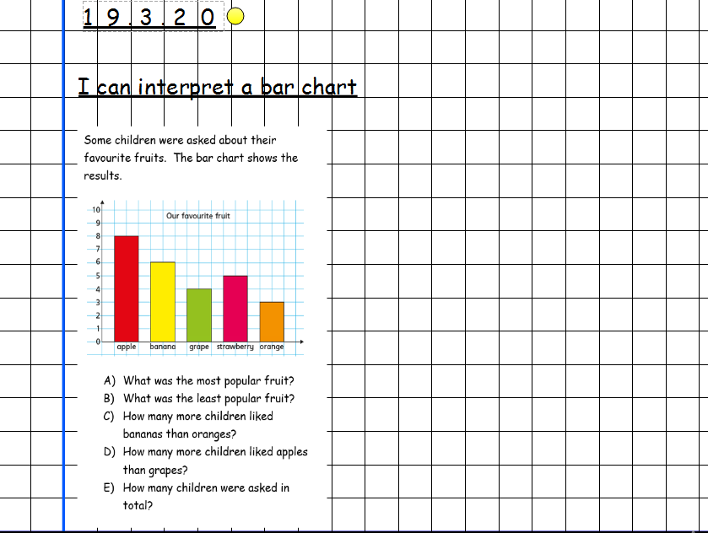
Remember to show how you worked out your answers. This might be a calculation.

Slide 9
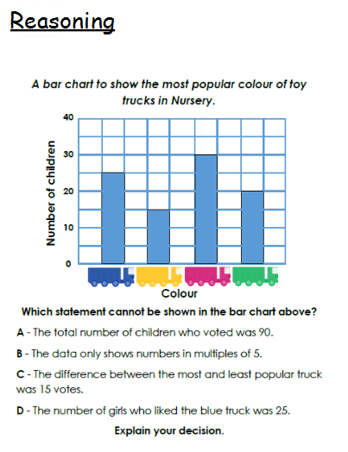
Remember to show how you arrived at your decision. This might be a calculation.

