Slide 1
Miss Pettitt’s Excellent Excel Computing Challenge
This has nothing to do with today’s task, but doesn’t it look yummy?! Mmm…

Slide 2
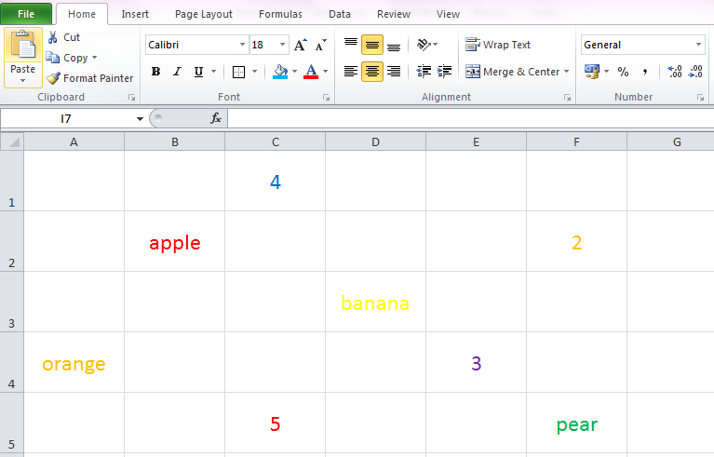
Introducing Spreadsheets Formatting Cells
Each box is called a ‘cell’
Font Style
Borders
Font Size
Cell Colour
Font Colour
Click and drag between rows or columns to adjust height or width.
Click on a row or column heading to highlight entire row or column.
To refer to a cell, we read the letter and then the number. This cell is C4.
This one is D4

Slide 3
CHALLENGE 1: Open the attached spreadsheet named cells and data or just refer to the one below.
Identify the cell reference for each item…
orange = 4. 4 = 7. 2 =
apple = 5. 5 = 8. pear =
banana = 6. 3 =

Slide 4
ANSWERS – how did you do?
orange = A4 4. 4 = C1 7. 2 = F2
apple = B2 5. 5 = C5 8. pear = F5
banana = D3 6. 3 = E4

Slide 5
CHALLENGE 2: Now have a play around with the spreadsheet. Have a go at formatting the cells using some of the features shown on the first slide.
Can you change the font colour?
Can you add a border?
Can you change the size and style of the font?
Can change the colour of a cell?

