Slide 4
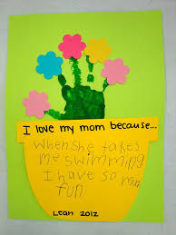
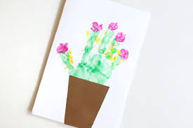
In school this week we would have been making these to take home to celebrate Mother’s Day.
If you already have some paint at home and wanted to make one then here are the instructions of what to do:

Slide 5
1 - Paint your whole hand green using a paint brush and place your hand down on a piece of paper.
(Don’t forget to keep your fingers nice and still!)
2 – Using your thumb (it’s a little bigger than your fingertips) paint it a bright colour and print it above each of your fingers to make the middle of each flower.
3 - Clean your thumb and then paint it a different colour and print to make the petals for each of your flowers.
You can choose which colours you want to use.
4 – Next make a pot out a different piece of paper and complete your ‘I love my Mummy because … ‘ writing.
(There is link to download and print this writing frame on the main post. Alternatively you can draw a pot and write on it)
5 – Stick the pot the bottom of your handprint.
6 - Be proud of your wonderful creation and give it to your Mummy on Sunday along with a big cuddle! ☺

Slide 6
If you did want to make me
then there is a link to download and print this writing frame on the main post.
If you want to make me but don’t have a printer you can always draw me. ☺

