Slide 1
RE - Monday

Slide 2
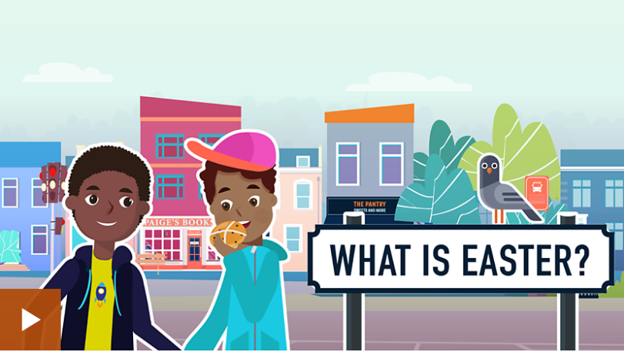
Watch the ‘What is Easter?’ film on this webpage. www.bbc.co.uk/bitesize/topics/ztkxpv4/articles/z4t6rj6

Slide 3
Watch it again and this time note down any important phrases that someone might need explaining e.g. Palm Sunday
Read through the rest of the web page.
Can you explain what these words mean and what Christians think about them to someone who you are living with?

Slide 4
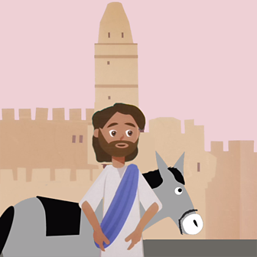
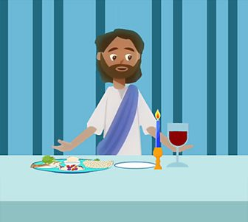
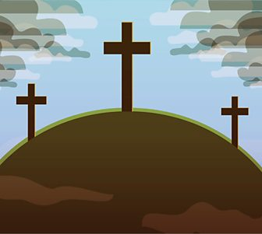
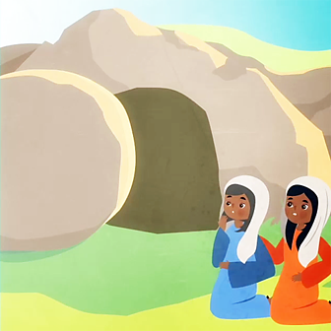
As you read through the web page, you will find information about 4 important days in what Christians call Holy Week; Palm Sunday, Maundy Thursday, Good Friday and Easter Sunday.

Slide 5
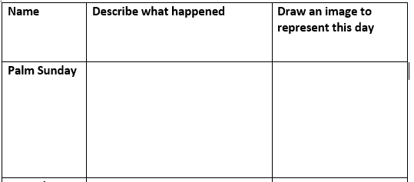
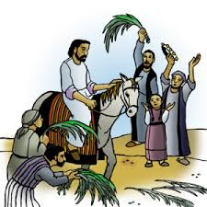
I can describe the event of Holy Week.
Fill in the grid (attached on web page) – I have done the example of the first one
This is the first day of Holy Week, and celebrated Jesus’ arrival in Jerusalem riding on a donkey. Crowds of people came to greet him throwing palm branches

