Slide 1
Thursday 19th March

Slide 2
Early Morning Work

Slide 3
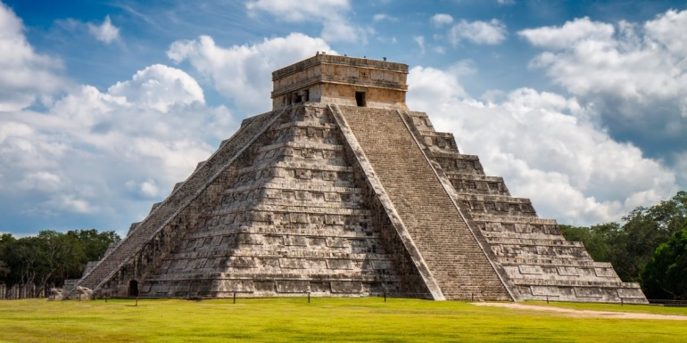
Reading challenge
How many pages of your book can you read in 15 minutes?

Slide 4
SPaG Morning Challenge

Slide 6
Write the correct contraction to replace the underlined words.
I can not eat that cake; it is too big!
He will not go outside because he is afraid.
I will try my best but I can not promise to get it right.
Do not shout at me or I will send you to your room.
You are making me so proud today!

Slide 7
6C and 6S Maths

Slide 8
Success in Seven

Slide 9
Starter:

Slide 10
Starter:

Slide 11
Starter:

Slide 12
Enough of my voice!!
See worksheets uploaded on the website.
Choose the ‘less tricky’ one if you are feeling unsure or the ‘main’ sheet if you feel confident and want a challenge.

Slide 13
6P Maths

Slide 14
I can apply my arithmetic knowledge
Have a go at the following arithmetic questions
https://myminimaths.co.uk/year-6-arithmetic-practice-paper-week-2/
You can then check your answers here:
https://myminimaths.co.uk/year-6-arithmetic-practice-paper-week-2-answers/
No peeking!!

Slide 15
English

Slide 16
How could you describe these Maya adventure story scenes?

Slide 18
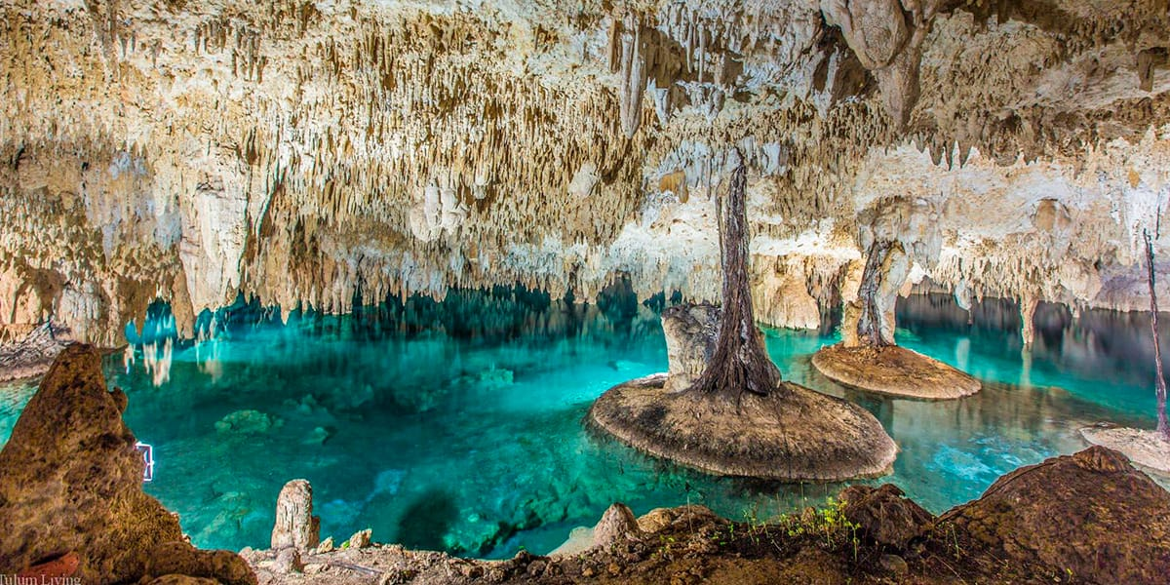

Slide 19
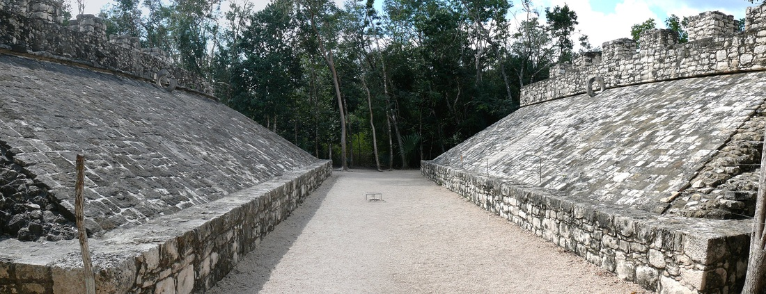

Slide 20
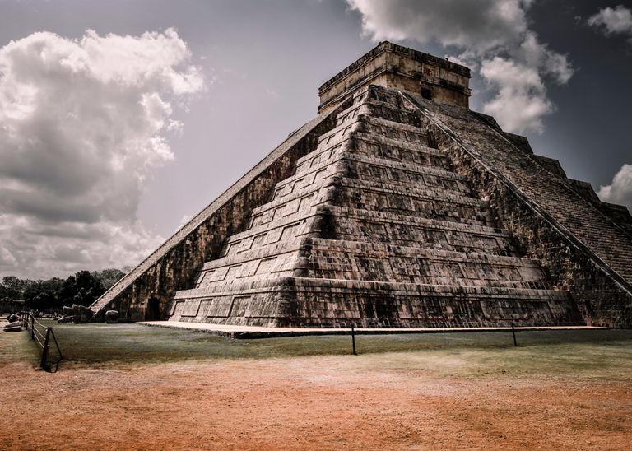

Slide 21
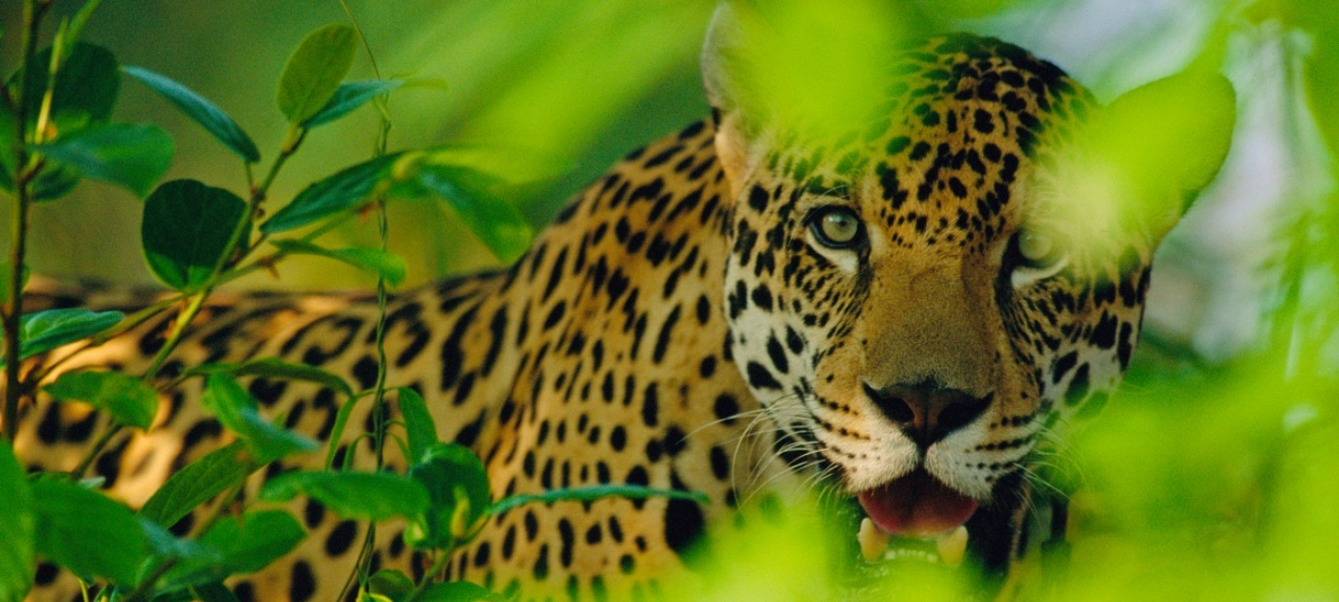

Slide 22
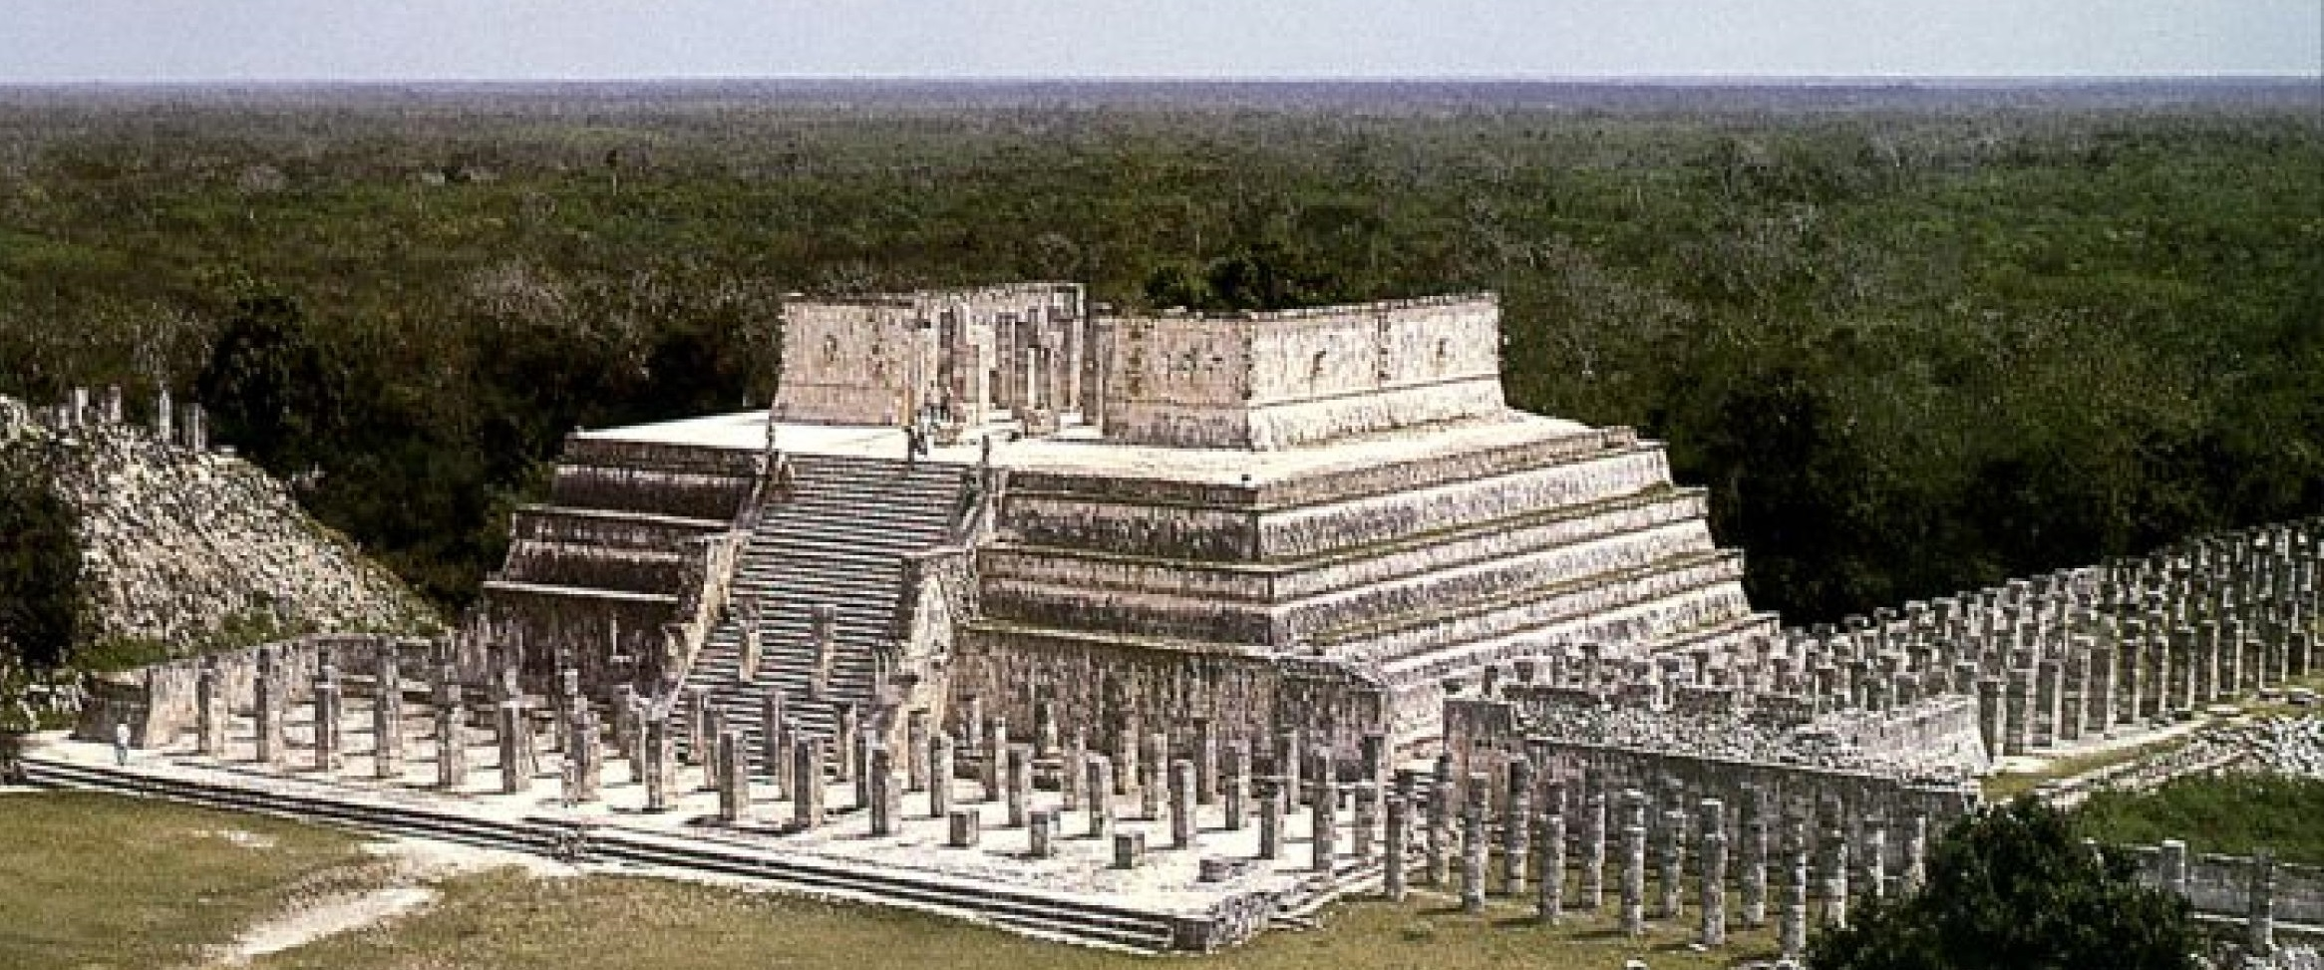

Slide 23
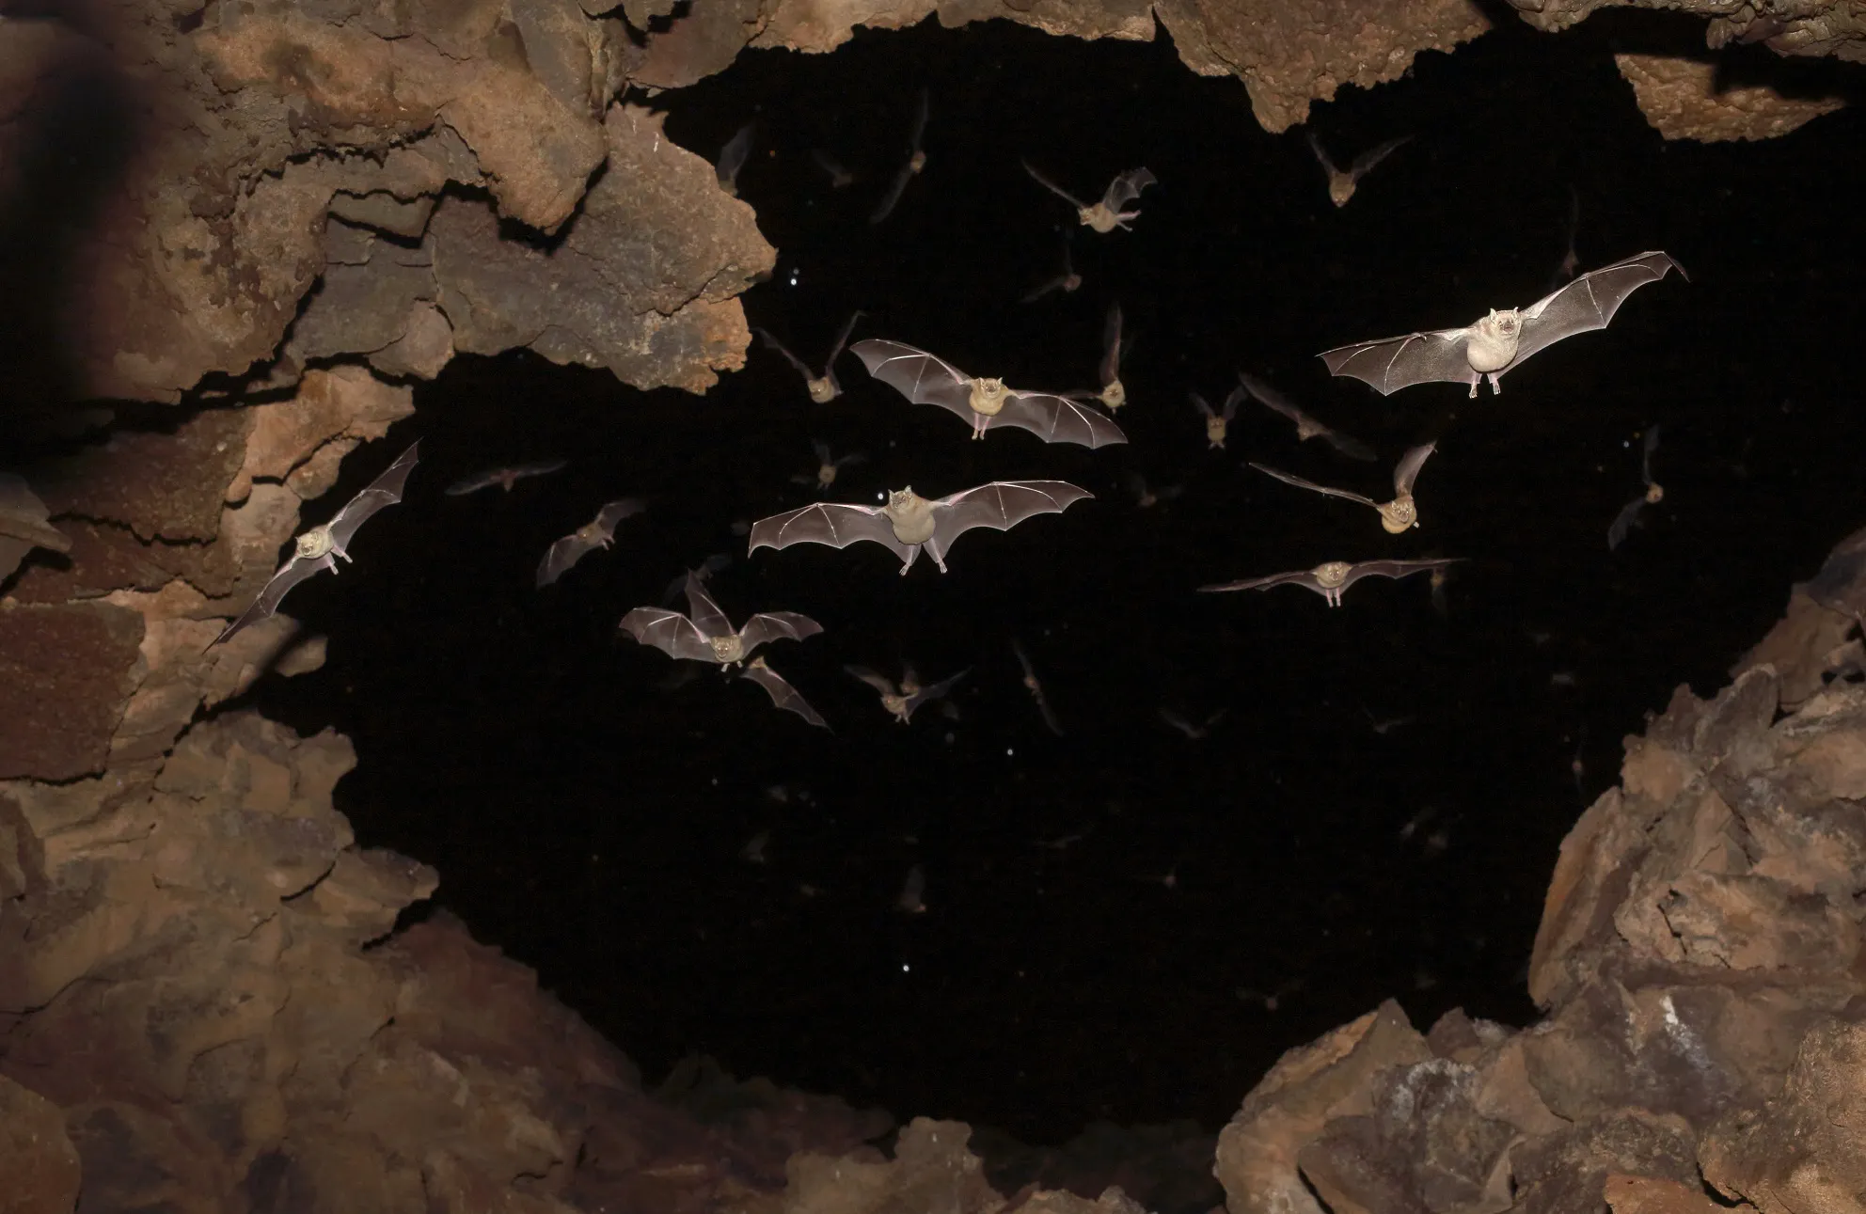

Slide 24
Which picture do you think these descriptions are referring to?
Perfectly carved stone steps led the way to the highest point where the sacrificial altar lay. It was a tribute to the great god, Kulkulcan.
Bats flitted in the midnight skies
The king of the jungle’s predators espied his victims behind the cover of the lush foliage
The steeply sloped edges of the pok-a-tok court held secrets from times of sacrifice
Aqua-marine colours shimmered in the light that filtered through into the sacred cenote
Crystal clear waters
Azure blue
Stalactites descended from the cavernous ceiling
Stalagmites grew upwards like the outstretched arms of excited children reaching out for sweets
Stone monuments stood proudly amidst the jungle clearing
Fragile wings outstretched in the moonlit skies
Stone giants rose from the ground
Sky blacker than pitch
Marble pillars stood tall like proud centurions in formation around the grand pyramid

Slide 25
I can describe scenes for my Maya adventure story
Write your own descriptions for each of the following scenes:
Cenote
Pok-a-tok Court
Jaguar
Temple
Bats in a cave
Remember to use your neatest handwriting and underline your title and subheadings with a ruler/straight edge!

