Slide 1
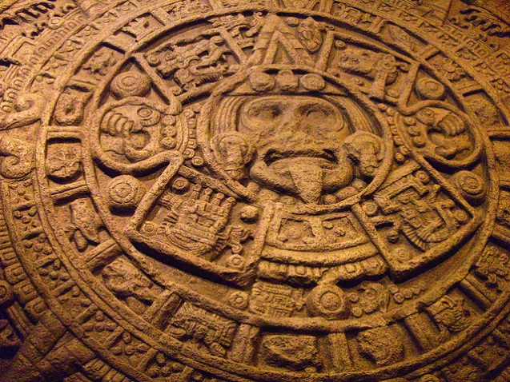
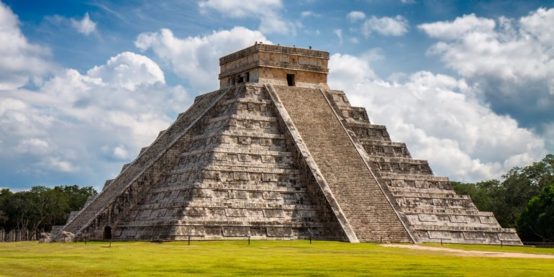
Early Morning Work
Create some sentences about the Mayans that use past progressive verbs.
was / were + ing VERB
e.g. The Maya were pacing to find the Golden Idol.

Slide 2
6S and 6C Maths
I can calculate duration of time

Slide 3
Success in Seven

Slide 4
Starter: What do you already know about time?

Slide 5
Starter:

Slide 6
Starter:

Slide 7
Activity:

Slide 8
Activity:

Slide 9
6P Maths
I can find the difference between
measurements on two different scales

Slide 10
Success in Seven

Slide 11
Starter:

Slide 12
Starter:

Slide 13
Starter:

Slide 17
I can plan an exciting adventure story with several challenges using the Indiana Jones story as a stimulus.

Slide 18
Try to recall the scenes we watched from the film clips of Indiana Jones.
Indiana didn’t face just one problem in these film clips. He had to escape from danger many times in a short amount of time. This makes for an exciting story.
Here are the dangers(challenges) he had to overcome:
A gun was pointed at his head when he studied the ancient map
Tarantulas crawled upon their backs
A deep, deep pit opening stopped them from continuing their journey through the tomb easily
The Spanish man nearly fell down the pit
A trap was set to kill them with an arrow#
The gold idol had to be replaced with an item of exactly the same weight
The bullwhip became unattached from the wooden log leaving Indiana stranded and his traitor free to escape with the treasure.

Slide 19
All these problems were overcome in a short time period allowing the hero to continue his quest.
Now it’s your turn to plan your own adventure story.
Remember, your introduction is already done – you know your main character is Indiana and you have set the scene in the jungles of Mexico amid the Maya ruins. You have also unveiled to the reader what the special treasure from Maya times your hero is searching for.

Slide 20
Use the planning format attached or design your own planning structure to map out your dangers faced along Indiana’s quest to get his hands on the special artefact.

Slide 21
Once you’ve written your plan, keep it safe as we will need it when we write the continuation of our stories.
Remember your story must make sense to you without missing gaps in how the story grows. If you don’t picture the story in your mind first, it’ll be hard to make it come to life for the reader.
Enjoy!

Slide 22
Well done Year 6 ☺

