Slide 1
Chapter 8
Read Chapter 8 of the Hodgeheg.

Slide 2
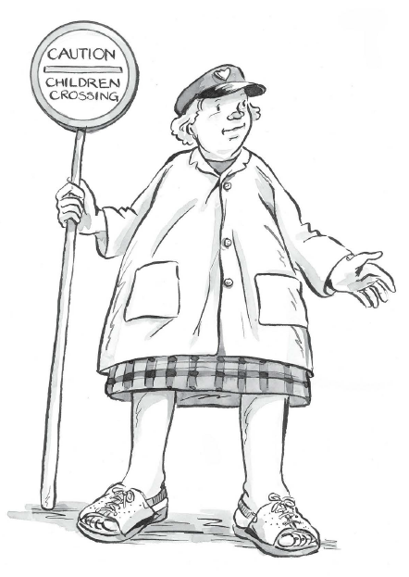
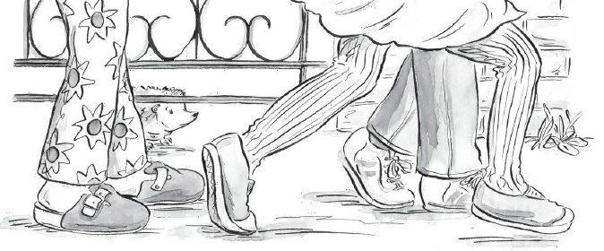
In the story Max was trying to find a way to cross the road safely.

Slide 3
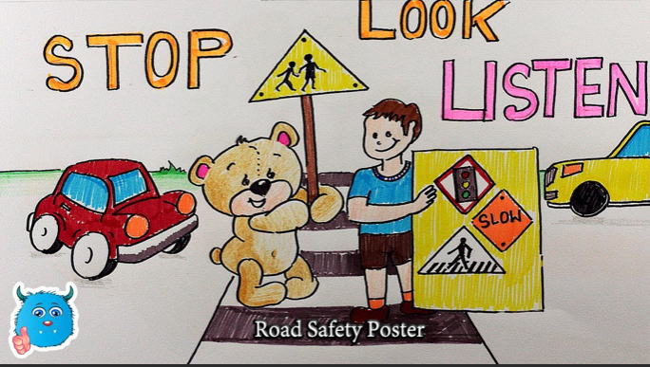
Watch this song about the Hodgeheg and road safety
https://www.youtube.com/watch?v=2o2PSotuqjY

Slide 4
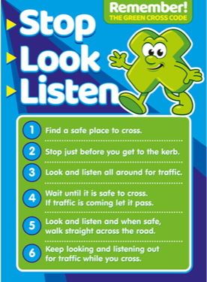
On a piece of paper create your own road safety poster to help Max cross the road safely.

