Slide 5
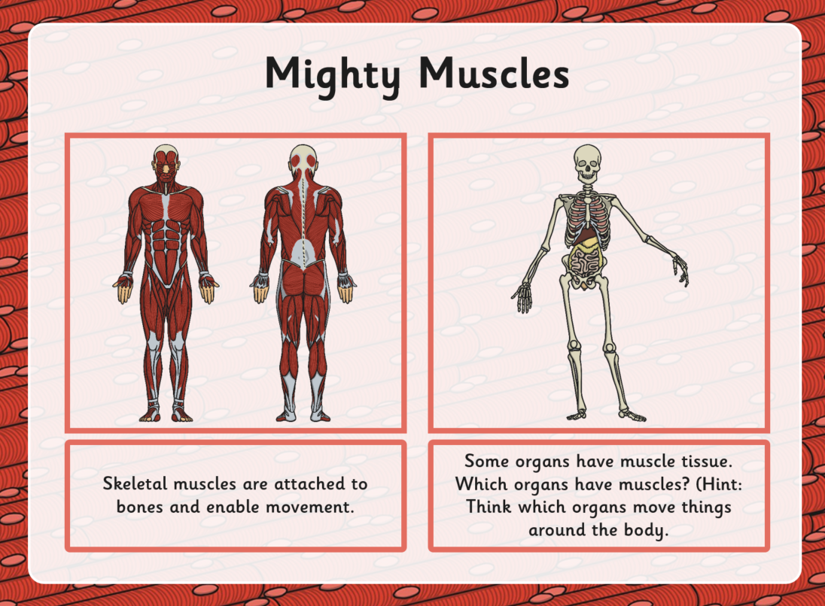

Slide 6
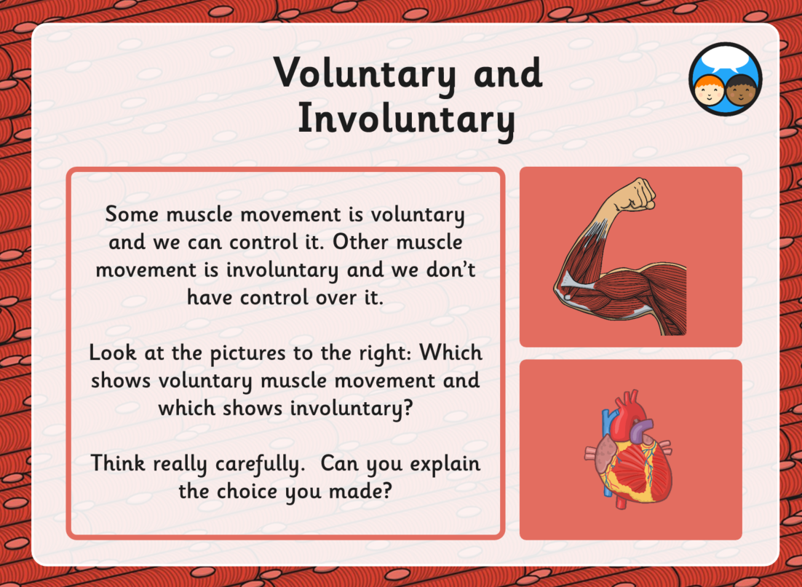

Slide 8
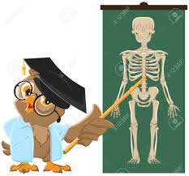
Challenge!
Can you be a science professor and explain to your family how your skeleton and muscles work? Can you do a little presentation (talk) and teach them 3 new facts, such as how many bones there are in the human body?
Help your family learn what the different functions of the skeleton are or how it moves. You could teach them the names of some of the bones or explain how a joint works.
Try to use scientific vocabulary. You could use one of your toys, such as a teddy bear, to help with your explanations and show them how and why our arms and legs move.
Be creative and have fun!
Remember to look back at the other home learning
science tasks to help you.

