Slide 1
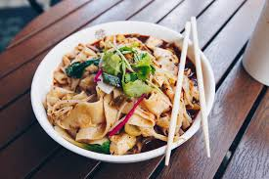
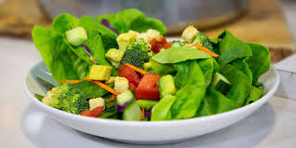
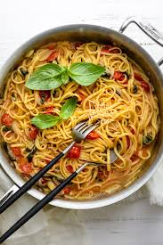
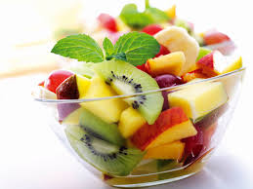
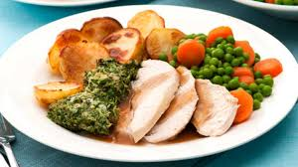
DT
So far in class we have discussed lots of different things to do with the food we eat.

Slide 3
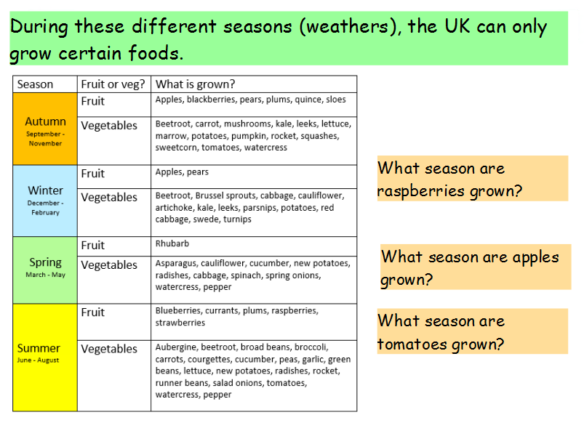

Slide 4
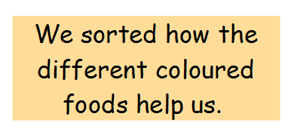
Eat the rainbow!

Slide 5
Our next step was to design and make our own healthy fruit tarts.

Slide 6
These are the objectives we wanted you think about:
1. I understand what it means to have a healthy and varied diet.
2. I can prepare and cook a healthy vegetable tart using a range of cooking techniques.
3. I know that different foods are grown and processed in different places around the world and at different times of the year (seasonality).

Slide 7
Challenge! Can you find a way of achieving these objectives at home?
Why not design your own healthy menu for a day at a restaurant. Can the customer
“Eat the rainbow?”.
You could think about where the different foods you are eating each day are coming from.
You could help make lunch or dinner with a grown up and wash and prepare the vegetables.
Make sure you do this safely and always with an adult!

