Slide 1
Year 3 | Week 7 | Day 1

Slide 2
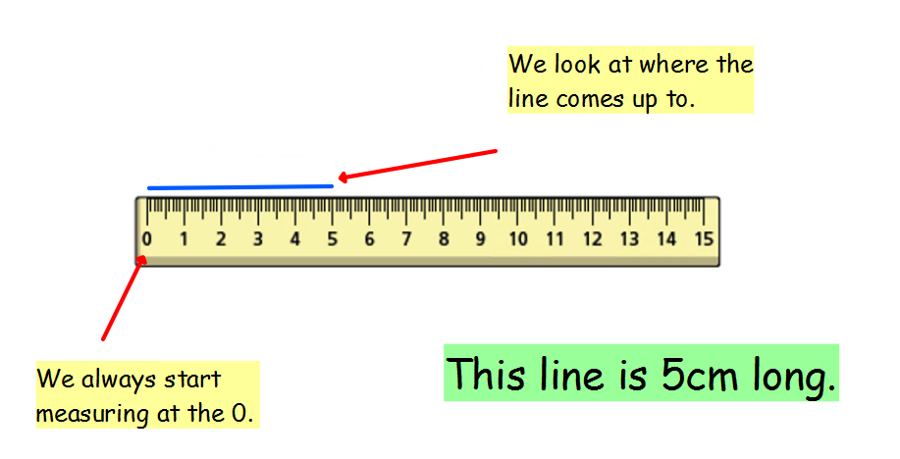

Slide 6
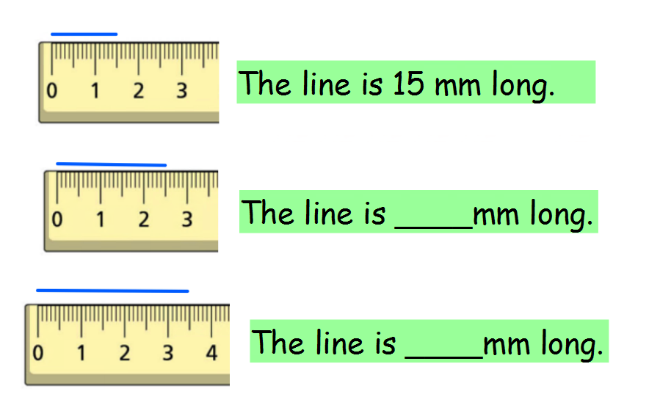

Slide 7
