Slide 1
Muscles for Moving
I can explain how muscles work.

Slide 4
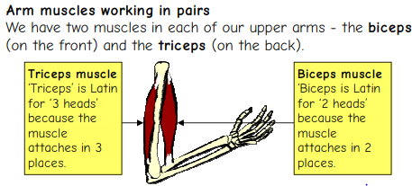

Slide 5
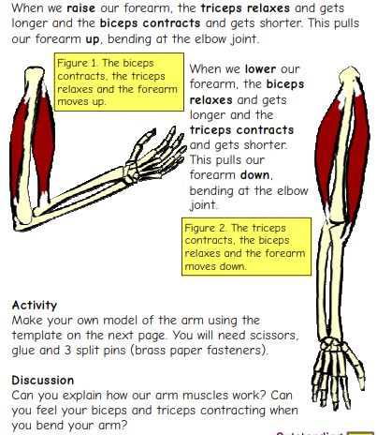

Slide 6
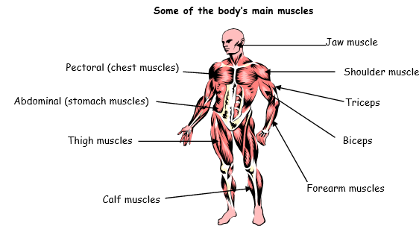
Identifying and using muscles.

Slide 7
