Slide 1
Year 3 | Week 7 | Day 2

Slide 2
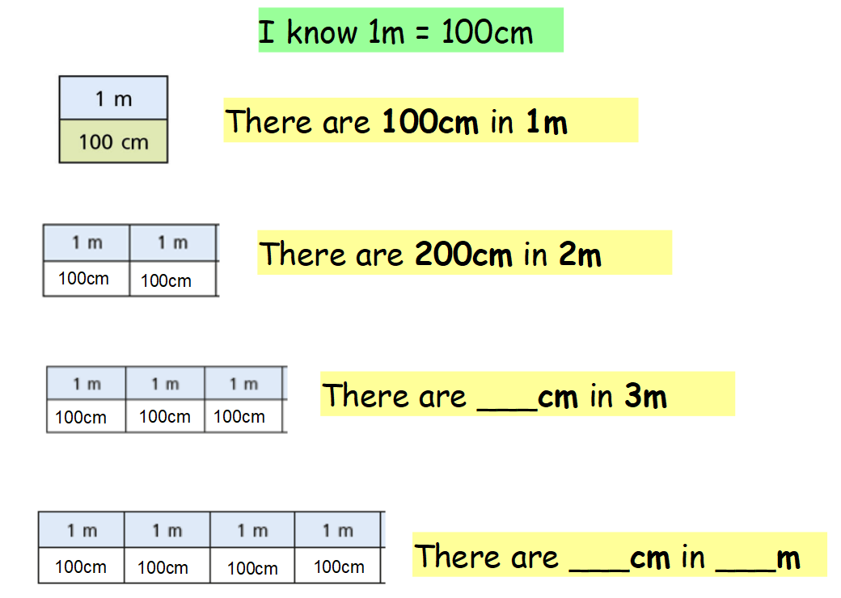
300
400
4

Slide 3
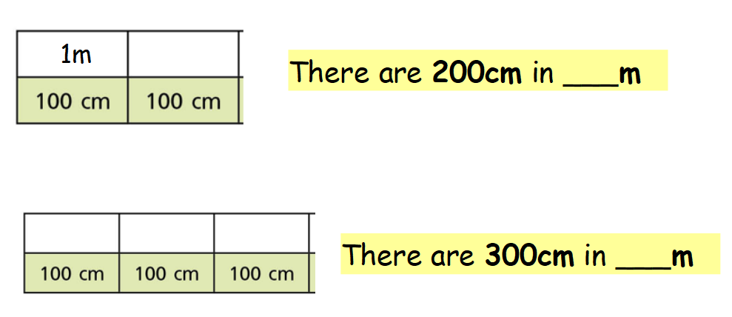
1m
2
1m
1m
1m
3

Slide 4
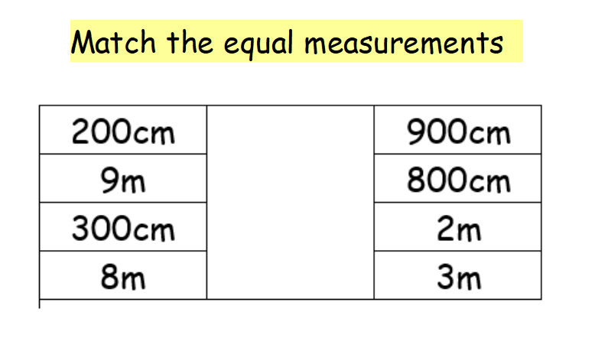

Slide 5
Use Eva’s method to convert 1m 60cm into cm.
1
60
100
60
160

Slide 6
20cm
110cm
180cm

Slide 7
Remember ½ m = 50cm
Alex is correct because 2 ½ m is equivalent to 250cm and 250cm is greater than 220cm.

