Slide 1
Chapter 6
Read Chapter 6 or listen to Mrs Spiers reading it and then work through the slides to answer the questions.
Remember to use APE (Answer it, Prove it and Explain it) when asked. You can use the sentence starters to help you.

Slide 2
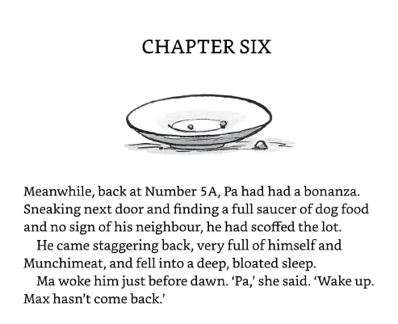
Use a dictionary to find the definition of bonanza, scoffed and bloated.
The definition of bonanza is ….
The definition of scoffed is ….
The definition of bloated ….

Slide 3
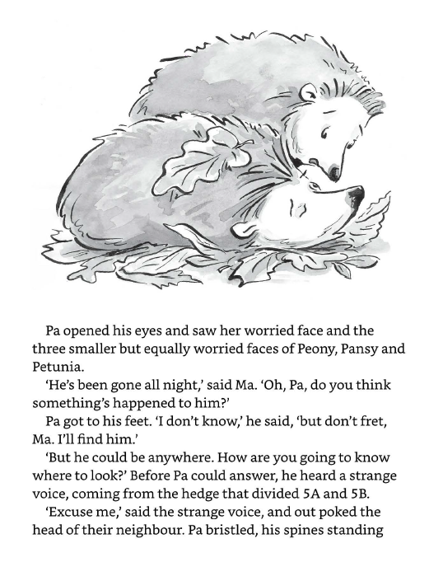
2. Read this extract. What is Ma worried about? (Use Ape)
Answer it –
Ma is worried because….
Prove it –
The text tells us …..
Explain it –
This tells us ……

Slide 4
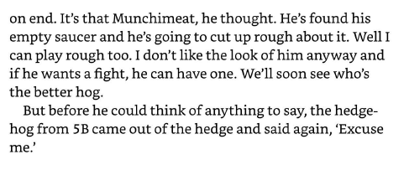
3. Read this part. Why do you think Pa’s spines stood on end? (Use Ape)
Answer it –
I think Pa’s spines stood on end because….
Prove it –
The text tells us …..
Explain it –
This means that……

Slide 5
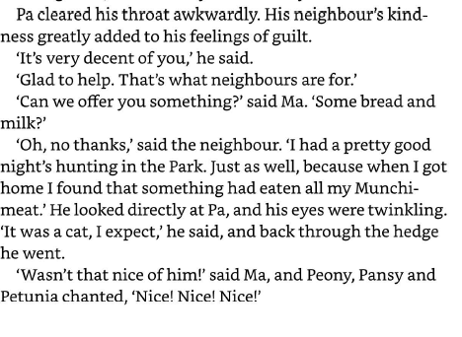
4. Read this extract. Did the neighbour really think a cat had eaten the munchimeat? (Use Ape)
Answer it –
The neighbour ________ think a cat had eaten the munchimeat.
Prove it –
The text tells us …..
Explain it –
This means that……

Slide 6
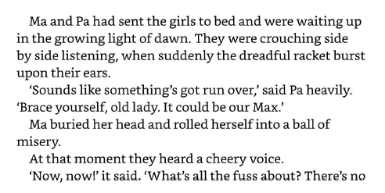
5. Read this extract. What do you think is going through Ma’s mind when Pa says ‘sounds like something’s got run over’?
Answer it –
I think Ma is thinking ……
Prove it –
The text tells us …..
Explain it –
This means that……

