Slide 1
Chapter 7
Read Chapter 7 or listen to Miss Barnett reading it then work through the slides to answer the questions.

Slide 2
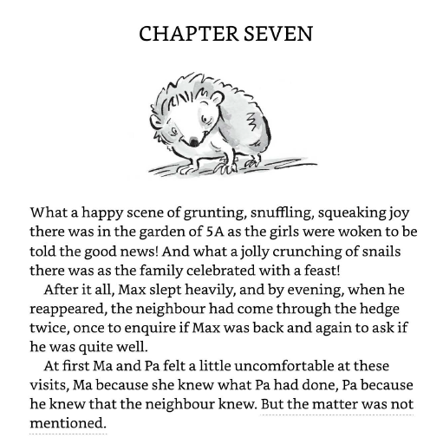
1. Look at this extract. Find 4 interesting verbs.

Slide 3
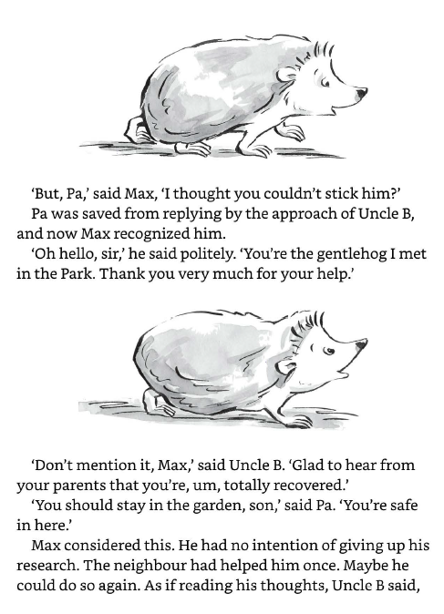
2. Look at this extract. Find 2 adverbs.

Slide 4
Look at this extract.
3. Find 2 adverbs.
4. Find 3 proper nouns.

Slide 5
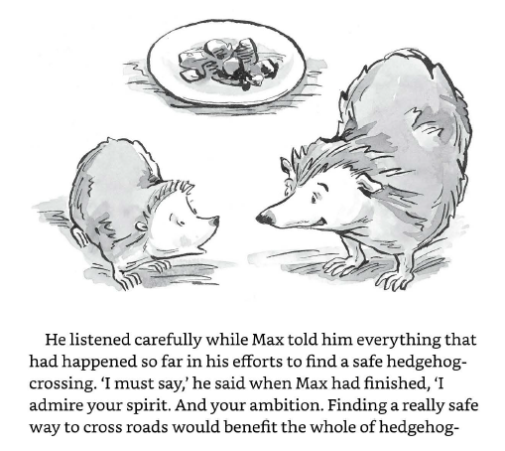
Look at this extract.
5. What type of word is listened?
6. What type of word is carefully?
7. Use a dictionary to find the definitions of admire, ambition and benefit.
8. Write 3 sentences. Include one of the words from question 7 in each sentence.

