Slide 1
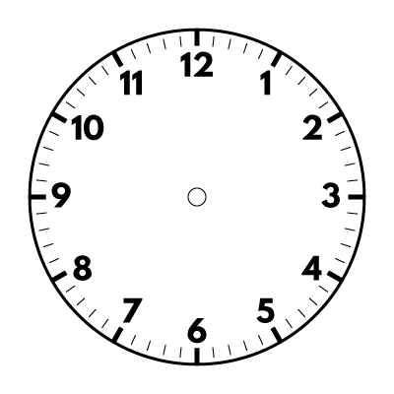
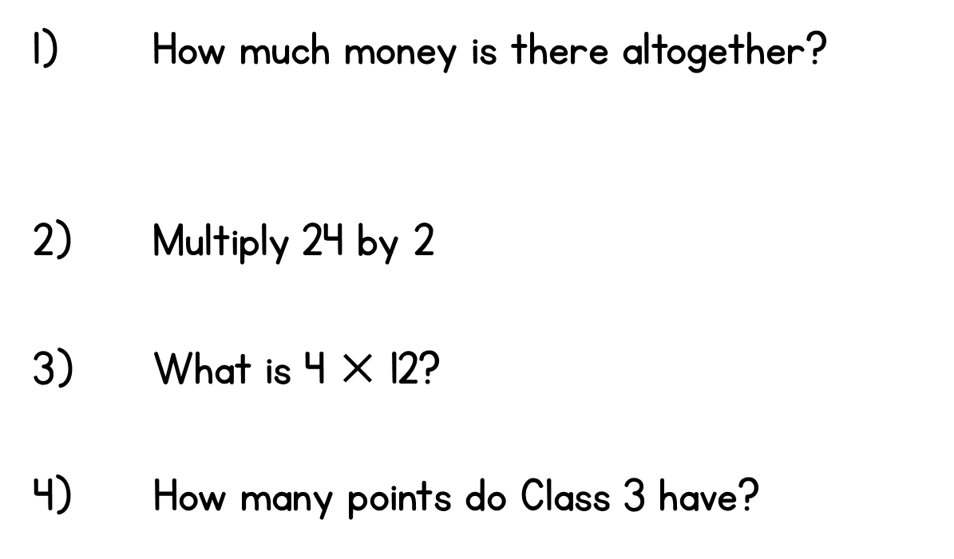
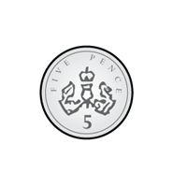
Year 3 | Week 5 | Day 1

Slide 2
Year 3 | Week 5 | Day 1

Slide 3
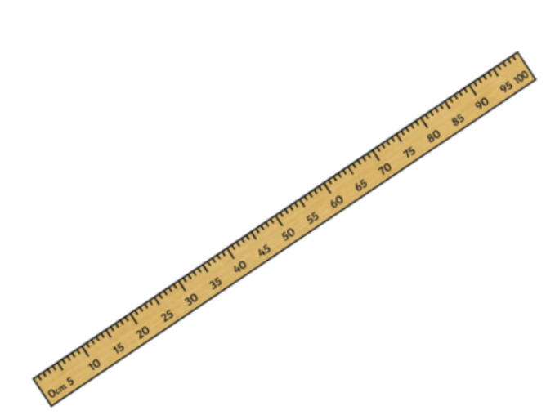
I can understand units of measurement
We can use a metre stick or ruler to measure length.
We can use metres, centimetres and millimetres to measure length.

Slide 4
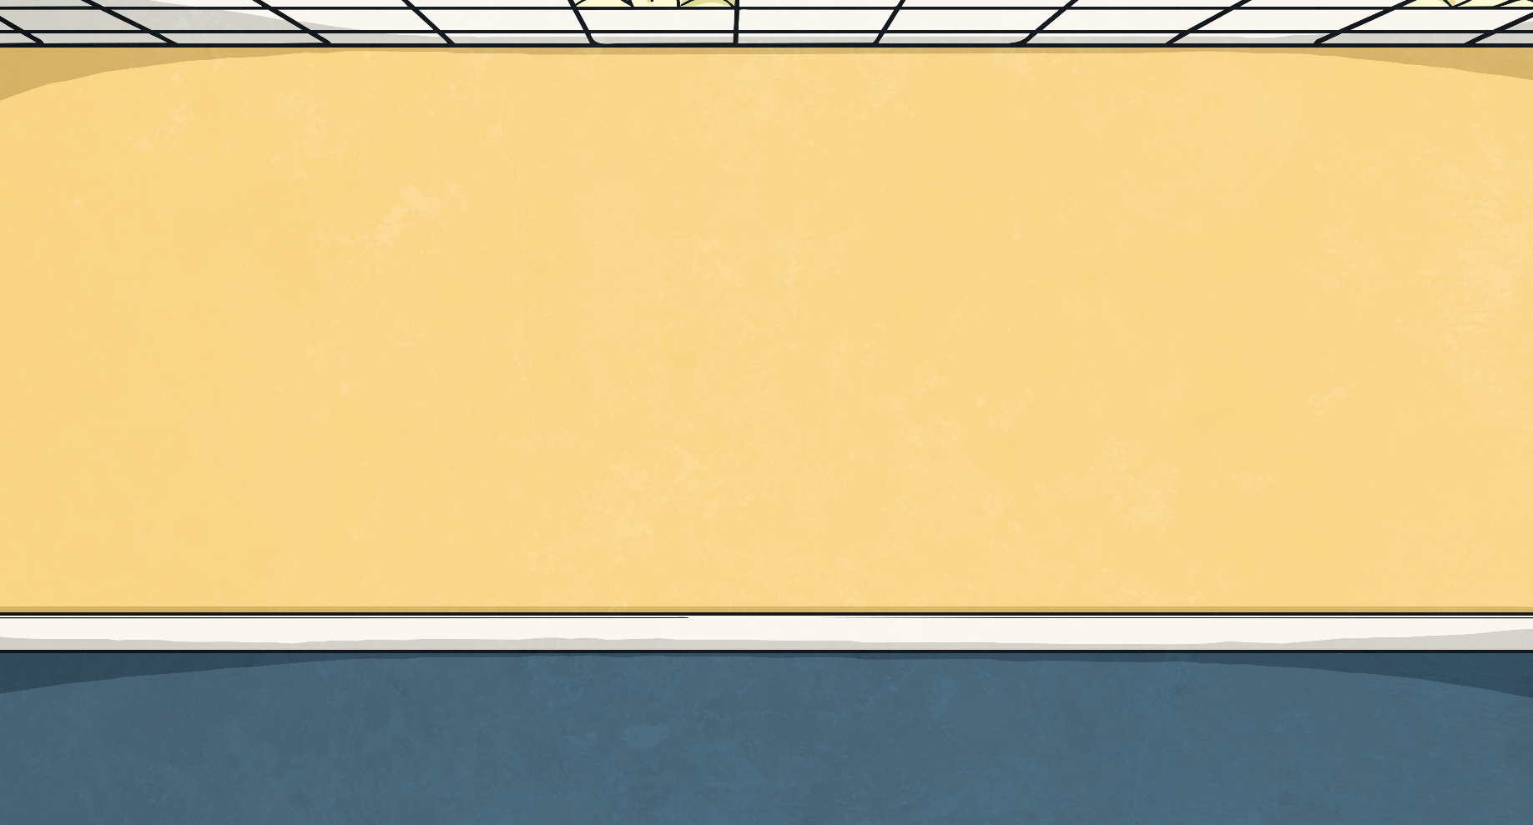
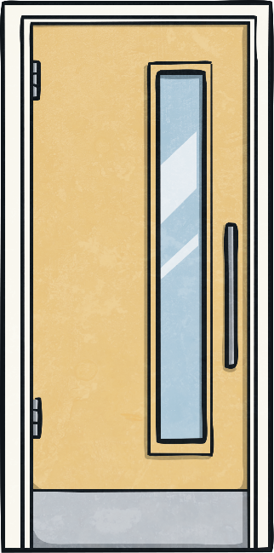
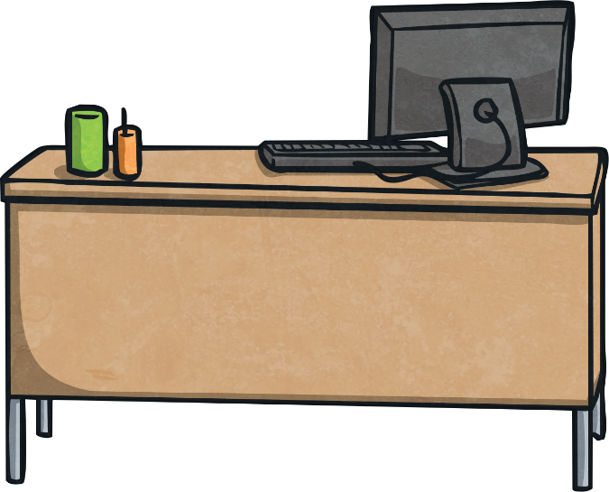
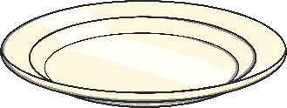
We use different units of measurement to measure different things.
Good morning class.
A door handle is about 1 metre high.
A full stop is about 1 millimetre long.
A pea is about 1 centimetre wide.
Find things around your house you could measure using metres, centimetres and millimetres.

Slide 5
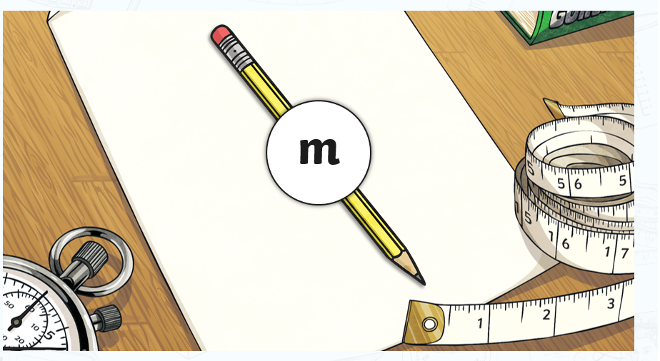
Do we measure a pencil using metres?

Slide 6
Do we measure the height of a book using metres?

Slide 7
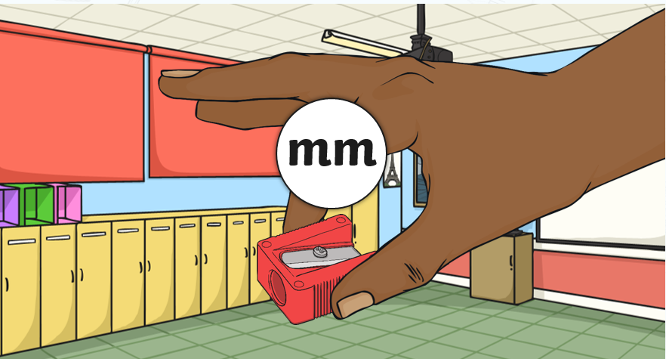
Do we measure a sharpener using millimetres?

Slide 8
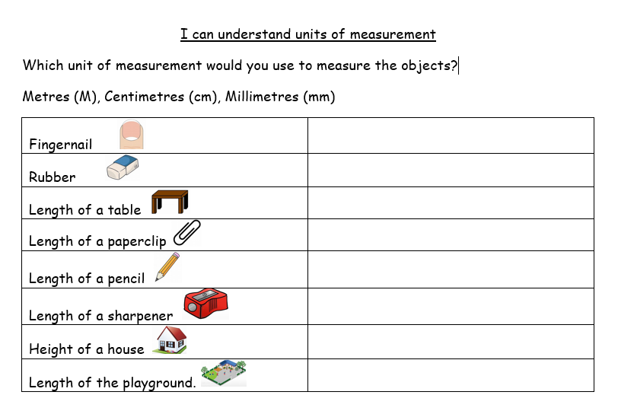
Download and print the sheet or write the answers on a notepad.

Slide 9
