Slide 1
Friday - English

Slide 2
Today your are going to be planning your own Millions story.
You have got a couple of options about what your story can be about.

Slide 3
Story Writing Options
Write the same Millions story from Anthony's perspective.
Write the same story with different characters.
Write the same story with your own ending.
Write a totally different story called 'Millions'
Write a sequel to Millions.
Think carefully about which story you think you will write, and what will happen within it.

Slide 4
Figure out the answer to these questions about your story?
Who will be in your story?
Where is your story set?
What goes wrong in your story?
How is the problem solved?

Slide 5
Here is an example plan that Mrs Poole made (on website) – she has chosen a story with different characters

Slide 6
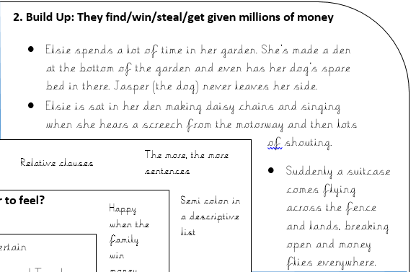

Slide 7
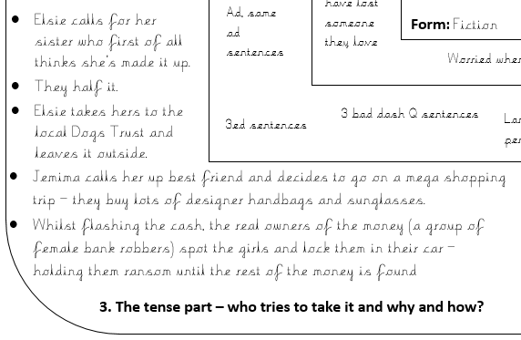

Slide 8
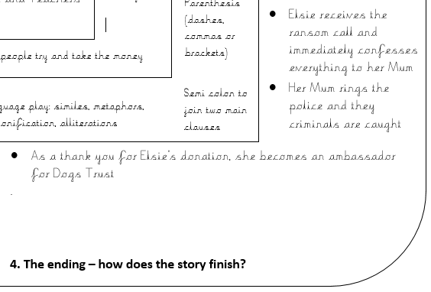

Slide 9
Skills we have practised for you to put in your plan
past tense: Damian trembled as he waited silently in the loft.
relative clauses (noun, which/who/where): He stared at the bag, which lay on the ground.
higher level vocabulary: Petrified and confused, he crept silently to the edge of the loft.
'show not tell': As his stomach twisted into knots...
accurate speech punctuation:
"I can't believe it!" gasped Anthony.
"What are we going to do?" Damian shouted.

Slide 10
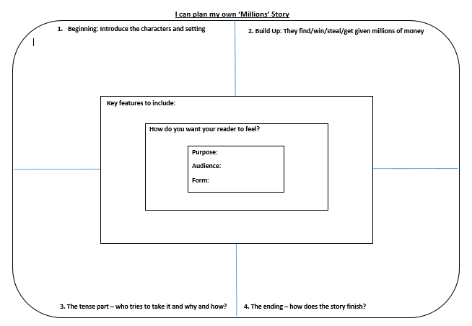
I can plan my own Millions story.
On the web page, there is a blank plan structure (the one we usually use).
You can either print it off and write your plan on that, or draw your own similar version, like the one below.
1. Beginning – characters and setting
2. How do they get the money?
3. Who tries to take the money and why?
4. The ending

