Slide 1
English - Monday

Slide 2
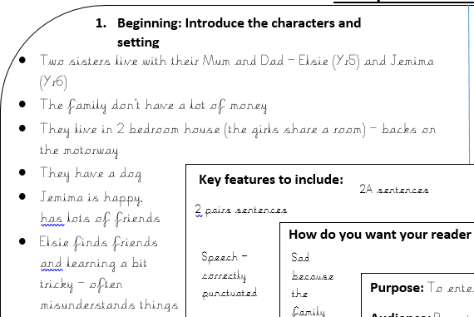
Today you are going to be writing the beginning section of your Millions story.
Therefore you will need to look at this section of your plan:

Slide 3
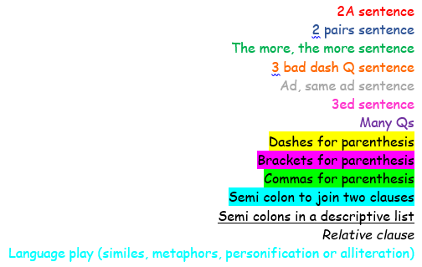
Mrs Poole has written the first part of her story as an example of what a good beginning looks like.
She has coloured some sections to help you understand what features she has used.
Below is the key showing which colour is which
(Not all of them are in this section, but may be in the next couple)

Slide 5
I can write the beginning of the story.
Here is a guide, if you would like to use it, for how to write the beginning section of the story.
It makes sure that everything that needs to be in a beginning is there, but it would be great if you could add more details about the character’s situation
Introduce the setting – 3 sentences
Introduce character 1 – 3 sentences
Introduce character 2 – 3 sentences

