Slide 1
English - Tuesday

Slide 2
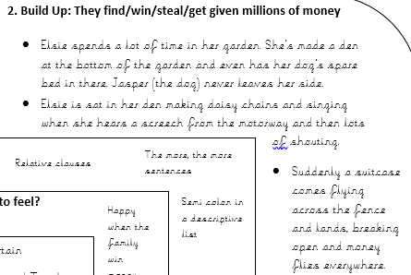
Today you are going to be writing the build up section of your Millions story.
Therefore you will need to look at this section of your plan:
Today is the section where they get the money.

Slide 3
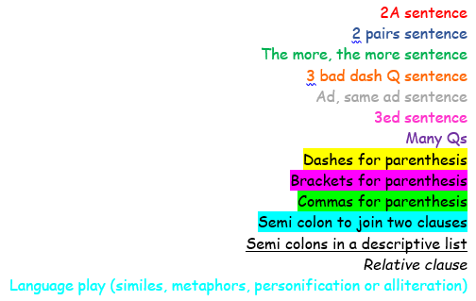
Mrs Poole has written this part of her story as an example of what a good one looks like.
She has coloured some sections to help you understand what features she has used.
Below is the key showing which colour is which
(Not all of them are in this section, but may be in the next couple)

Slide 4
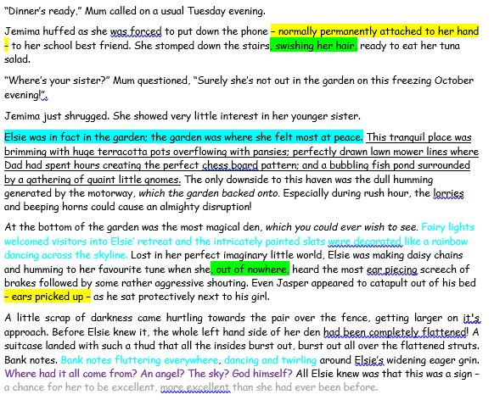

Slide 6
I can write the build up of the story.
Here is a guide, if you would like to use it, for how to write the build up section of the story.
It makes sure that everything that needs to be in a build up is there, but it would be great if you could add more details about the character’s, what’s happening and anything else.
Describe where the character is– 3 sentences
Explain what the character is doing– 3 sentences
Describe how they get the money– 3 sentences
Describe what the money looks like – 2 sentences

