Slide 1
English - Wednesday

Slide 2
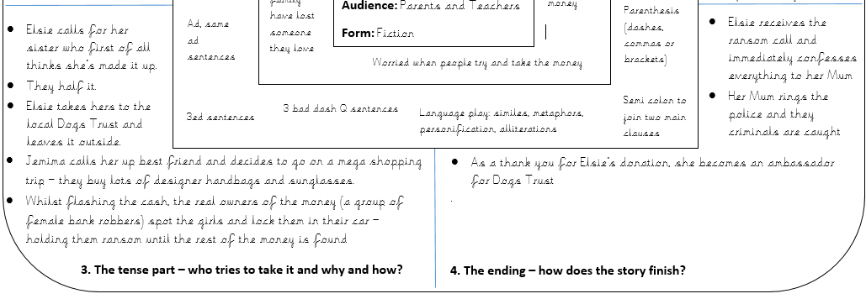
Today you are going to finishing your Millions story.
Therefore you will need to look at the last two sections of your plan:

Slide 3
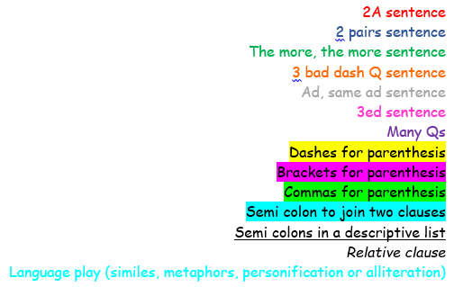
Mrs Poole has written an example of what a good one looks like.
She has coloured some sections to help you understand what features she has used.
Below is the key showing which colour is which
(Not all of them are in this section, but may be in the next couple)

Slide 4
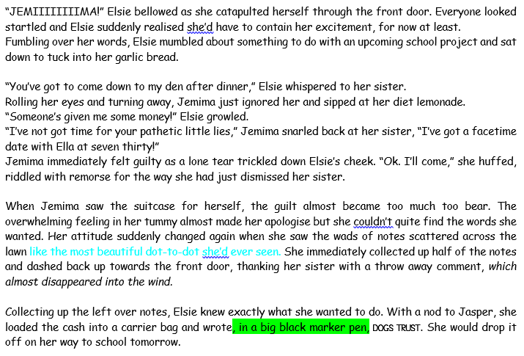

Slide 5
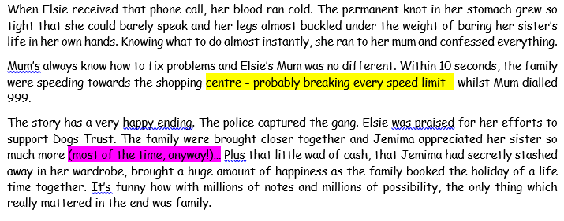

Slide 6
I can write the problem and ending of a story.
Today you need to finish your story. So you need to use whatever you need to for your story.
Remember to include:
- relative clause
- semi colons
- parenthesis
- metaphors
- personification
- similes

