Slide 1
I can understand how mirrors reflect light and how they can help us see objects

Slide 2
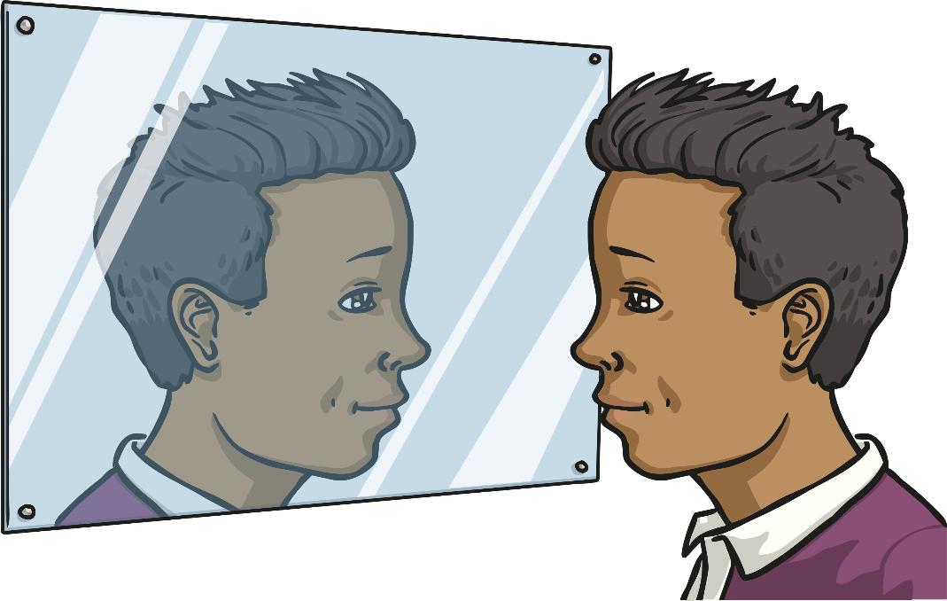
How is light reflected?
Read the following four explanations of how light is reflected.
Three of the explanations are false; only one of them is accurate!
Can you work out which one is the correct one?

Slide 7
Which one is accurate?

Slide 8
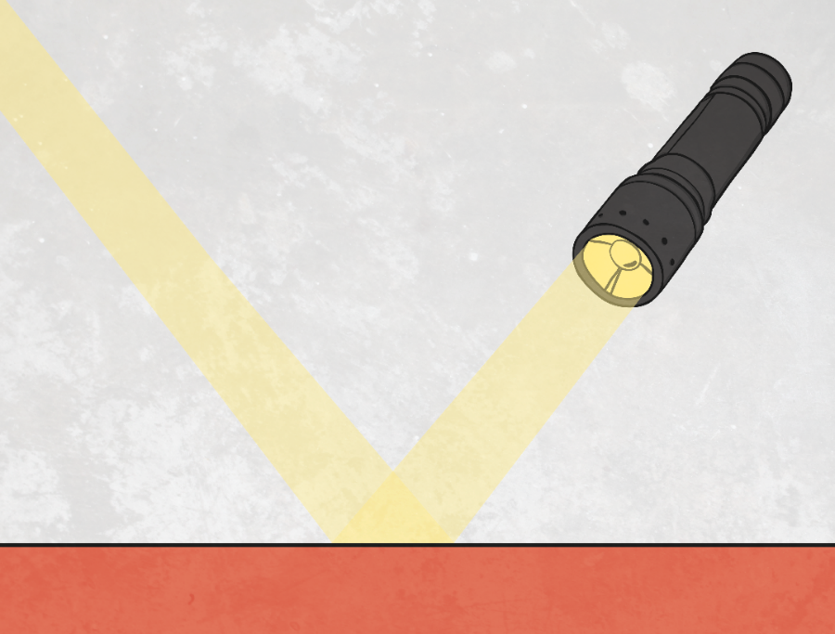
Reflection explanation 3!
Reflection is when light bounces off a surface, changing the direction of a ray of light.
All objects reflect light; smooth and shiny surface reflect all the rays of light at the same angle, rather than scattering the rays of light like rough or dull surfaces.
The light ray that hits the mirror or other object is described as the incident ray, and the ray of light that bounces off is known as the reflected ray.
- - - - - - - - - - - - - - - - - - - - - - - -
reflected ray
incident ray

Slide 9
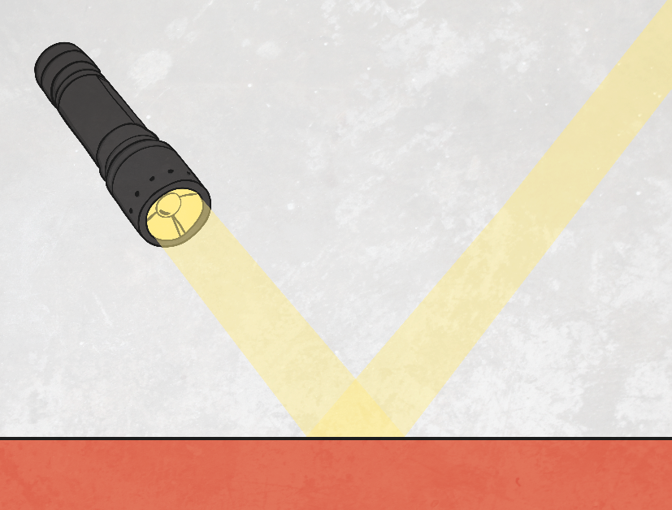
How is light reflected?
When rays of light reflect, the angle of incidence is always the same as the angle of reflection.
The red dashed line is called the ‘normal’ line. It is drawn at a right angle, or perpendicular to the reflector.
The angle of incidence is the angle between the normal line and the incident ray of light.
The angle of reflection is the angle between the normal line and the reflected ray of light.
angle of incidence
angle of reflection
- - - - - - - - - - - - - - - - - - -

Slide 10
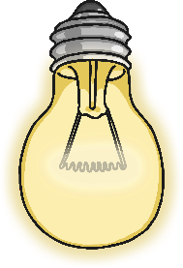
Seeing reflections
The law of reflection is what allows us to see an object reflected in a mirror.
Look at the way light travels to enable the boy to see his face reflected in the mirror:
Light from the bulb hits the boy’s face and bounces off.
The light reflected from the boy’s face hits the mirror.
The light reflected from the mirror travels to the boy’s eyes, so he can see the image of his face reflected in the mirror.
1
2
3

Slide 11
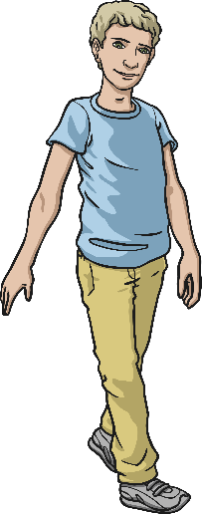
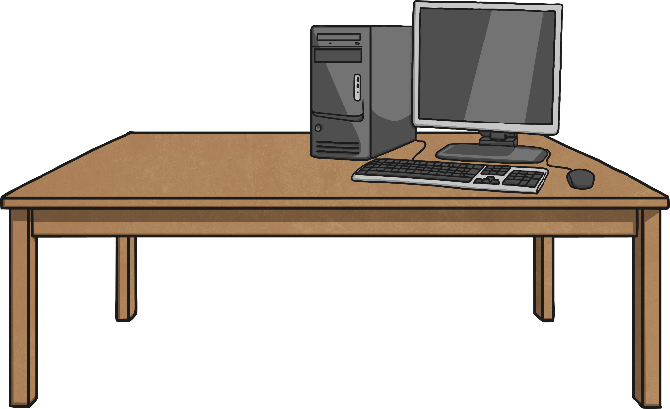
Seeing reflections
How is light travelling to enable the boy to see the computer behind the wall?
wall

Slide 12
Seeing reflections
How is light travelling to enable the boy to see the computer behind the wall?
2
1
3
wall

Slide 13
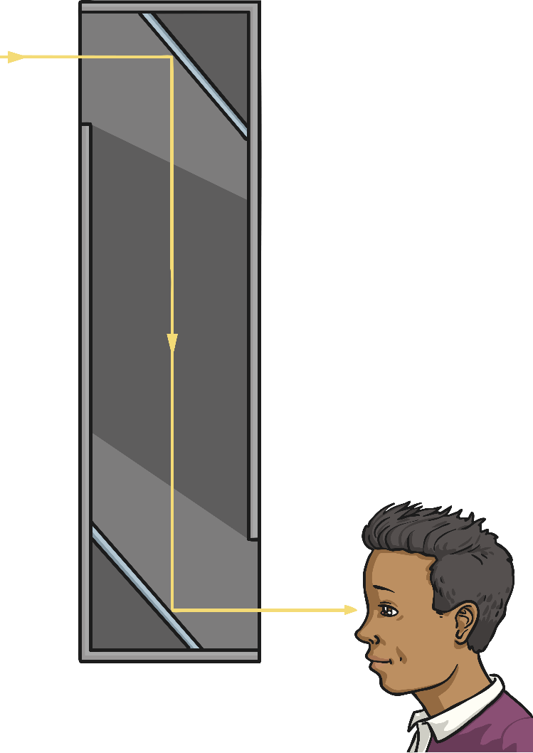
Option 1 part 1 - If you have the resources at home, make a periscope
Don’t worry if you can’t – move on to Option 2!
You are going to use your understanding of reflection and the angles of incidence and reflection to make a periscope.
A periscope is a device for seeing over or around something.
Periscopes were first used by sailors in around 1860, who used them in submarines to see above the surface of the water. They were also used by soldiers in the First World War, to see over the top of their trenches. They are still used today by tanks and some submarines.
A simple periscope is a tube with a mirror at either end. The mirrors need to be positioned so that the light is reflected from the mirror at one end, down the tube to the other mirror, then out of the tube to the observer’s eyes.
Use a cereal box, scissors, 2 mirrors and sticky tape to make your periscope.

Slide 14
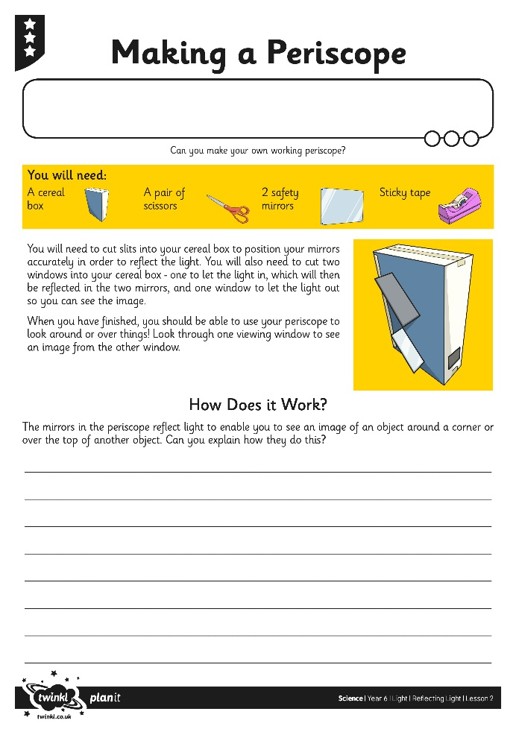
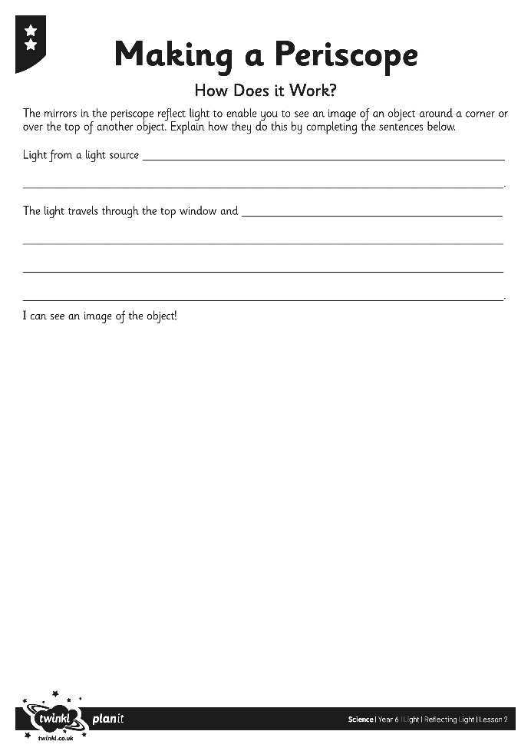
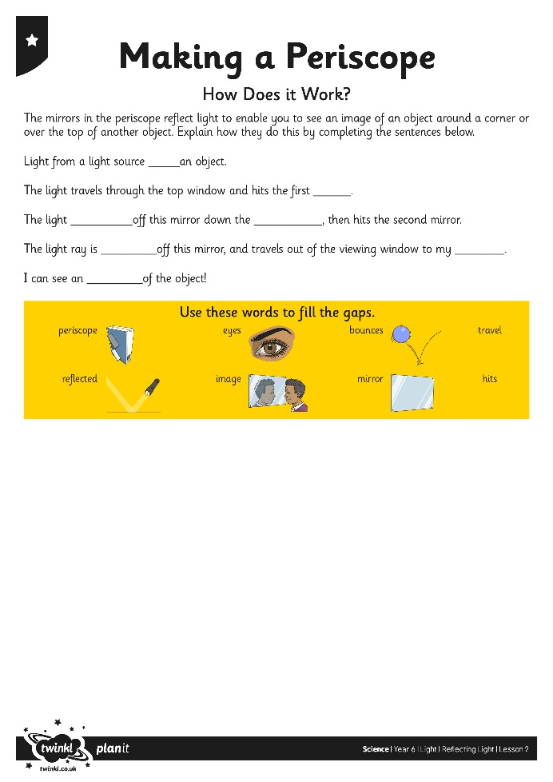
Option 1 part 2 – How does it work?
Test out your periscope by using it to look over things, such as your table or chair, or around corners!
Think about how it works. How is light reflected by the mirrors in the periscope?
Complete your Periscope Activity Sheet to explain your understanding.

Slide 15
Option 2 – Light it up!
If you can, print off the resource sheet and follow the instructions.
If not, just have a go at following it on screen.
When you have finished, write a short explanation in your books to explain how reflection works. You can draw a diagram too!

