Slide 1
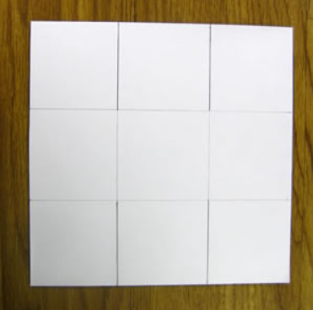
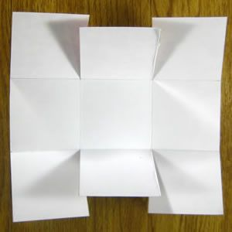
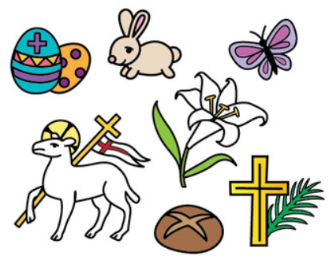
Ask a grown up to cut a piece of paper like this
Grown ups:
Fold the paper into 3rds in both directions (A4 paper or cut into a square shape)
Cut 4 slits as shown.
Now decorate the back however you like! You could draw patterns, colour it in, or draw symbols of Easter like bunnies, daffodils and eggs!

Slide 2
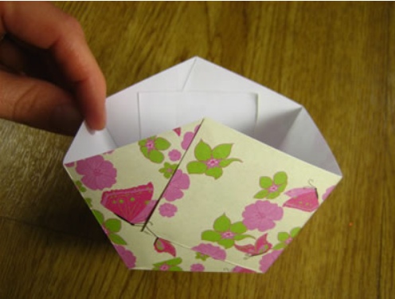
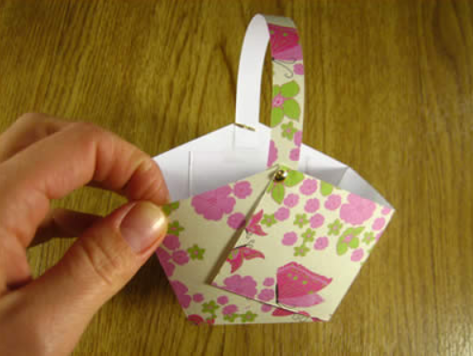
Now fold the 2 end piece in and stick over the middle square.
Do this on both sides of your basket.
Lastly, cut a strip of paper and attach as a handle!

