Slide 1
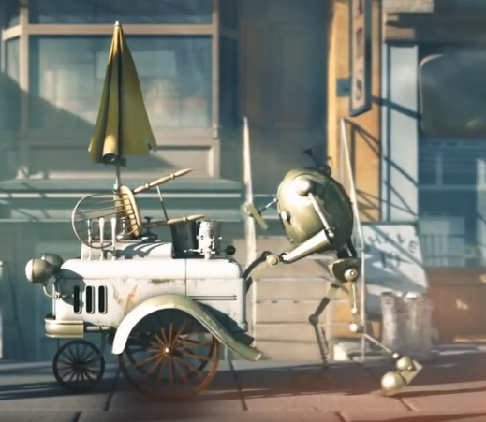
Bibo
The Good Old Days

Slide 2
Look at these scenes. They tell of a happy time in Bibo’s life.

Slide 6
Today’s writing task: write a descriptive account of the good old days of Bibo’s life.
Write in the past tense
Write in the first person for Bibo’s viewpoint.
Use superlatives (-est words or words with the word ‘most’ in front of them) e.g. best, greatest, most delicious.
Use a colon to join two clauses instead of using the word ‘because’
Use expanded noun phrases e.g. smooth, creamy, soft ice-cream.
Don’t repeat vocabulary if you can find a suitable synonym e.g. replace ice-cream with ‘frozen delights’
Try to use a simile e.g. like treasure
The next set of slides show you an example write. Use it to help you get started if you like. You need to demonstrate the happiness Bibo has for these days.

Slide 7
I can write a description of a happy time in Bibo’s life. The Good Old Days
In the good old days, everyday was like summer: I remember the sun shining, the shadows on the pavements and the queue of happy children.
These children were my life. Everything I did, I did it for them. Every step I took was to serve them the cool, delicious ice-cream they longed for. It was without a doubt, the very best ice-cream the world had ever known.

Slide 8
Children from all over town would skip their way towards me. Their laughter would echo as they approached me and my famous cart of frozen delights. Once served, their expectant eyes would widen as they gazed longingly at the smooth, creamy, soft ice-cream. Like treasure, they held their cone and as soon as a lick had been taken, their eyes would close as though they were meditating. They savoured the flavour of this most glorious desert.
Those were indeed, the good old days. The best days. The days filled with joy and purpose.

Slide 9
After completing your work, check you have used the features mentioned previously. Edit and improve if you have not used one of these features:
Write in the past tense
Write in the first person for Bibo’s viewpoint.
Use superlatives (-est words or words with the word ‘most’ in front of them) e.g. best, greatest, most delicious.
Use a colon to join two clauses instead of using the word ‘because’
Use expanded noun phrases e.g. smooth, creamy, soft ice-cream.
Don’t repeat vocabulary if you can find a suitable synonym e.g. replace ice-cream with ‘frozen delights’
Try to use a simile e.g. like treasure

