Slide 1
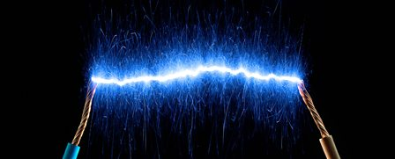
Electricity and Electrical Circuits

Slide 2
What is electricity? Click the image to remind ourselves.

Slide 3
What are conductors and insulators?

Slide 4
What is power?

Slide 5
How do electrical circuits work?

Slide 6
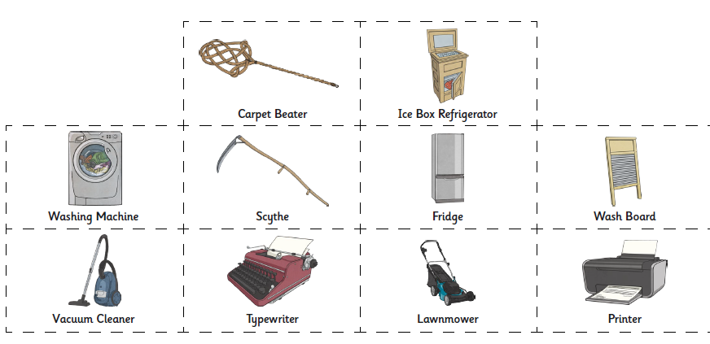
How has electricity impacted our lives?
Look at these everyday items. Which use electricity and which don’t? How has the power of electricity changed our lives?

Slide 7
Using the images on the last page, complete this table below (draw or print each image) in your learning book with the title: I can describe how electricity has impacted our lives.

Slide 8
Once you have completed the table, write a paragraph or two about how electricity impacts your daily life. How would your life be easier or more difficult without electrical items and an easy supply of electricity? What are you most grateful for? What would you miss more than anything else if there was a power cut? If your family could only keep three electrical items, what would they be? Explain.

