Slide 1
Food Chains

Slide 2
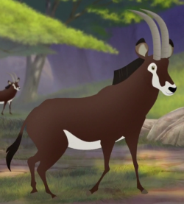
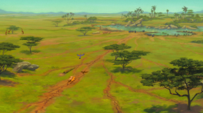
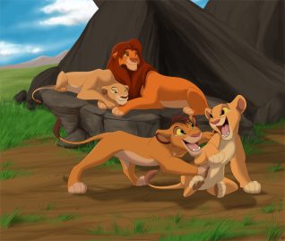
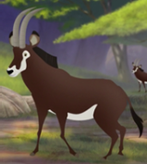
Mufasa’s Food chain
 | Consumer Predator | The lion hunts and kills its prey – the antelope, it then consumes it.
 | Consumer Prey | The antelope grazes on the desert grasses, consuming them.
 | Producer | The grasslands grow producing food for the animals that eat it.
 | Energy source | The Sun provides an energy source for the grass to grow.

Slide 3
Food Chains
Sun Grass seeds Mouse Owl

Slide 4
Food chains
Can you put another link in the chain?
What comes after the rabbit?
Sun Grass Rabbit

Slide 5
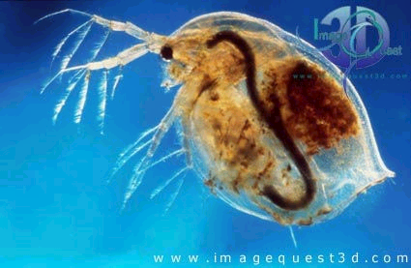
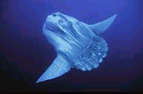
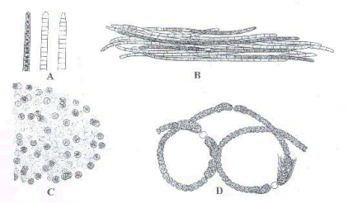
Food chains
Where does this chain take place?
Why does it start with the sun?
Sun Algae Water flea Sunfish

Slide 6
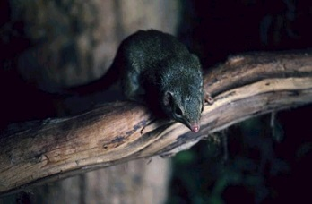
Food Chains
Sun Leaf Caterpillar
Shrew Badger
What is at the bottom
of the chain?
What is at the top
of the chain?

Slide 7
Sun Leaf Caterpillar
Shrew Badger

Slide 8
Look at your food chain from yesterday, here is mine
The food chain of the snow leopard begins with the sun as an energy source helping the grass and plants on the Himalayan mountains to grow. The grass grows and produces food for the mountain goats and bharals which live in the mountains. As they consume the grass, their predator, snow leopard hunts them and kills them as prey and consumes them with his family. He is at the top of the food chain.
Write a short paragraph explaining the process of your big cat’s food chain. I have done one as an example. Look at how I have used the technical vocabulary.

