Slide 1
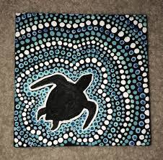
I can create a dot art picture

Slide 2
Dot Art
Dot paintings are now internationally recognised as unique and integral to Australian Aboriginal Art.
The simple dot style is beautifully aesthetic to the eye but has a far more hidden meaning and deeper purpose; to disguise the sacred meanings behind the stories in the paintings.

Slide 3
How to create dot art
https://www.google.com/search?q=how+to+create+dot+art&rlz=1C1CAFB_en__798GB868&oq=how+to+create+dot+art&aqs=chrome..69i57j0l2.6388j1j4&sourceid=chrome&ie=UTF-8#kpvalbx=_K9iVXsSUOf3T1fAPl7SQ2A434
https://www.youtube.com/watch?v=dWxyUqfWYfs

Slide 4
Creating your own dot art picture
Using pencils, paint (a lollypop stick or earbud could be used), chalk, crayons or even an art app on the computer, we’d like you to create your own dot art picture.
We’d like you to create a dot art picture of anything you like: an animal, a landscape scene, a pattern… the list is endless! Enjoy!

Slide 5
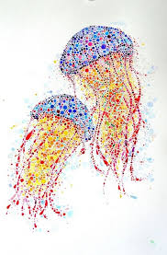
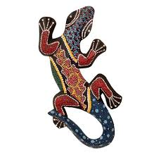
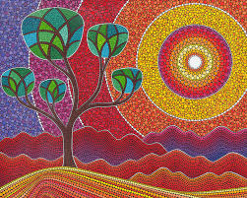

Slide 6
