Slide 2
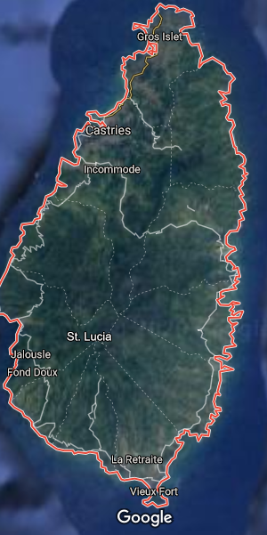
Today, you are going to be geography detectives.
On the next slides there are satellite photos of Saint Lucia.
They are taken from Google Maps.

Slide 3
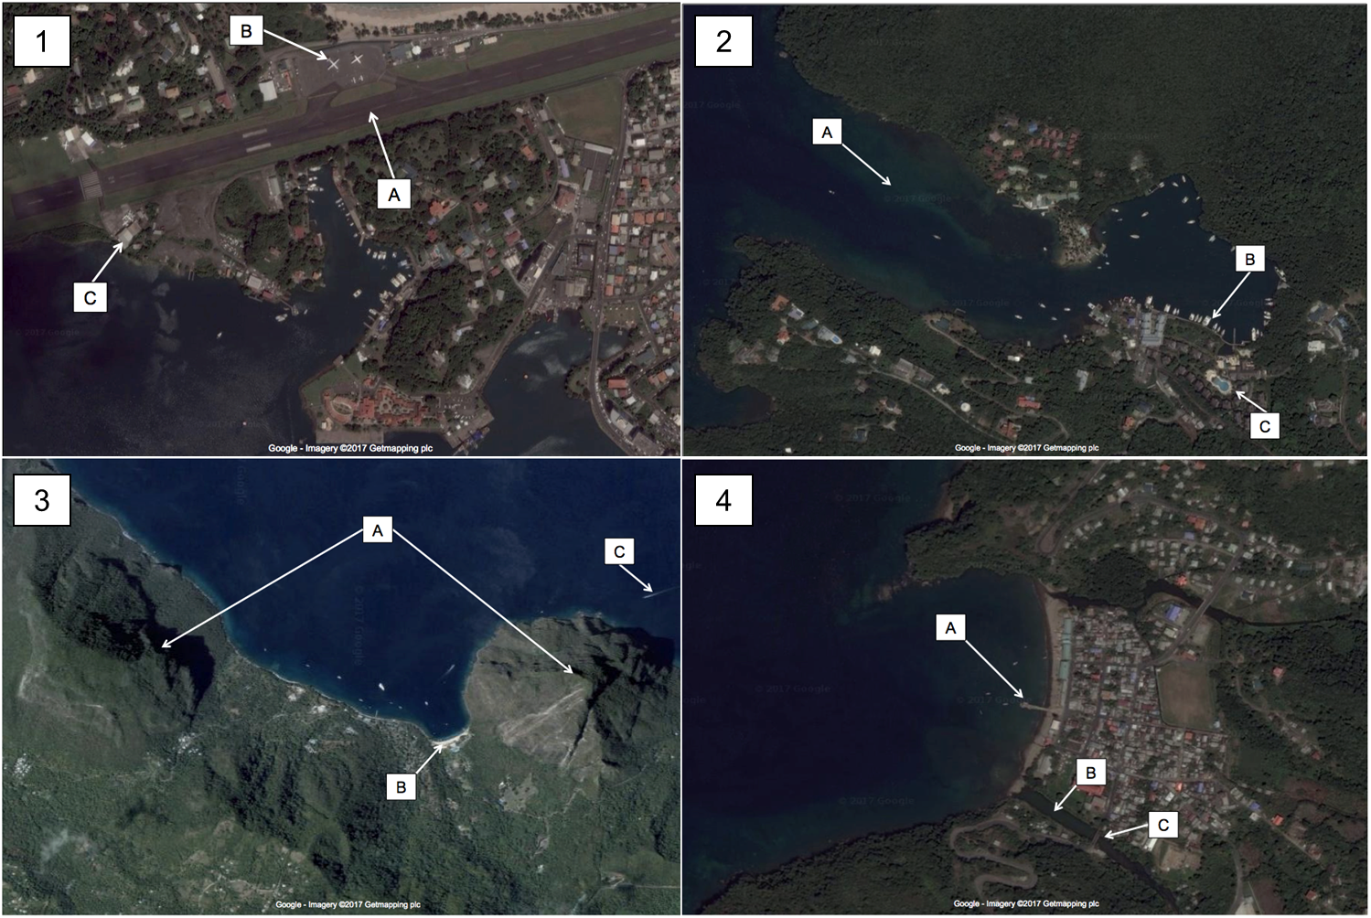
As you look at each of the pictures (close ups on the slides after), try and decide what each labelled feature is and whether it is human or physical.

Slide 4
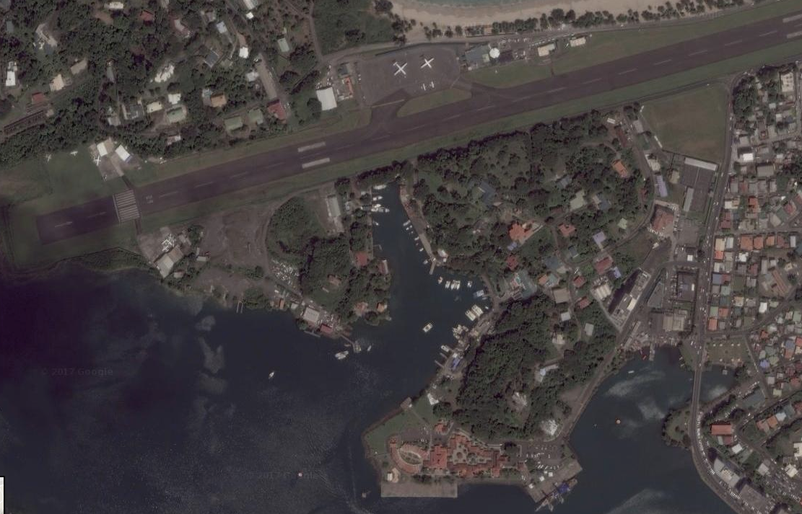
Can you identify the features in this satellite photo?
B
A
C
Are these human or
physical geographical
features?
Google - Imagery ©2017 Getmapping plc
Notes:
A = Charles Airport runway (human)
B = airplane/jumbo jet (human)
C = aircraft hangar (human)

Slide 5
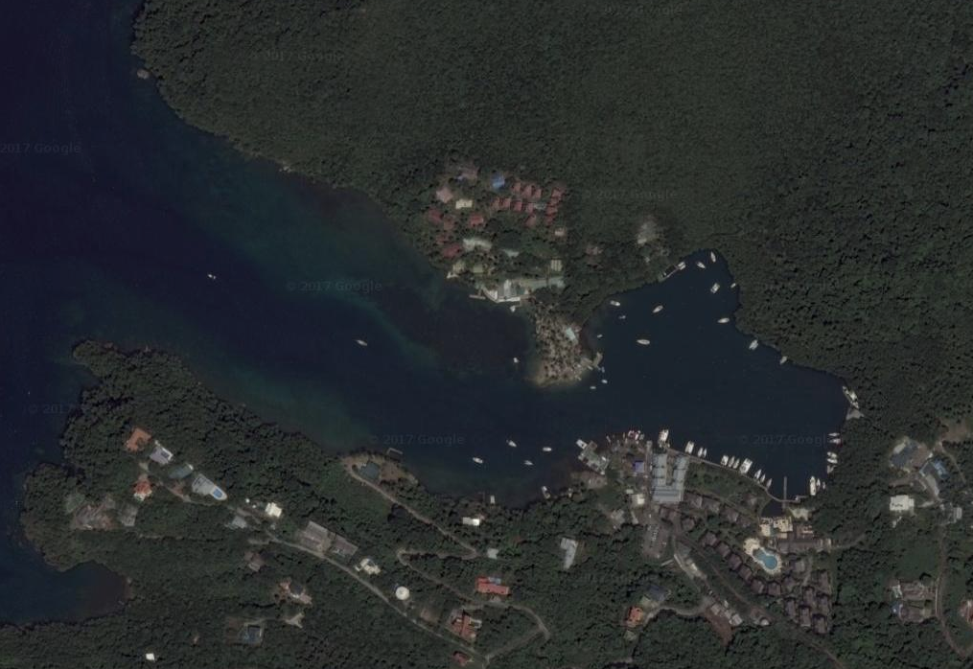
Can you identify the features in this satellite photo?
Are these human or
physical geographical
features?
A
B
C
Google - Imagery ©2017 Getmapping plc
Notes:
A = bay (physical)
B = marina (human)
C = swimming pool (human)

Slide 6
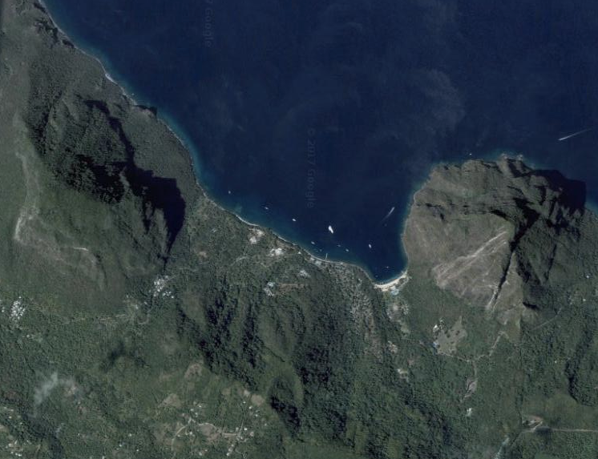
Can you identify the features in this satellite photo?
A
C
B
Are these human or
physical geographical
features?
Google - Imagery ©2017 Getmapping plc
Notes:
A = Petit Piton and Gros Piton (physical)
B = speedboat and wake (human)
C = beach/shoreline (physical)

Slide 7
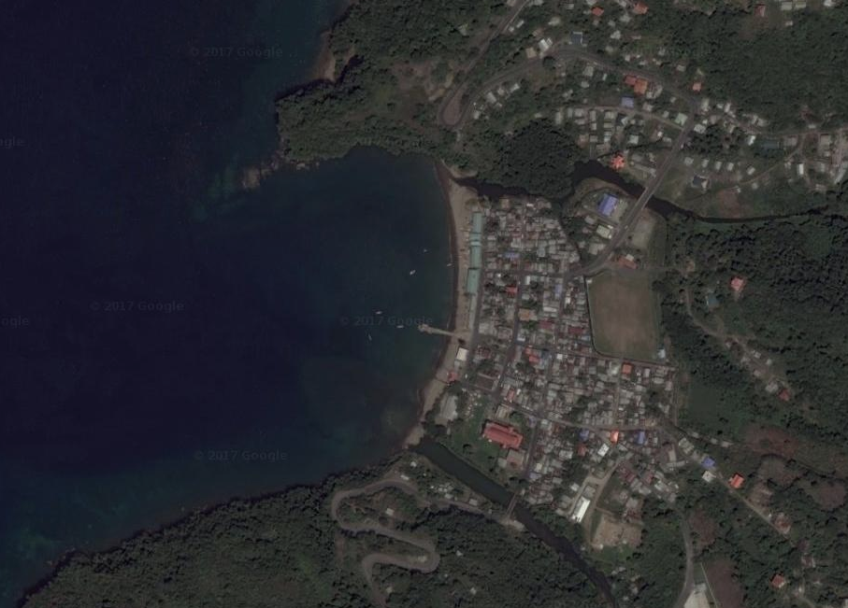
Can you identify the features in this satellite photo?
A
B
Are these human or
physical geographical
features?
C
Google - Imagery ©2017 Getmapping plc
Notes:
A = jetty (human)
B = river mouth (physical)
C = bridge (human)

Slide 8
Answers
Picture 1 A = Charles Airport runway (human) B = airplane/jumbo jet (human) C = aircraft hangar (human) | Picture 2 A = bay (physical) B = marina (human) C = swimming pool (human)
Picture 3 A = Petit Piton and Gros Piton (physical) B = speedboat and wake (human) C = beach/shoreline (physical) | Picture 4 A = jetty (human) B = river mouth (physical) C = bridge (human)

