Slide 1
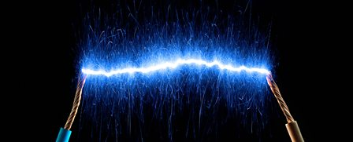
Electricity

Slide 2
What is electricity? Click the image to find out.

Slide 3
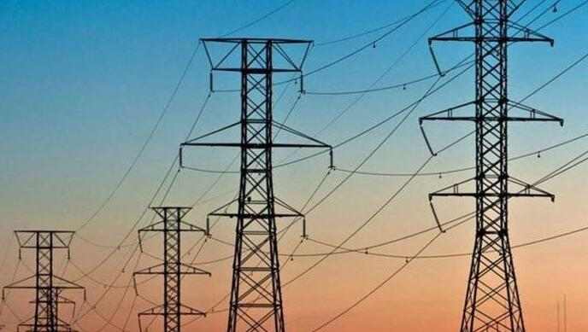
Let’s think about safety to start with…
What are the hazards of mains electricity?
What risks are there at home/school/in local areas?

Slide 4
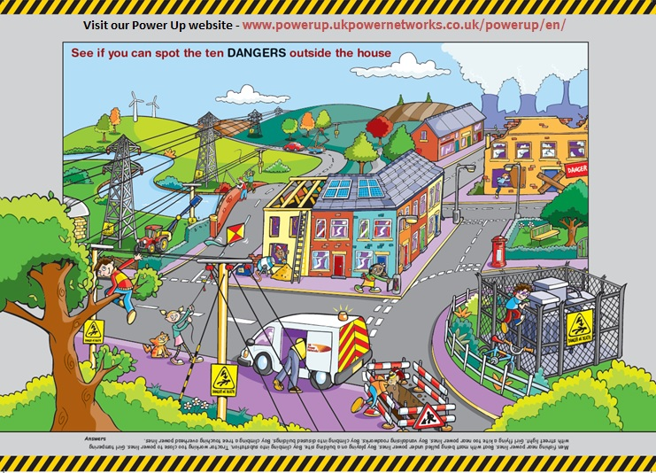
There are 10 dangers to spot!
I’ve put the answers on the next page…
Afterwards, you could create a little mind map of the dangers of electricity ☺

Slide 5
Man fishing near power lines
Boat being pulled under power lines
Boy playing on building site
Boy climbing into substation
Tractor working too close to power lines
Girl tampering with street light
Girl flying a kite too near power lines
Boy vandalising roadworks
Boy climbing into disused building
Boy climbing tree touching overhead power lines

Slide 6
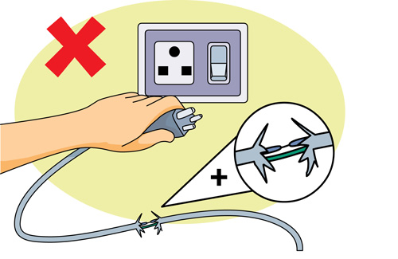
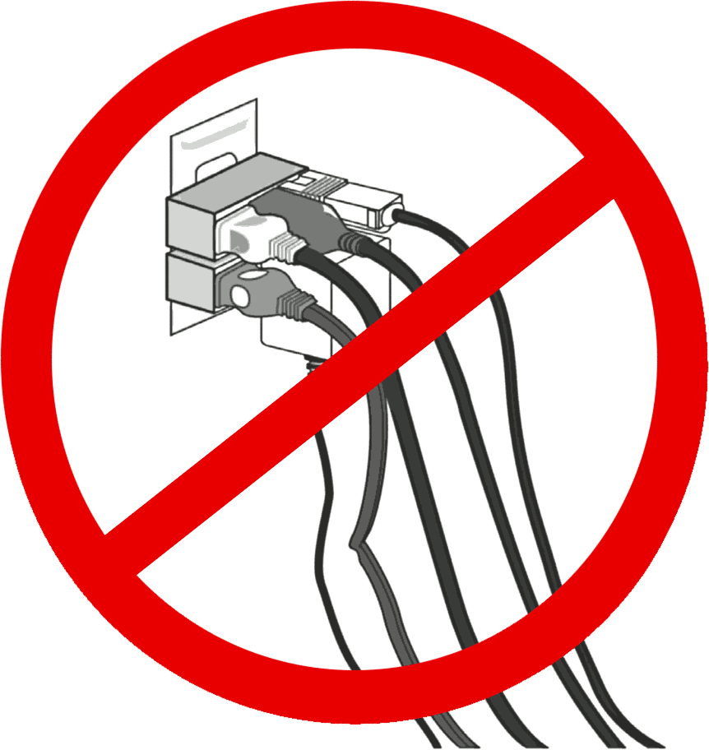
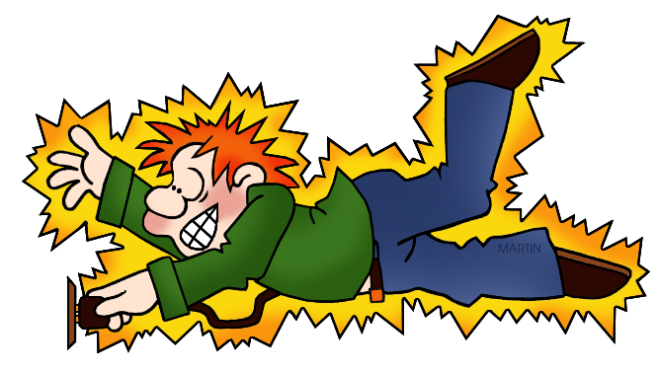
Dangers
of electricity – inside and outside

