Slide 1
Eric Joyner: American Artist

Slide 2
Look at the next four slides. They show you small sections of one of Eric Joyner’s works of art. Do not race through them. Have a good, close look at each section. What do you think the finished painting will look like?

Slide 8
Is this what you first thought?
What surprised you about this painting?
What do you like about this painting?
Where are they set?
What would you like to ask the artist if you had the chance?

Slide 9
Follow the same steps of looking and thinking for the following slides which slowly reveal Eric’s works of art.

Slide 25
The next set of slides, show us other completed works of art by Eric Joyner.
Which is your favourite? Explain why.
You should now have deduced which items Eric Joyner likes painting.

Slide 26
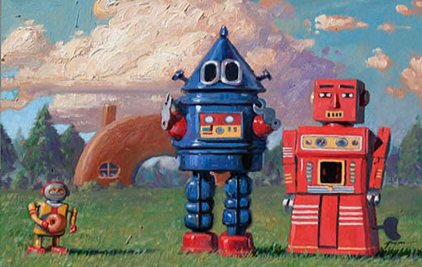

Slide 27
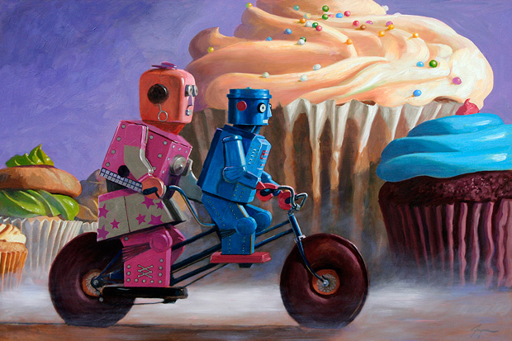

Slide 28
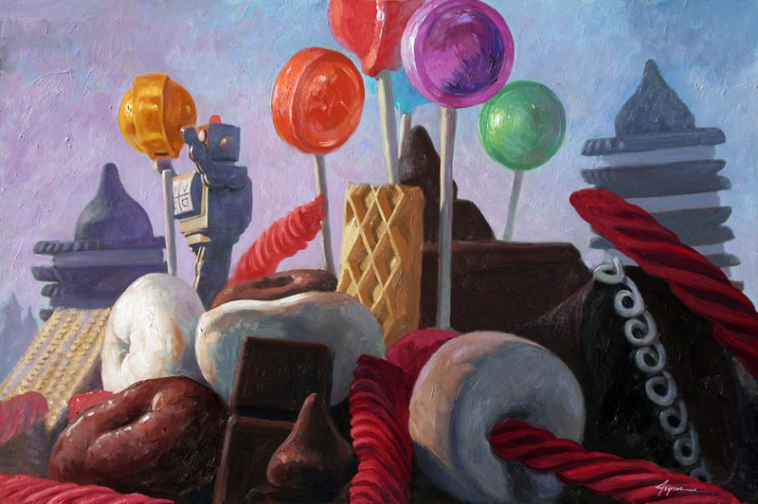

Slide 29
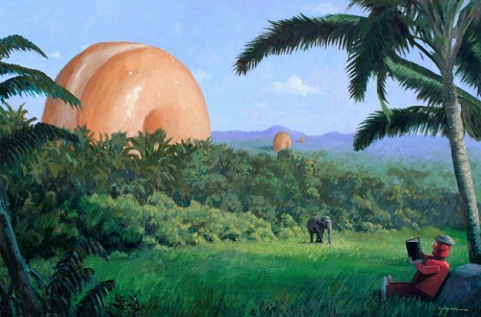

Slide 30
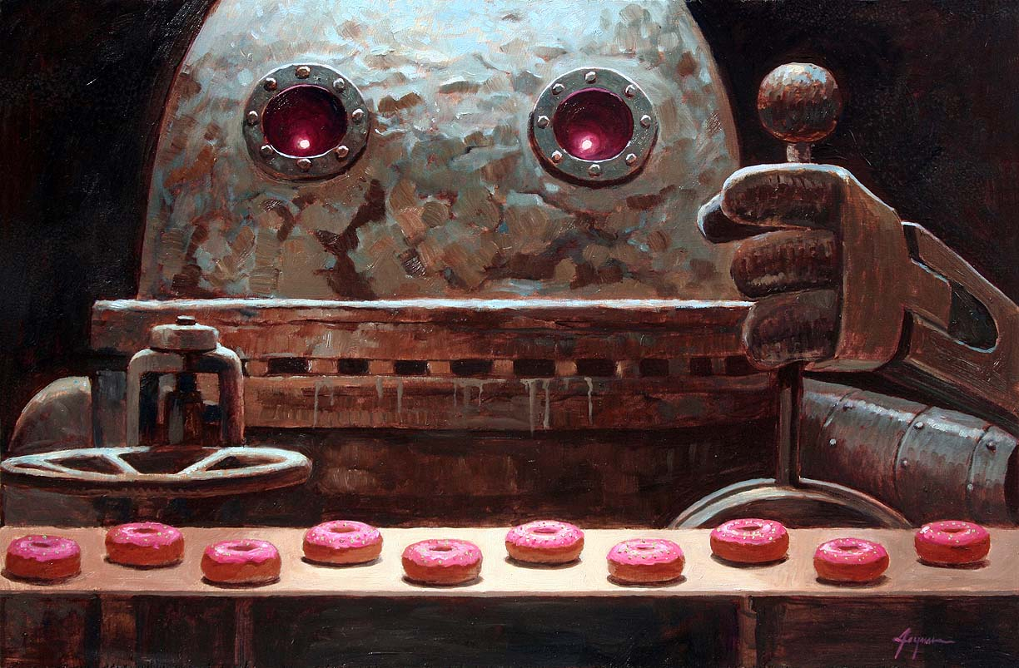

Slide 31
After watching the short video, it’s time to practise drawing a robot. The sheet attached to today’s lesson will help get you started.

