Slide 1
Eric Joyner: American Artist

Slide 2
Look at next set of slides to remind you about Eric Joyner’s work. As you look at them, have a think about the setting you will choose for your robot and doughnut work of art today.

Slide 3
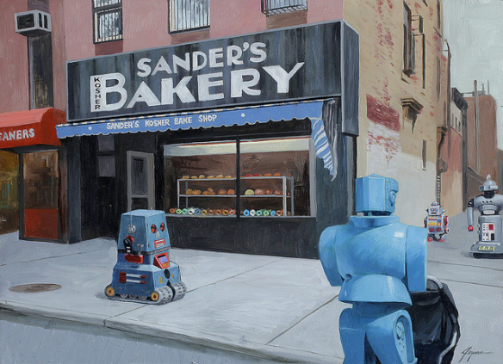

Slide 4
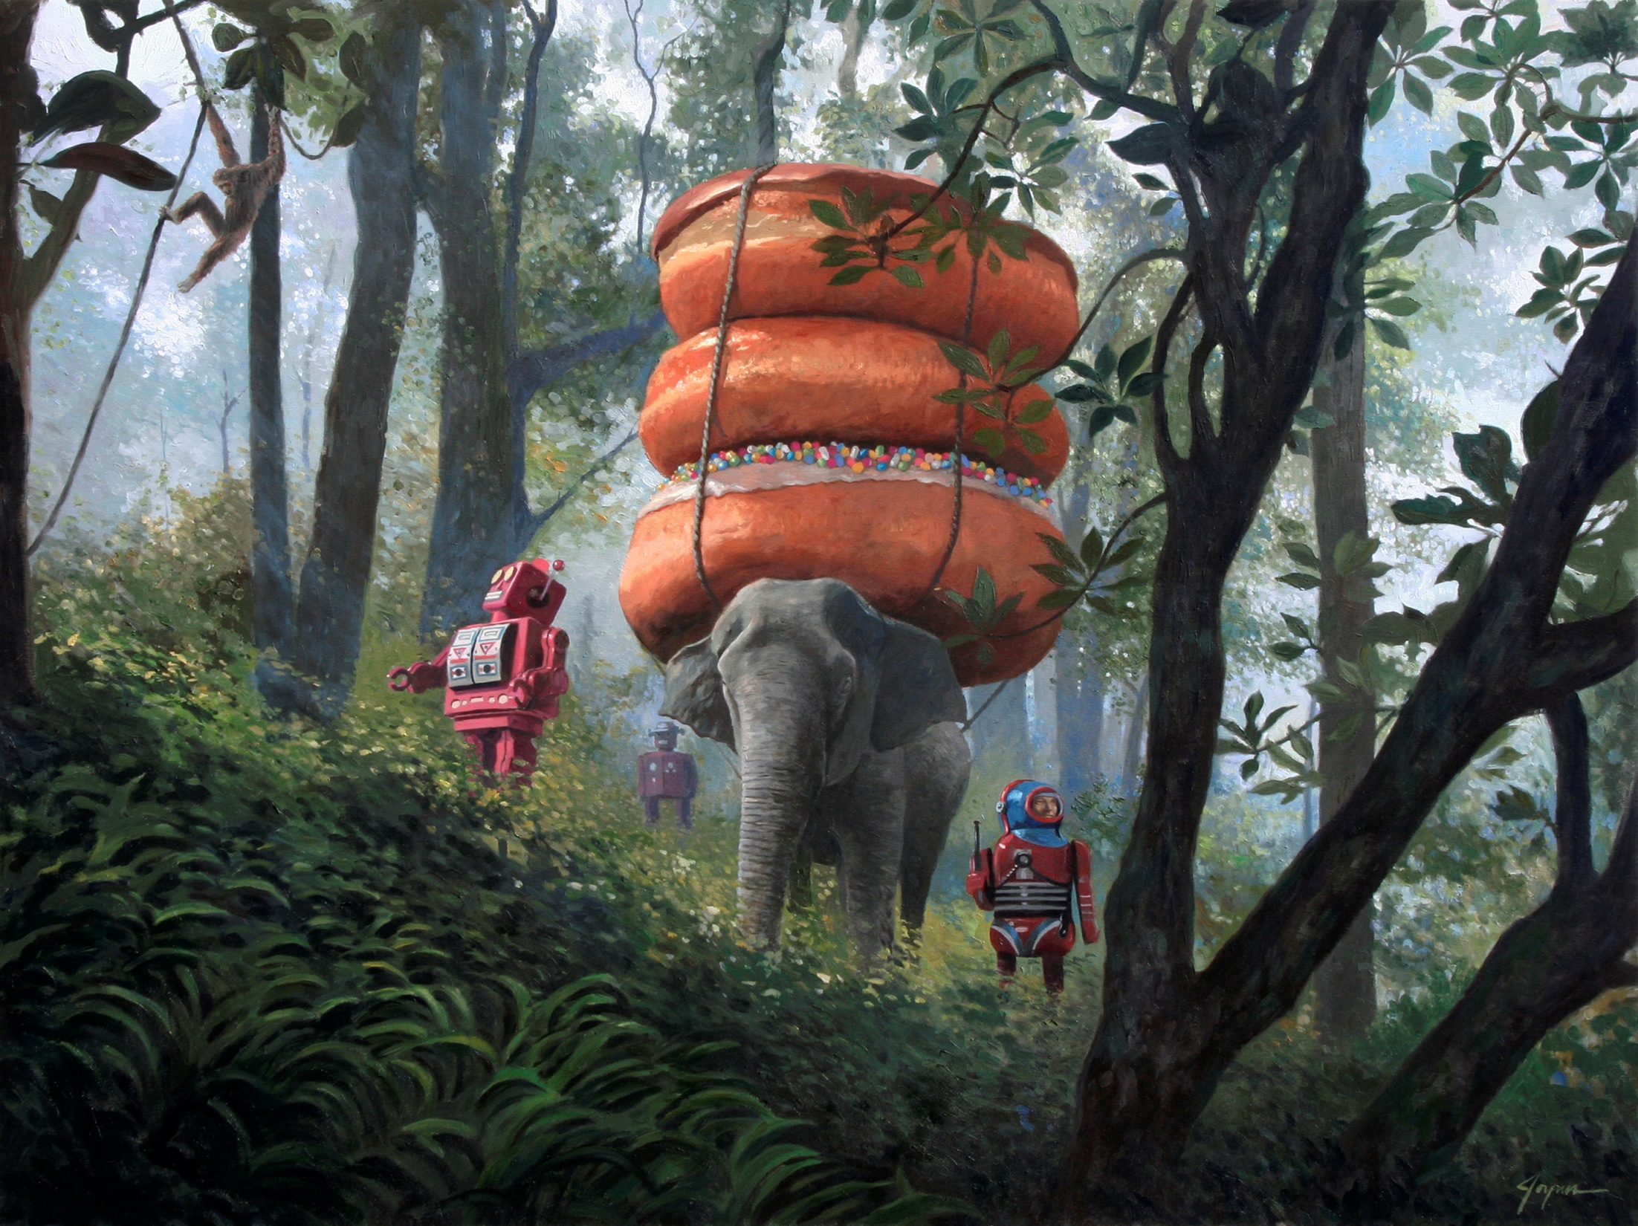

Slide 5
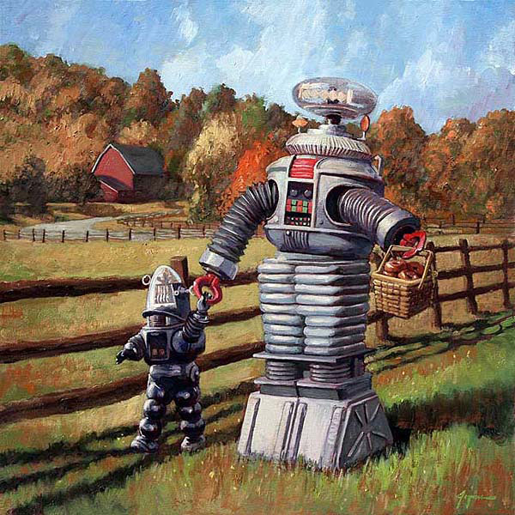

Slide 6
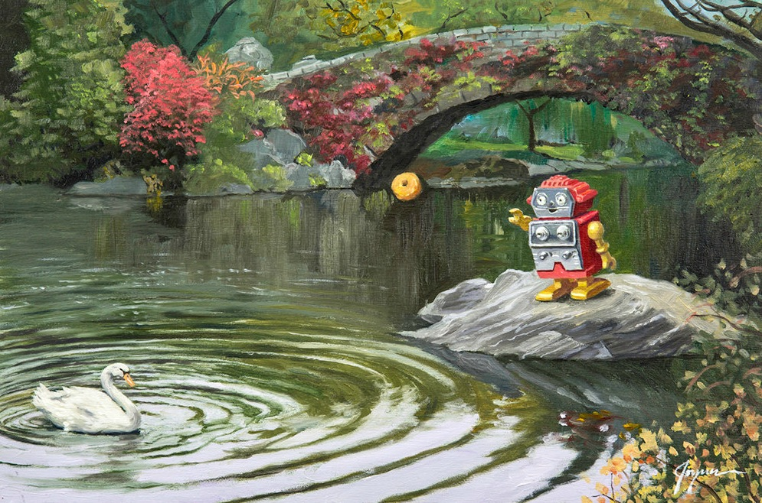

Slide 7
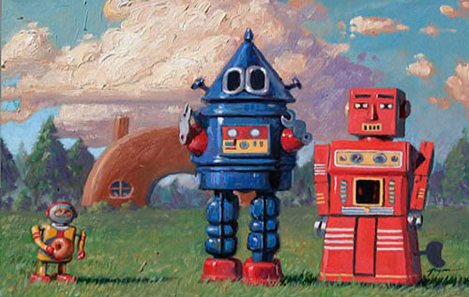

Slide 8
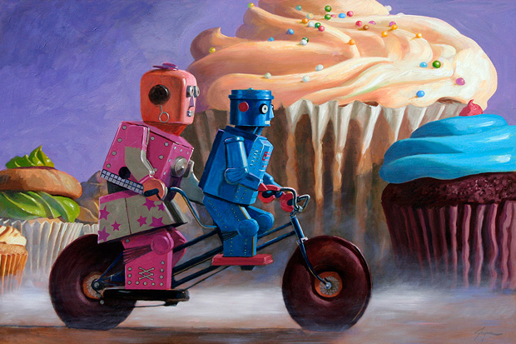

Slide 9
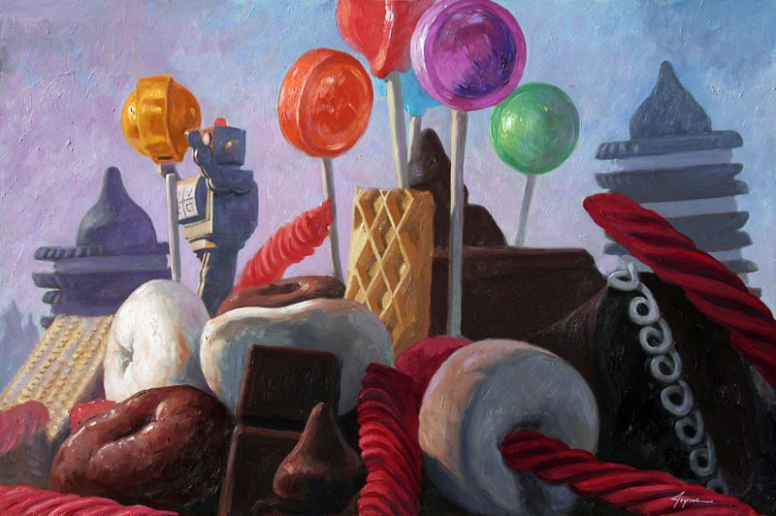

Slide 10
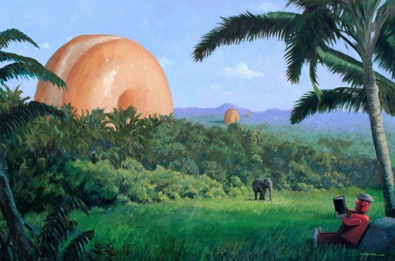

Slide 11
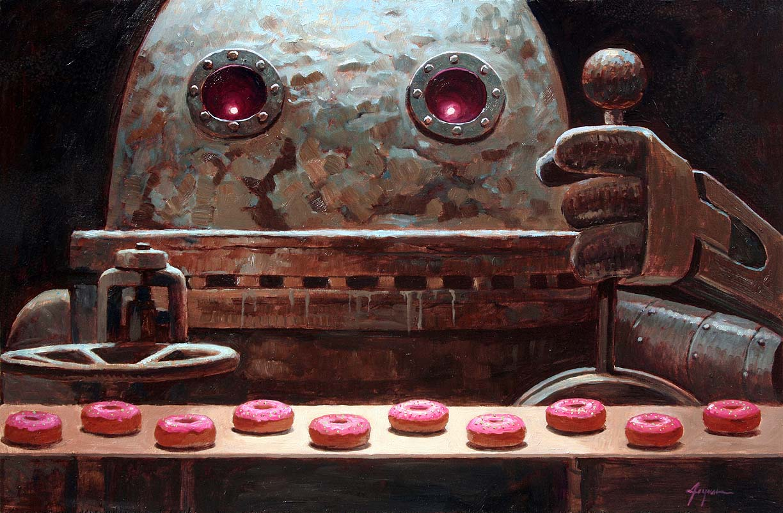

Slide 12
Now look at some of the work Year 6 completed last year to see if they also give you some inspiration.

Slide 13
Here you see the robot fishing and the doughtnut is the bait.

Slide 14
Here you can see the robot floating along the river in a doughnut.

Slide 15
Riding down the hillside on a doughnut.

Slide 16
Horse jumping over doughnut fences.

Slide 17
At the park, swinging on the doughnut swings.

Slide 18
At the beach. I love the doughnut sun as well as the doughnut rubber ring.

Slide 19
At the pool. I like the ‘Don’t Dive’ sign to add detail. Lots of care has been taken with the brickwork too.

Slide 20
Now it’s your turn.
Decide on the setting for your picture and create the line drawing. Next week, we will add the colour to bring it to life.
Remember, don’t press hard when sketching and don’t shade things in with your grey pencils. Just draw the lines – the shape and colour will be the next stage.
Enjoy and don’t get frustrated if it doesn’t work first time. Artists often restart their work many times until they are happy.

